Slide 1
Blunt trauma

Slide 2
Trauma Call
A 29 year old brought into ED by ambulance after motor bike accident, complaining from abdominal pain, looked pale
How would you manage?

Slide 3
Findings
Airway: intact
Breathing RR 22/min, O2 Sats 90 on air
PR 92, weak, BP: 105/50
Cold periphery
Distended abdomen
Tender right upper abdomen
What is your next step?

Slide 4
Progress
After 1.5 L of saline, patients vital signs improves, PR 83 and BP 115/60
CXR # left lower ribs
Neck and pelvis Xray normal
FAST scan free fluid in the peritoneal cavity
What is your provisional diagnosis and what is your next step?

Slide 5
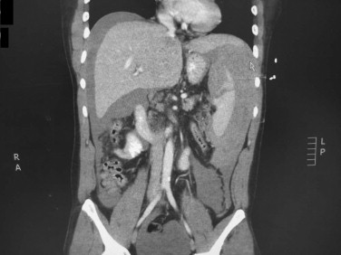
Describe this Image

Slide 6
Question
How would you grade Splenic injuries
What are the most important points in the management of splenic injury?

Slide 7
How do you prepare the patient for Open Splenectomy?
Describe the operation

Slide 8
Trauma
Describe how you close the midline laparotomy wound in trauma cases

Slide 9
Trauma
What are the risk factors for wound dehiscence and incisional hernia?

