Slide 1
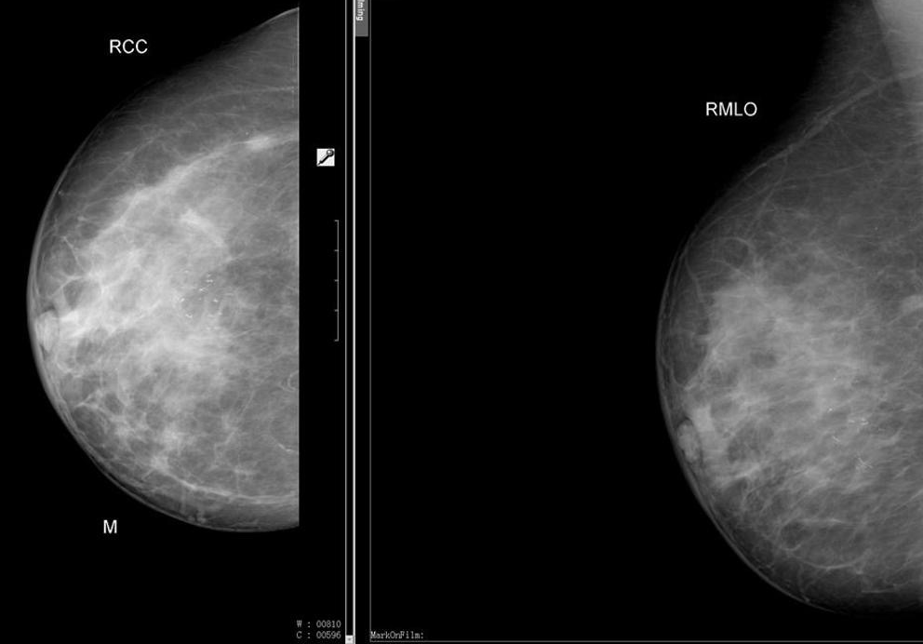
Describe this image.

Slide 2
How do you describe a mammographic lesion?

Slide 3
What are the ultrasound features of benign and malignant breast lesions?

Slide 4
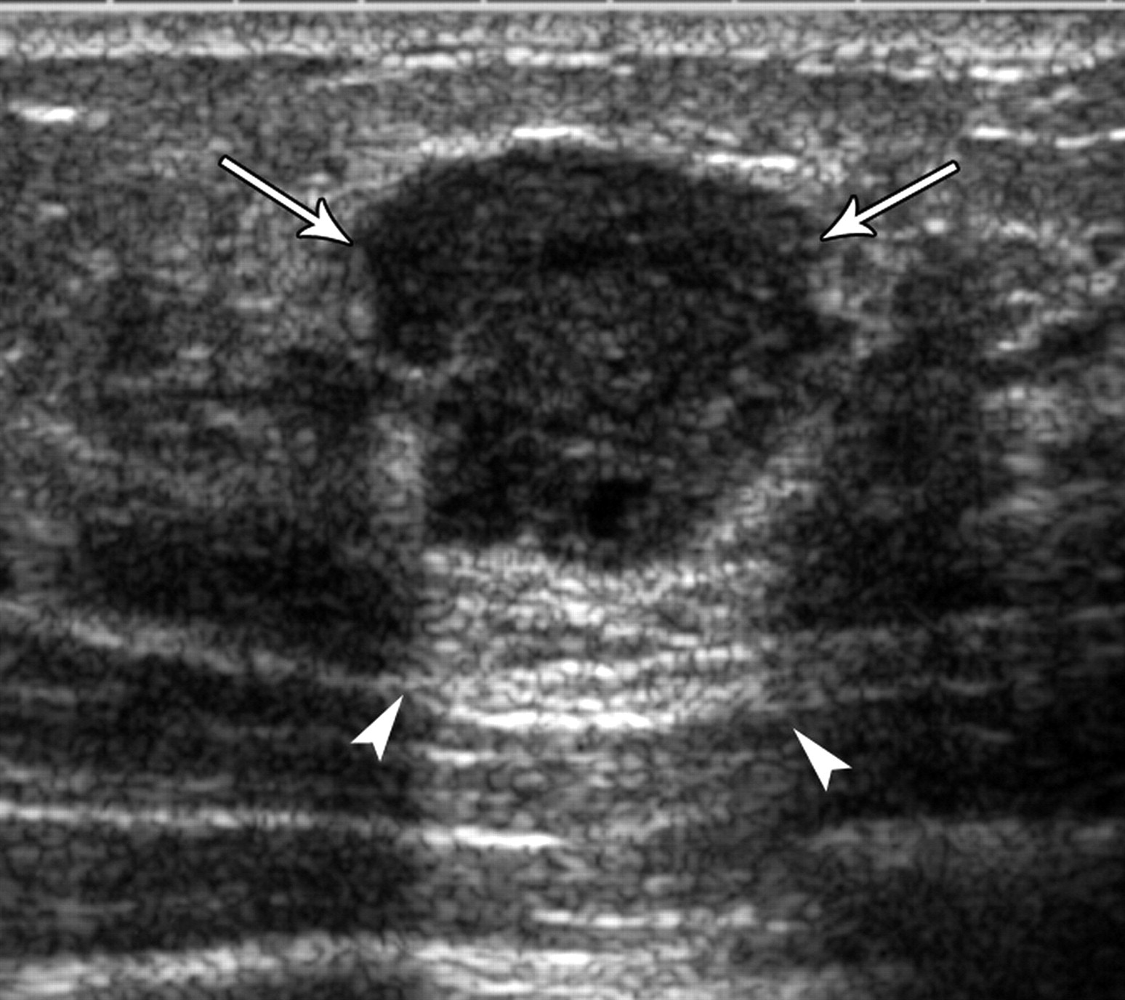
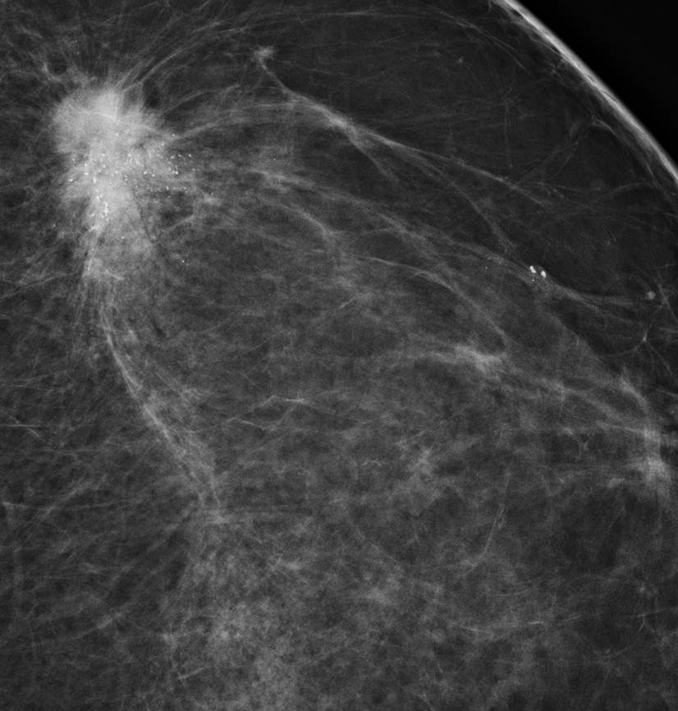
Describe these Images

Slide 5
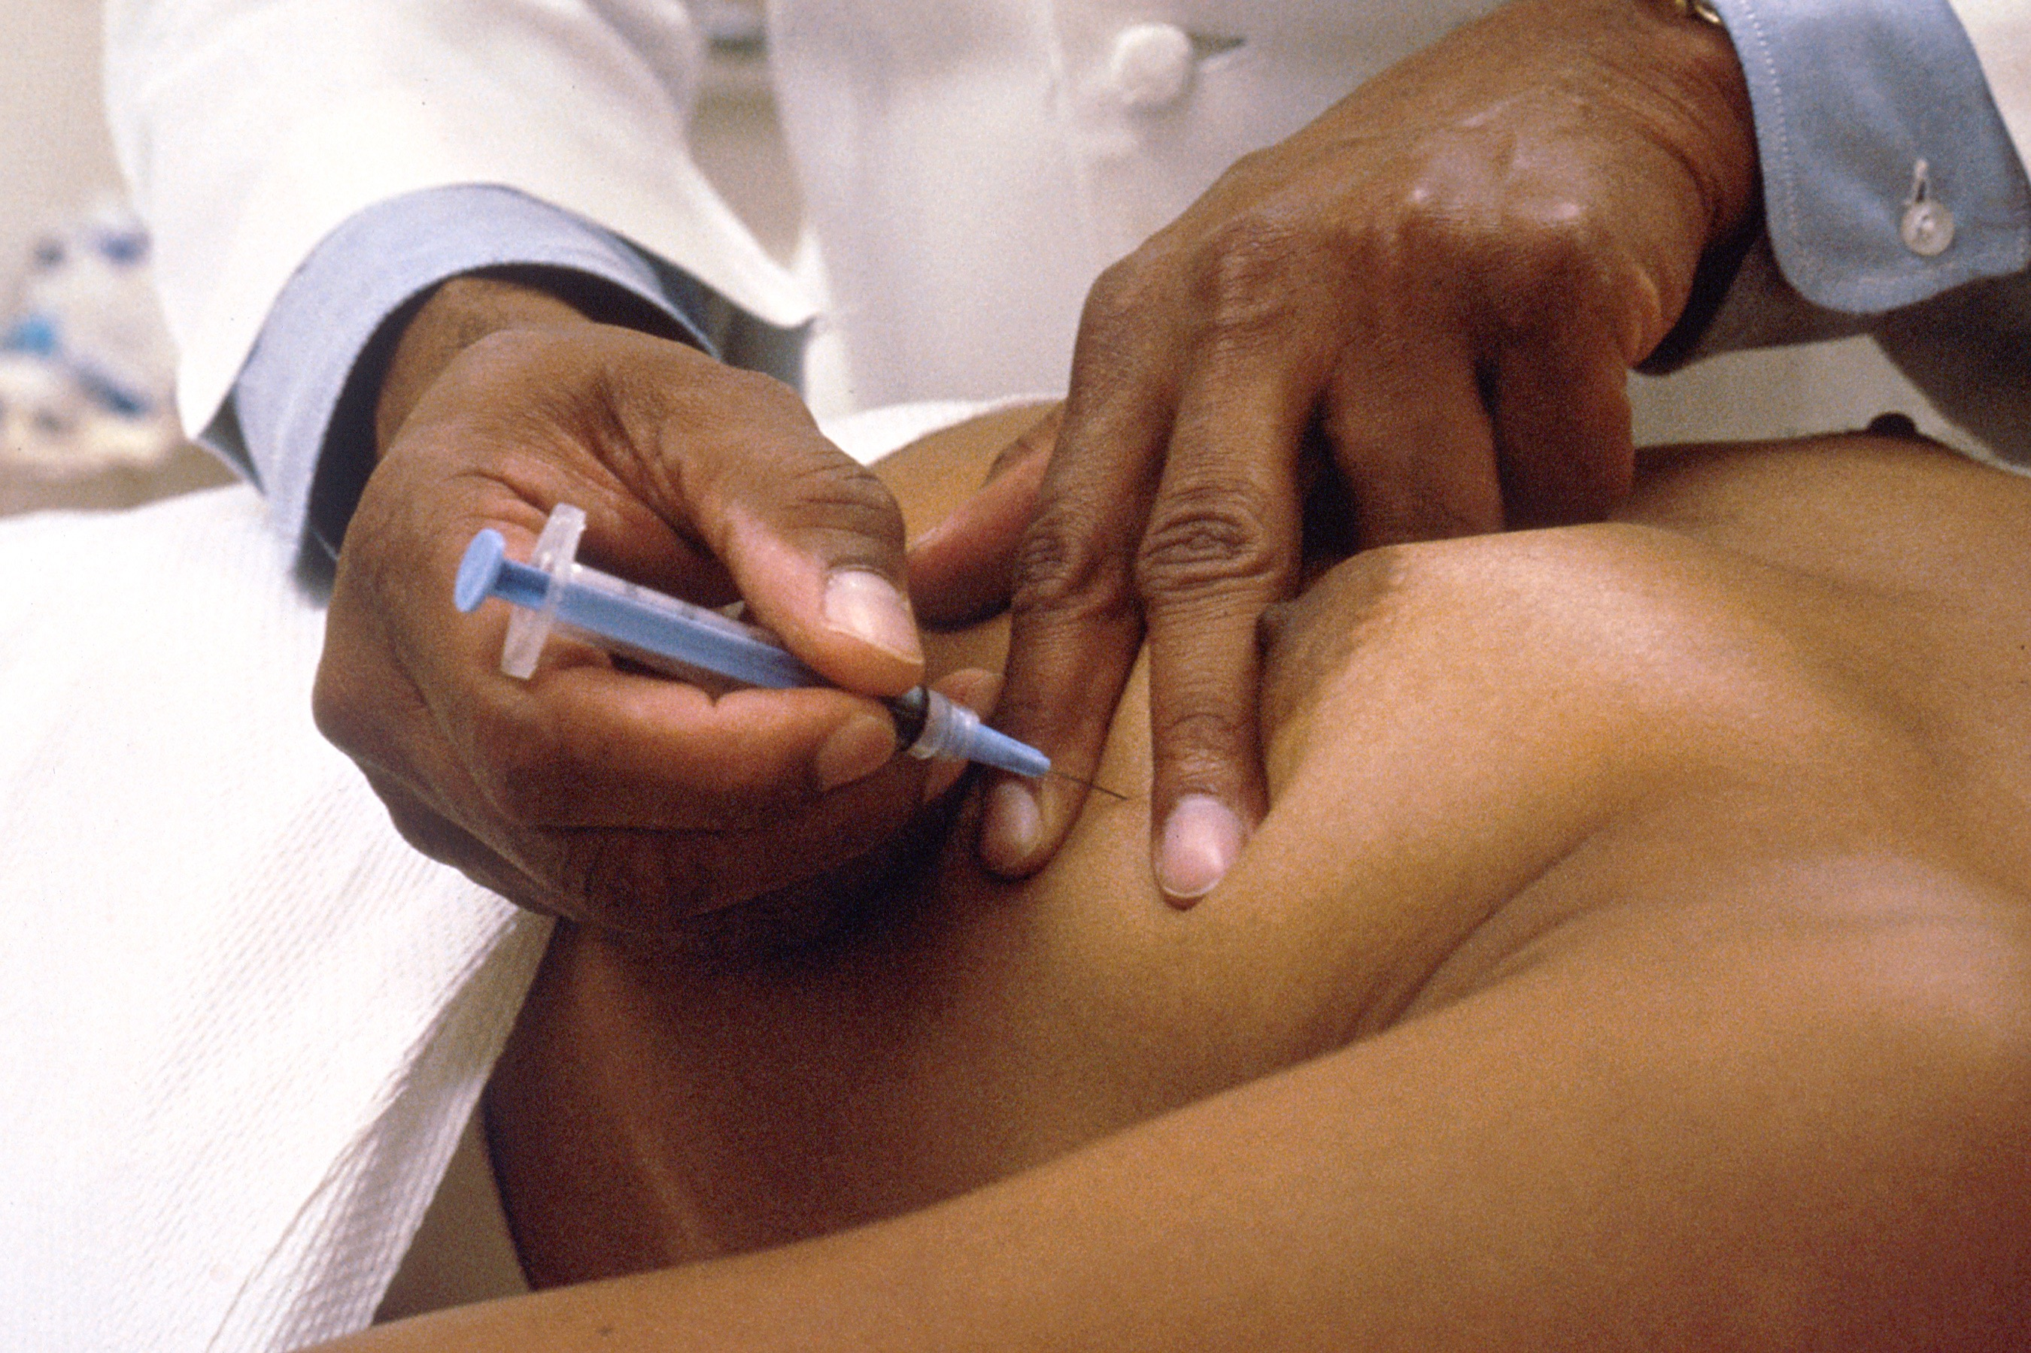
How do you perform an FNA?

Slide 6
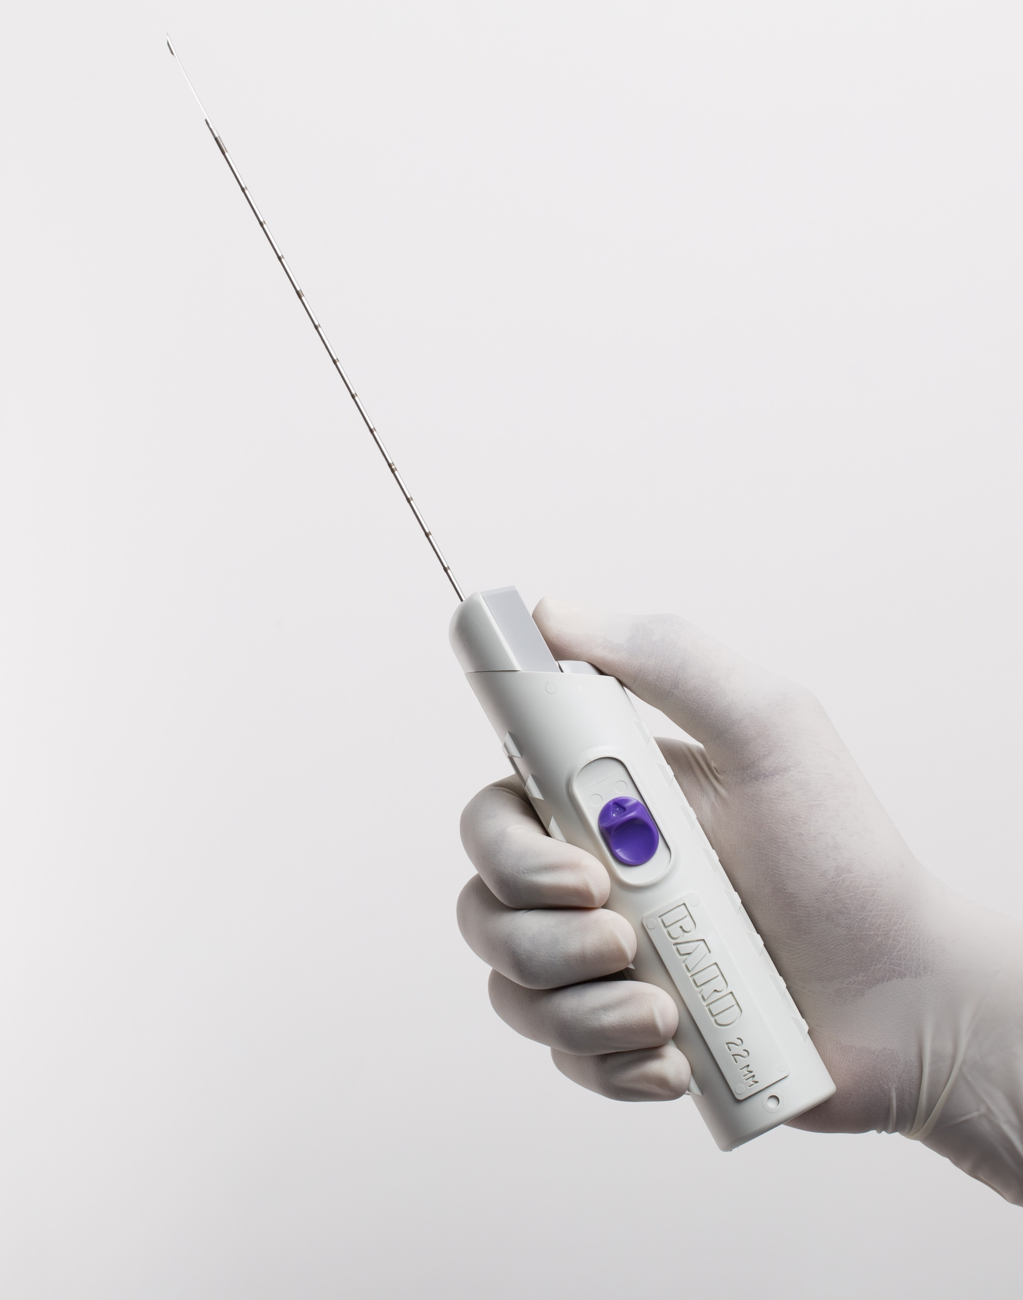
How do you perform a core biopsy?

Slide 7
62 Year Old woman with this lesion in the breast.
What is your approach to treatment?

Slide 8
What are the treatment options for the breast itself?

Slide 9
What are the treatment options for the axilla?

Slide 10
What systemic treatments for breast cancer are you aware of?

Slide 11
What is the role of adjuvant endocrine therapy?

Slide 12
What is the role of adjuvant chemotherapy?

