Slide 1
Neoadjuvant Chemotherapy for Breast Cancer
Philippa Mercer
NZAGS
New Plymouth 2021

Slide 2
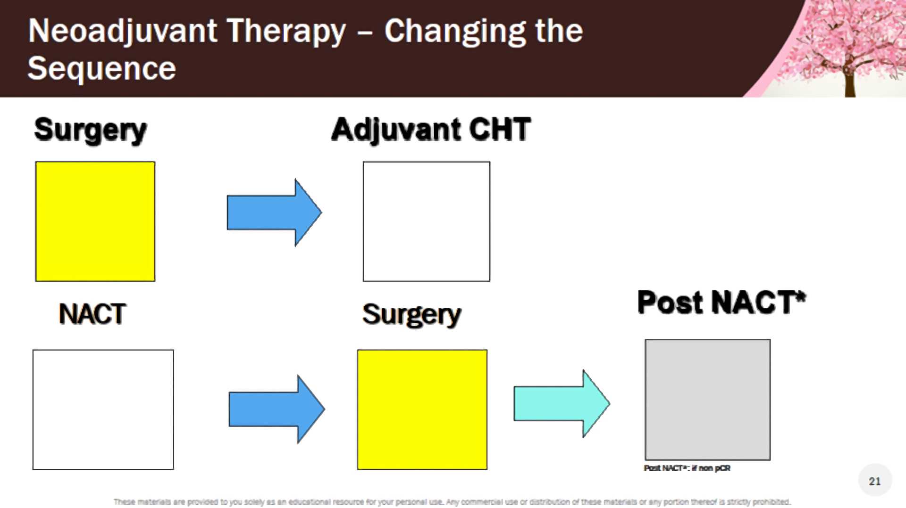

Slide 3
Neoadjuvant Chemotherapy - Rationale
NACT is a safe procedure with improved survival and less recurrence
High pathological complete response rate (pCR) in HER2+ and TNBC
Fast track procedure to evaluate new therapies
Increase the rate of breast conservation
Avoids delay due to surgical complications
Reduce the impact of surgery to the axilla
NACT is at tool of “in-vivo chemo-sensitivity testing”
Option of post neoadjuvant therapy in non pCR

Slide 4
Neoadjuvant Chemotherapy – Which patients?
Large locally advanced/inoperable tumours
Inflammatory breast cancer
Down stage tumours so BC possible
Smaller ca with aggressive features
Allows time for BRCA testing if required
Allows ability to assess response
St Gallen and European Soc. of Med Oncol (ESMO) recommend NACT for stage 2-3 Ca, HER2+ BC regardless of size
Notes:
St Gallen, European Soc. Of Med Oncol (ESMO) recommend NACT for stage 2-3 ca, HER2+ regardless of size

Slide 5
Neoadjuvant Chemotherapy - Limitations
Not indicated if no role for adjuvant chemotherapy – low risk Ca
Risk of delaying surgery
  Rare to get progression on NACT (3% vs >90% response)
Lack pathological data for prognosis
  Have to rely on clinical and radiological staging
Lesser role in certain sub-types
  Low grade ER+ (?Eliminate trial)
  Lobular ca
  Multicentric (>1 quadrant)

Slide 6
Neoadjuvant Chemotherapy: Rate
Australia
3.08% 2011
6.65 % 2016
10.35% HER2+, 9.71% triple negative (2011-2016)
US National Cancer Database 24% 2011
Canada 8.53% 2012-14
Dutch National Audit 14% 2015
What should the figure be? 20%??
(Pattiniott et al, Ann Breast Surg 2019)
CHCH Breast Cancer Registry 14% 2013-18

Slide 7
NACT: The work up
Mammogram
Ultrasound - Core Bx mass + receptors + Her 2
Core distant disease (US or stereo), often after MRI
US axilla – FNA/core abnormal nodes
Clip - breast Ca and increasing clip abnormal node(s)
MRI breast – younger, higher density, extent of Ca/ DCIS?, extent of lymphadenopathy?, check contralateral breast
+/- Staging – FDG PET, or CT/bone scan, routine bloods
MDM

Slide 8
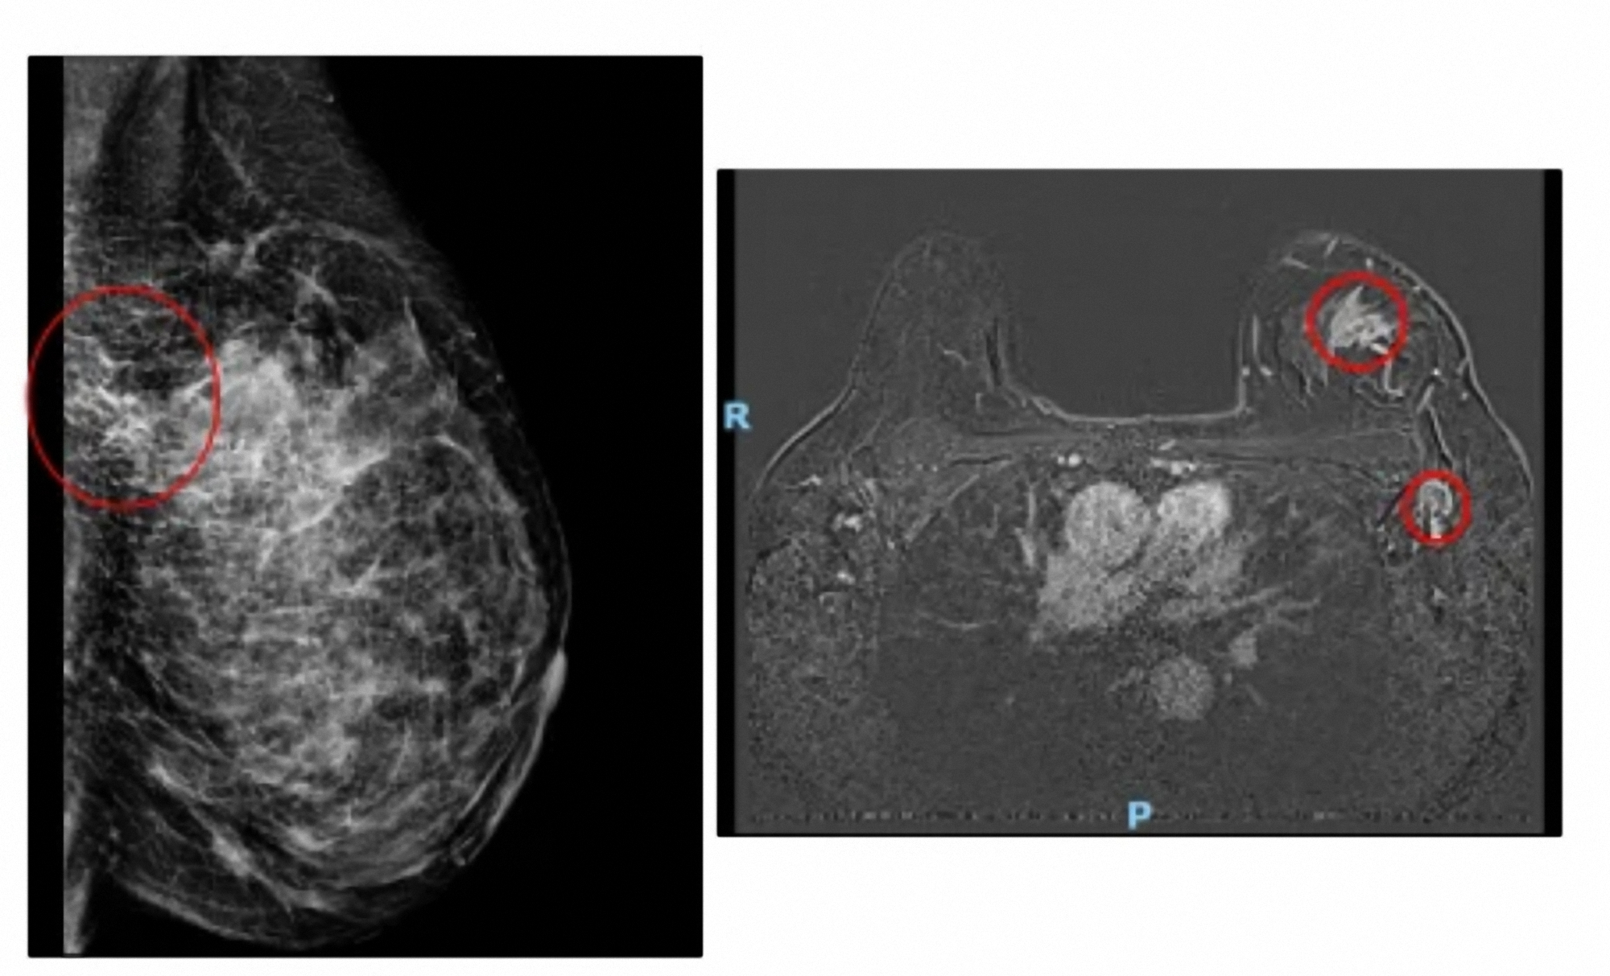
Pre NACT

Slide 9
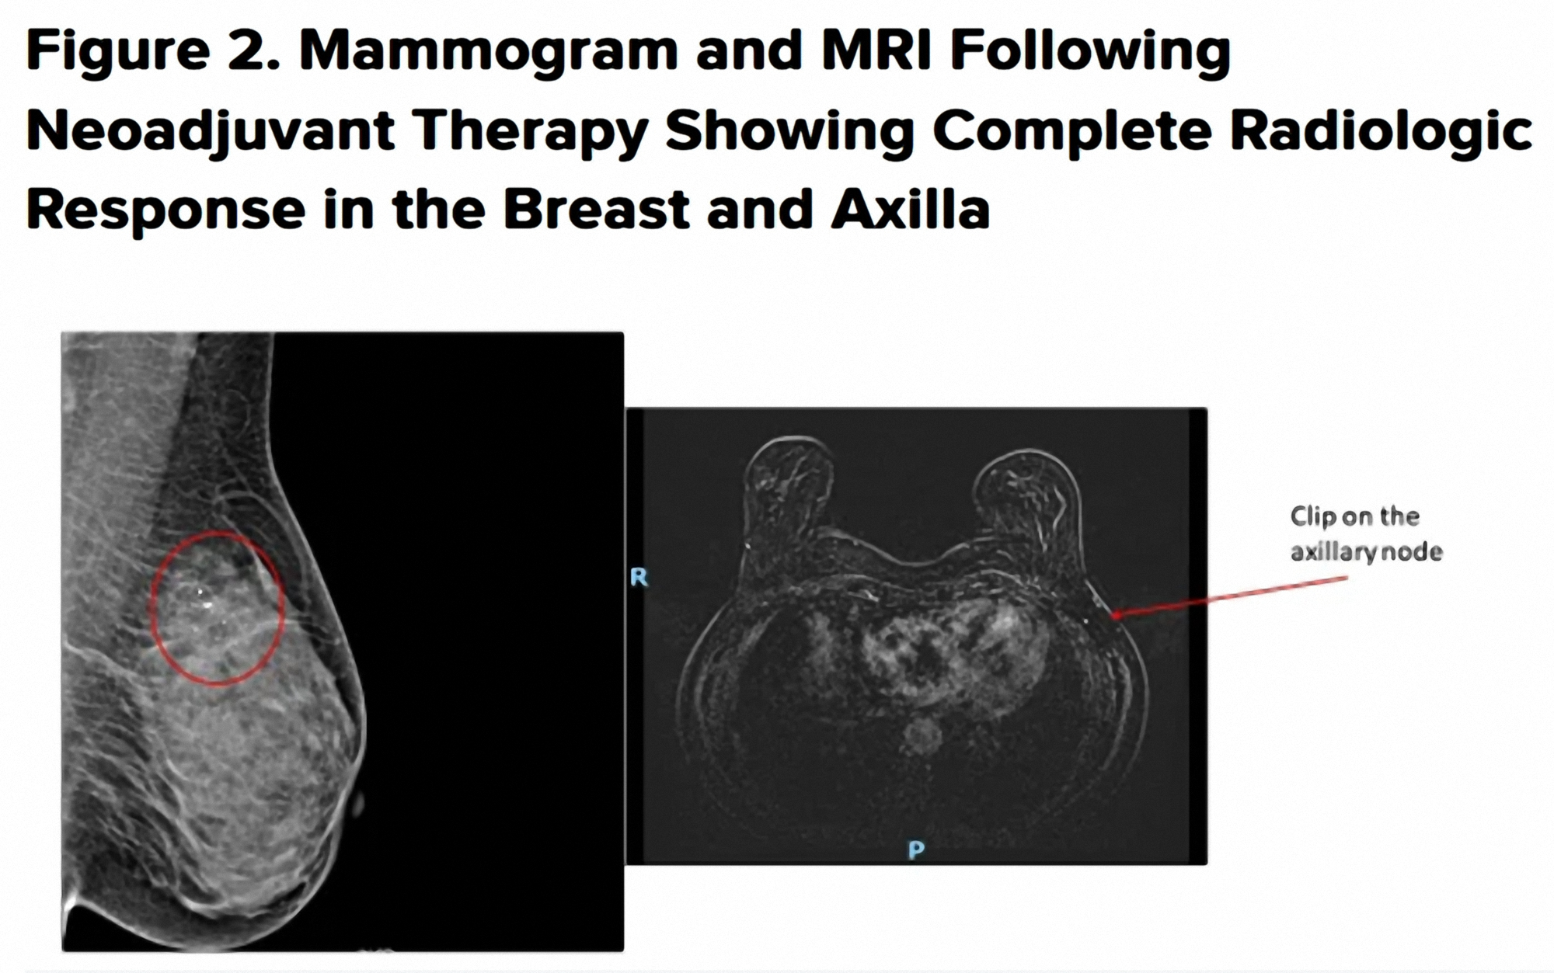

Slide 10
Imaging and Surgical Decisions:
NACT
-Mammography and US – may give all the necessary information initially and to assess response
-MRI – useful especially if dense breast or complex on mammography. Help assess extent
-Repeat imaging at end of NACT looking for evidence of response in the breast and axilla
-Some centres image during NACT to assess response
-MRI - complete response for HER2+ BC – high correlation with pCR
-Final surgical decision based on initial extent and clinical/radiology response – BC v Mastectomy, SNB/AND
-Excise clip/residual disease and residual calcification

Slide 11
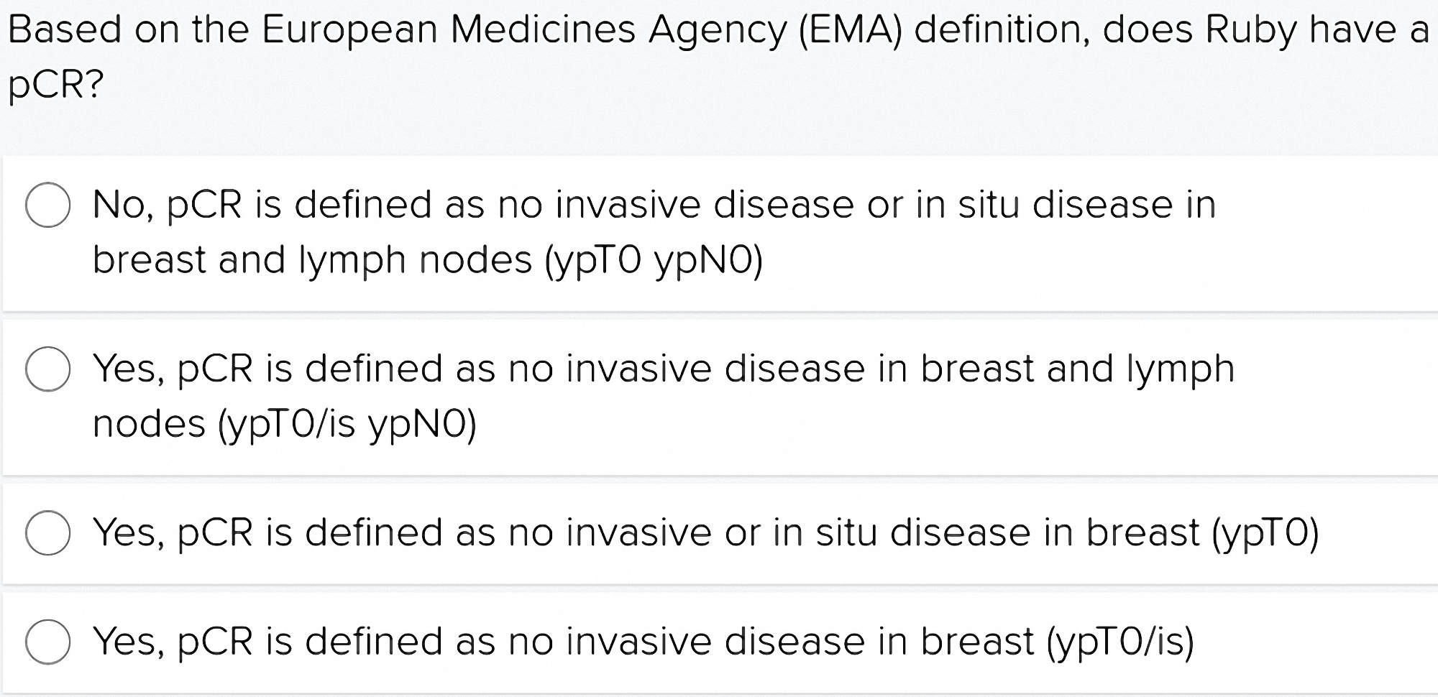

Slide 12
Definition of pCR
Vary between studies
EMA definition
no invasive disease in the breast or nodes (ypT0/isypN0)
appropriate end point of clinical trials of NACT

Slide 13
Adriamycin (Anthracycline), cyclophosphamide --- (AC)
+ Paclitaxel (Taxane)
5-fluorouracil, epirubicin (Anthracycline),cyclophosphamide -- (FEC)
+ Docetaxel (Taxane)
+ Trastuzamab +/- (pertuzumab – not funded in NZ) - 1 year
St Gallen and ESMO recommend dual trastuzumab + pertuzumab if higher risk disease, node +ve, hormone receptor negative. Phase 2 clinical trials show superior efficacy
Examples of Neoadjuvant Regimes:
Stage 2 or 3 or HER2+ Breast Cancer
Notes:
Anthracycline – Adriamycin (doxorubicin), ellence (epirubicin), Doxil (doxorubicin) etc
Taxane- taxol (paclitaxel), Taxotere (docetaxel)

Slide 14
Response Rate
Complete, partial, stable, progression
Path pCR rates in the breast and axilla varies by phenotype
Triple Negative HER2+ HE+HER2-
Breast pCR 47.9% 50.2% 15.5% p<0.0001
Axilla pCR 49.4% 64.7% 21.1% p<0.0001
Boughey J et al, Ann Surg 2014

Slide 15
HER2+
Approx 10-15% of early BC
Adjuvant - anthracycline/taxane based chemotherapy or taxane/platinum with HER2-directed antibody transtuzumab
10yr DFS 73.7% and 37% reduction in death

Slide 16
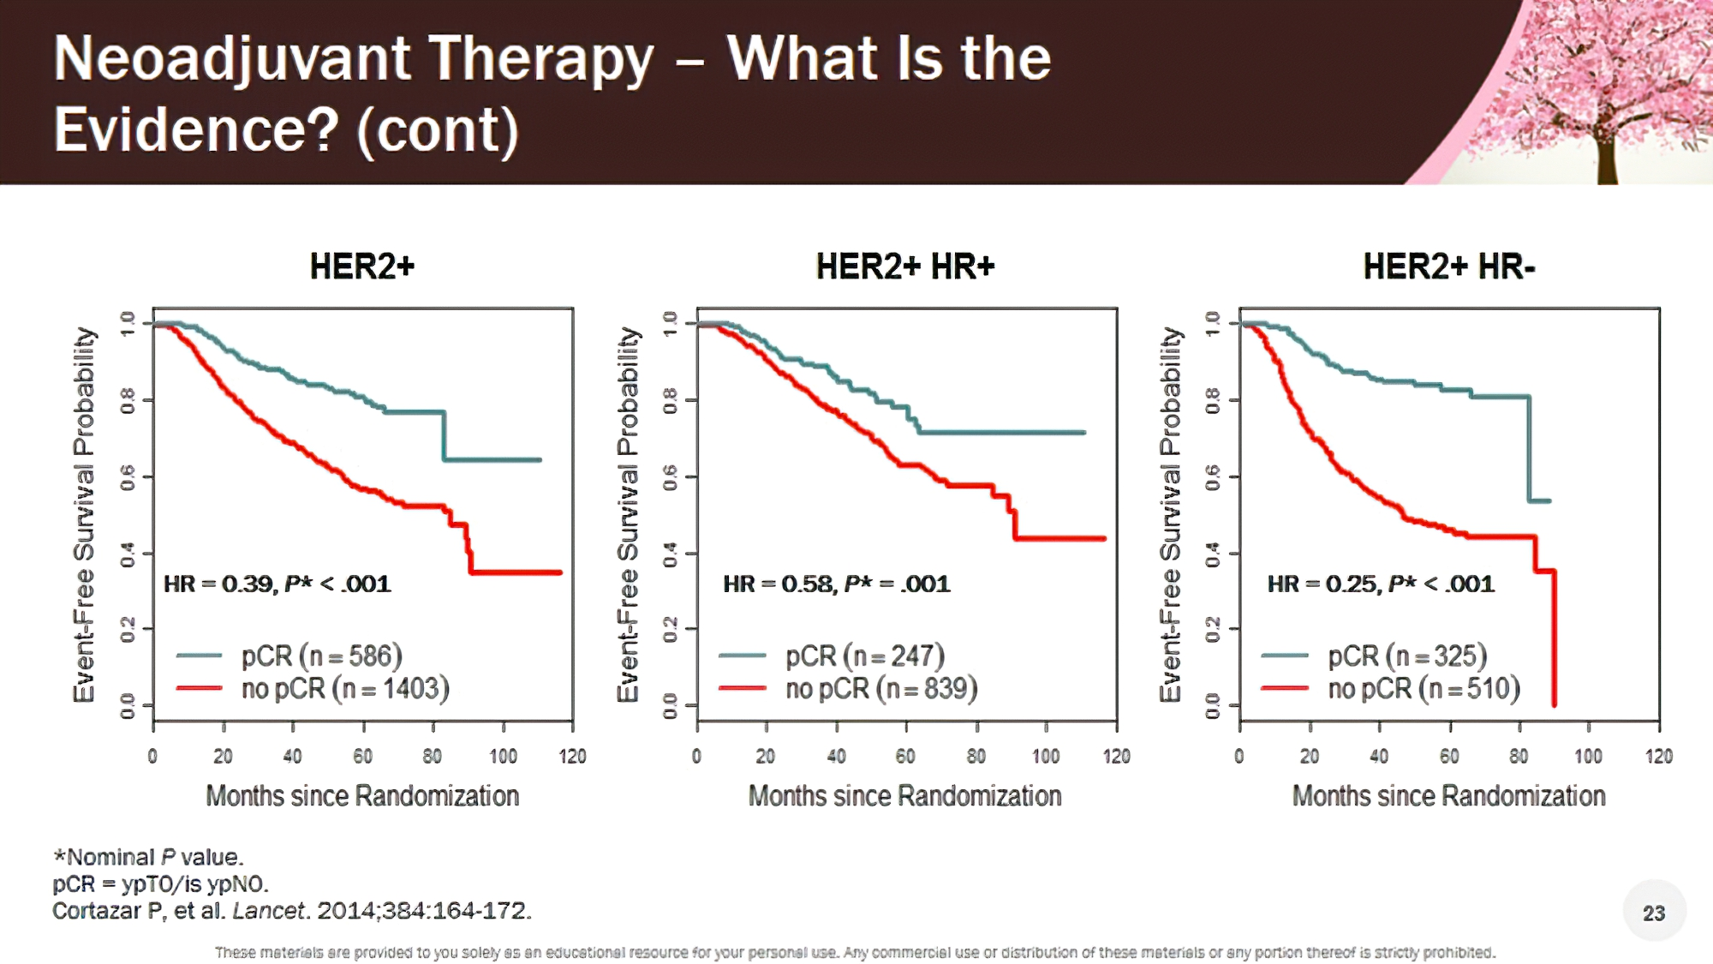

Slide 17
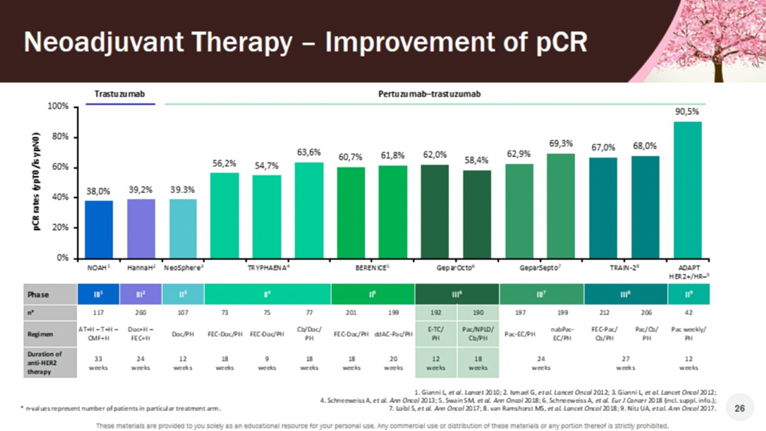

Slide 18
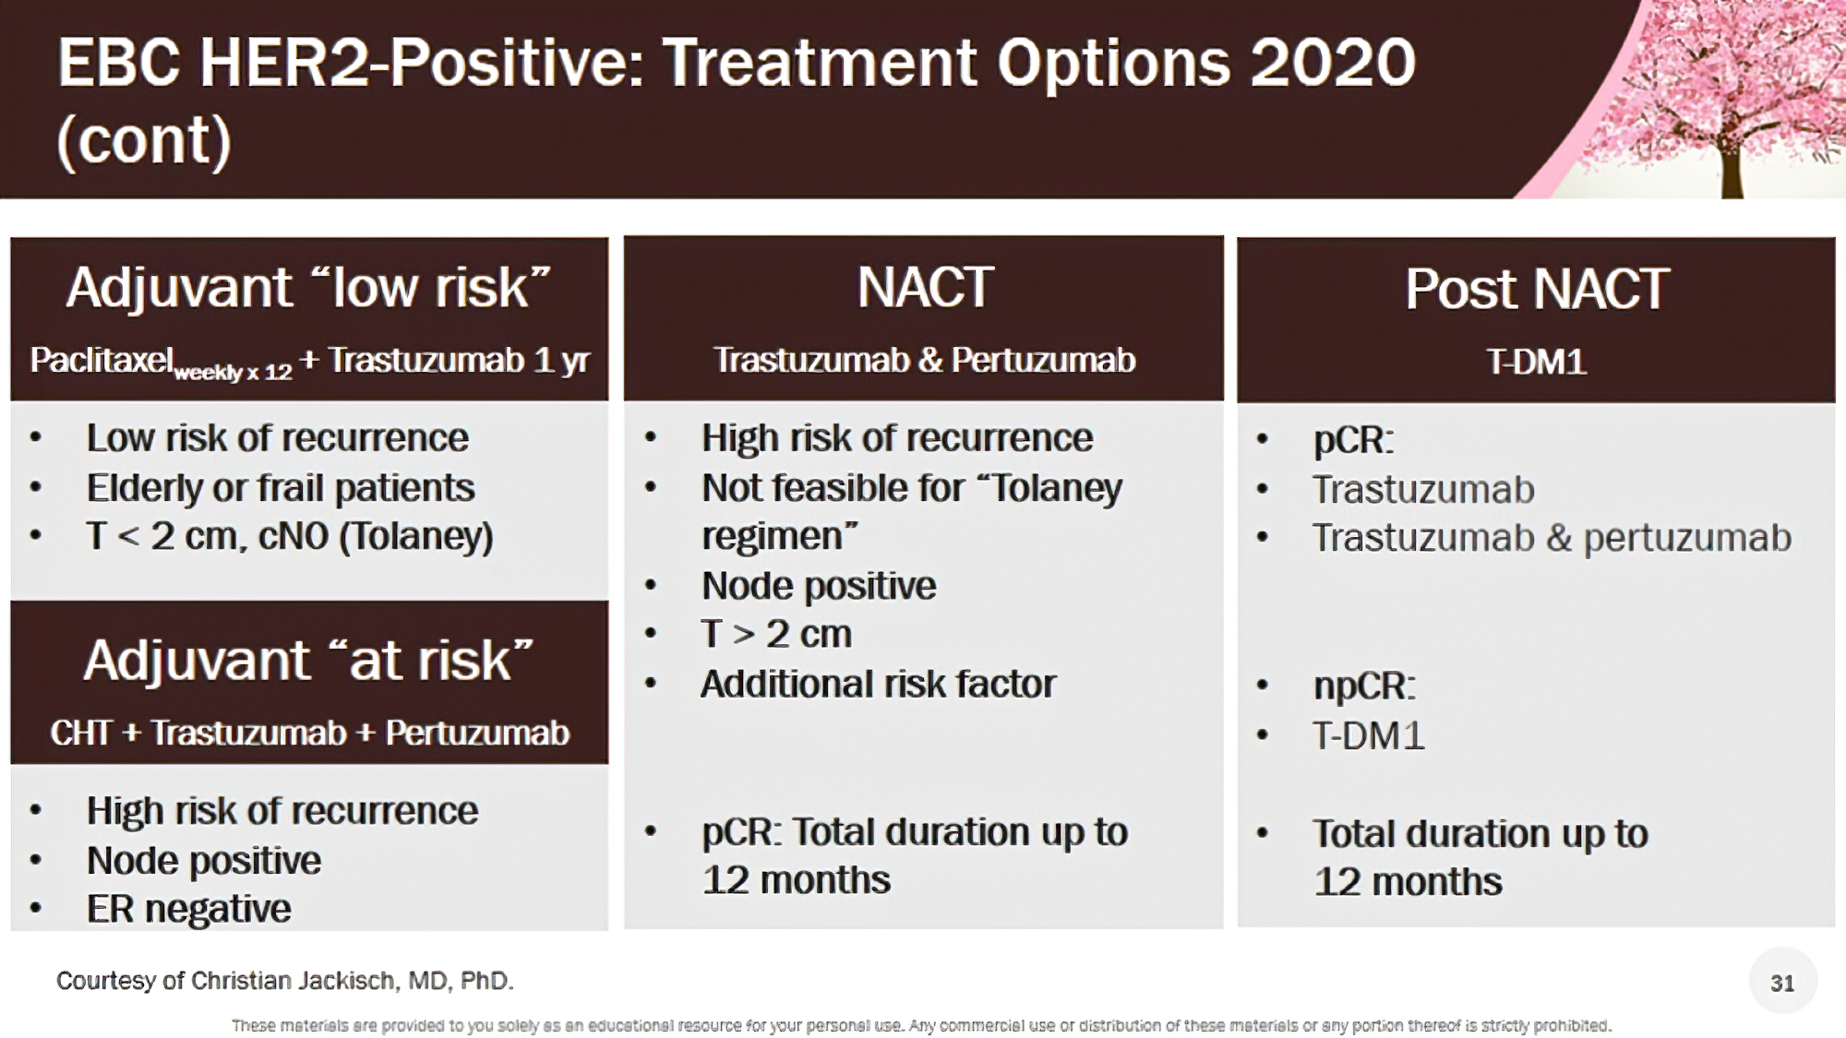
EBC HER2-Positive: Treatment Options 2020 (cont)

Slide 19
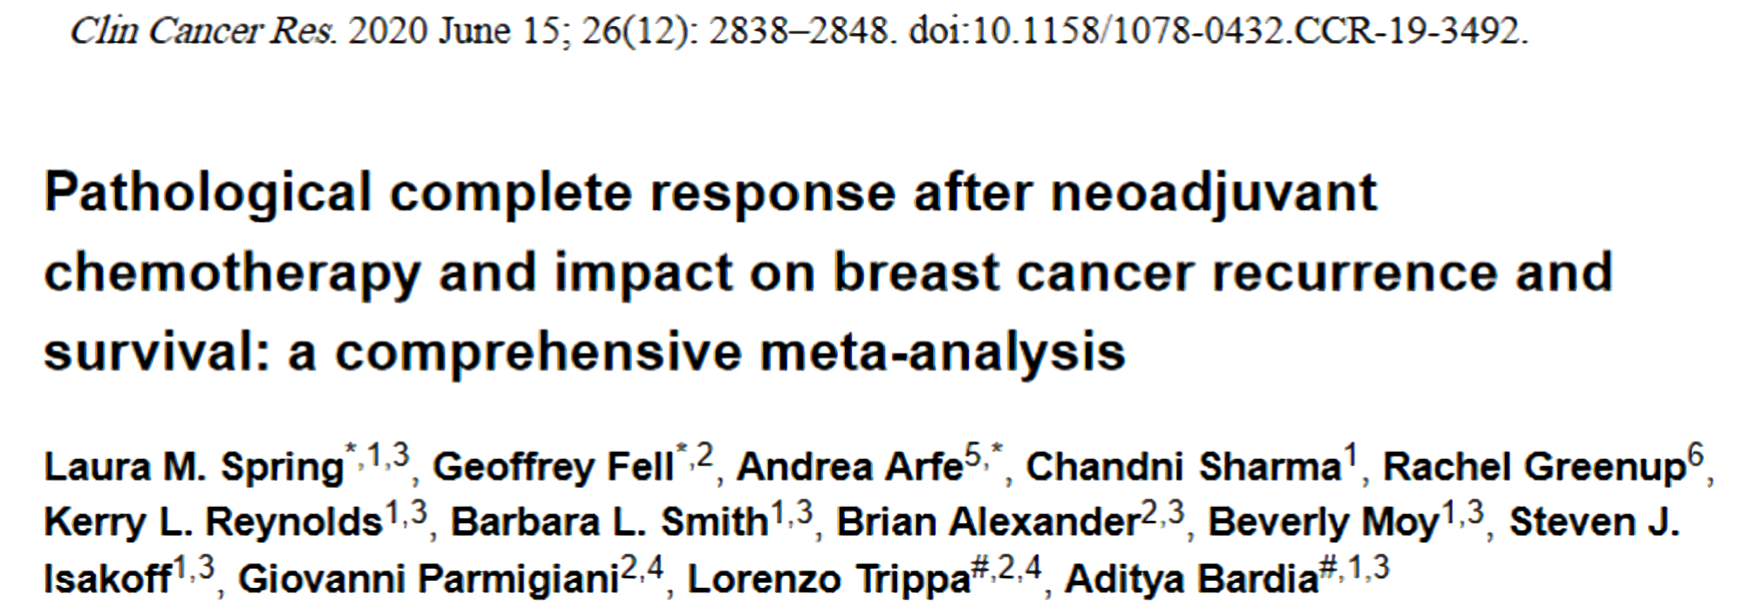
A new meta-analysis addressing many of the concerns of sceptics to neoadjuvant Chemotherapy

Slide 20
Path CR vs Event Free and Overall Survival after NACT: Spring L et al
Patients with pCR vs patients with residual disease had significantly better EFS
HR 0.31 (95% Cl 0.24 – 0.39)
N=26738

Slide 21
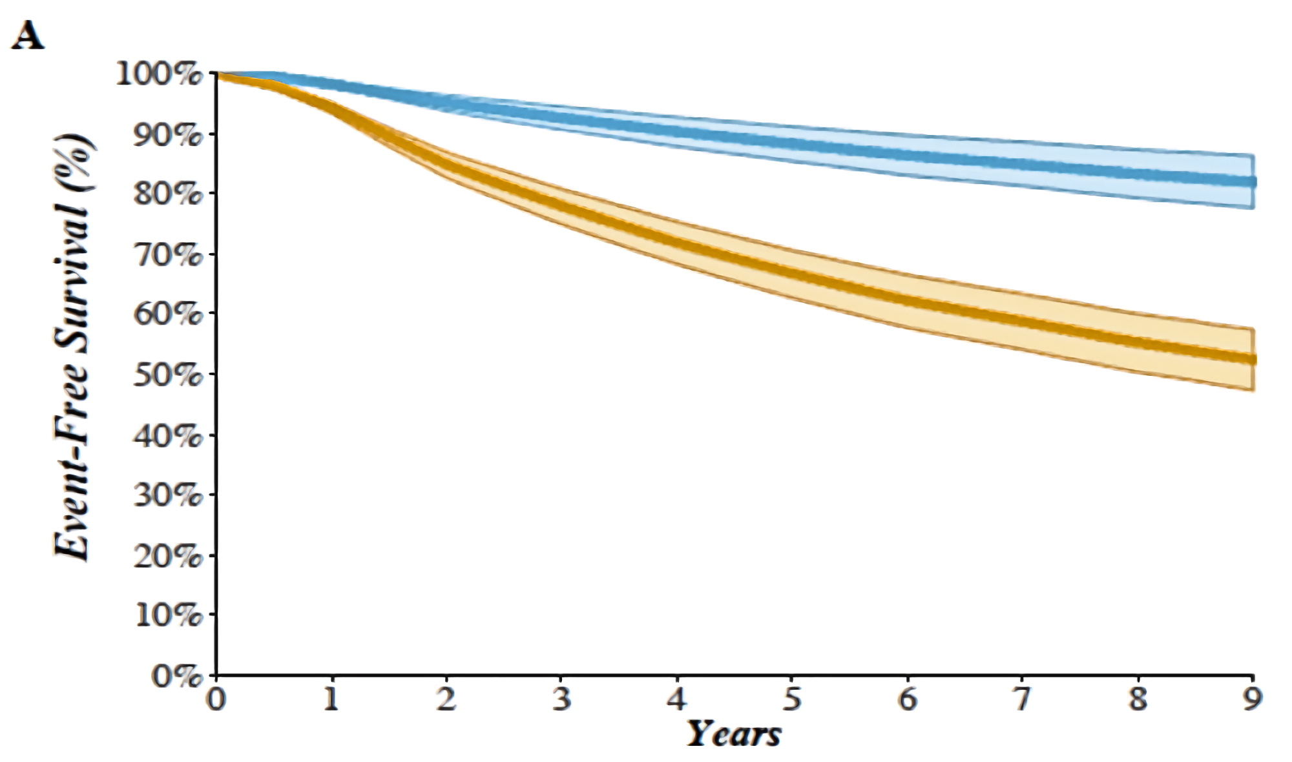
Relationship between pCR and Event free survival: Spring L et al
5yr EFS pCR vs RD:
88% vs 67%
OS:
94% vs 75%

Slide 22
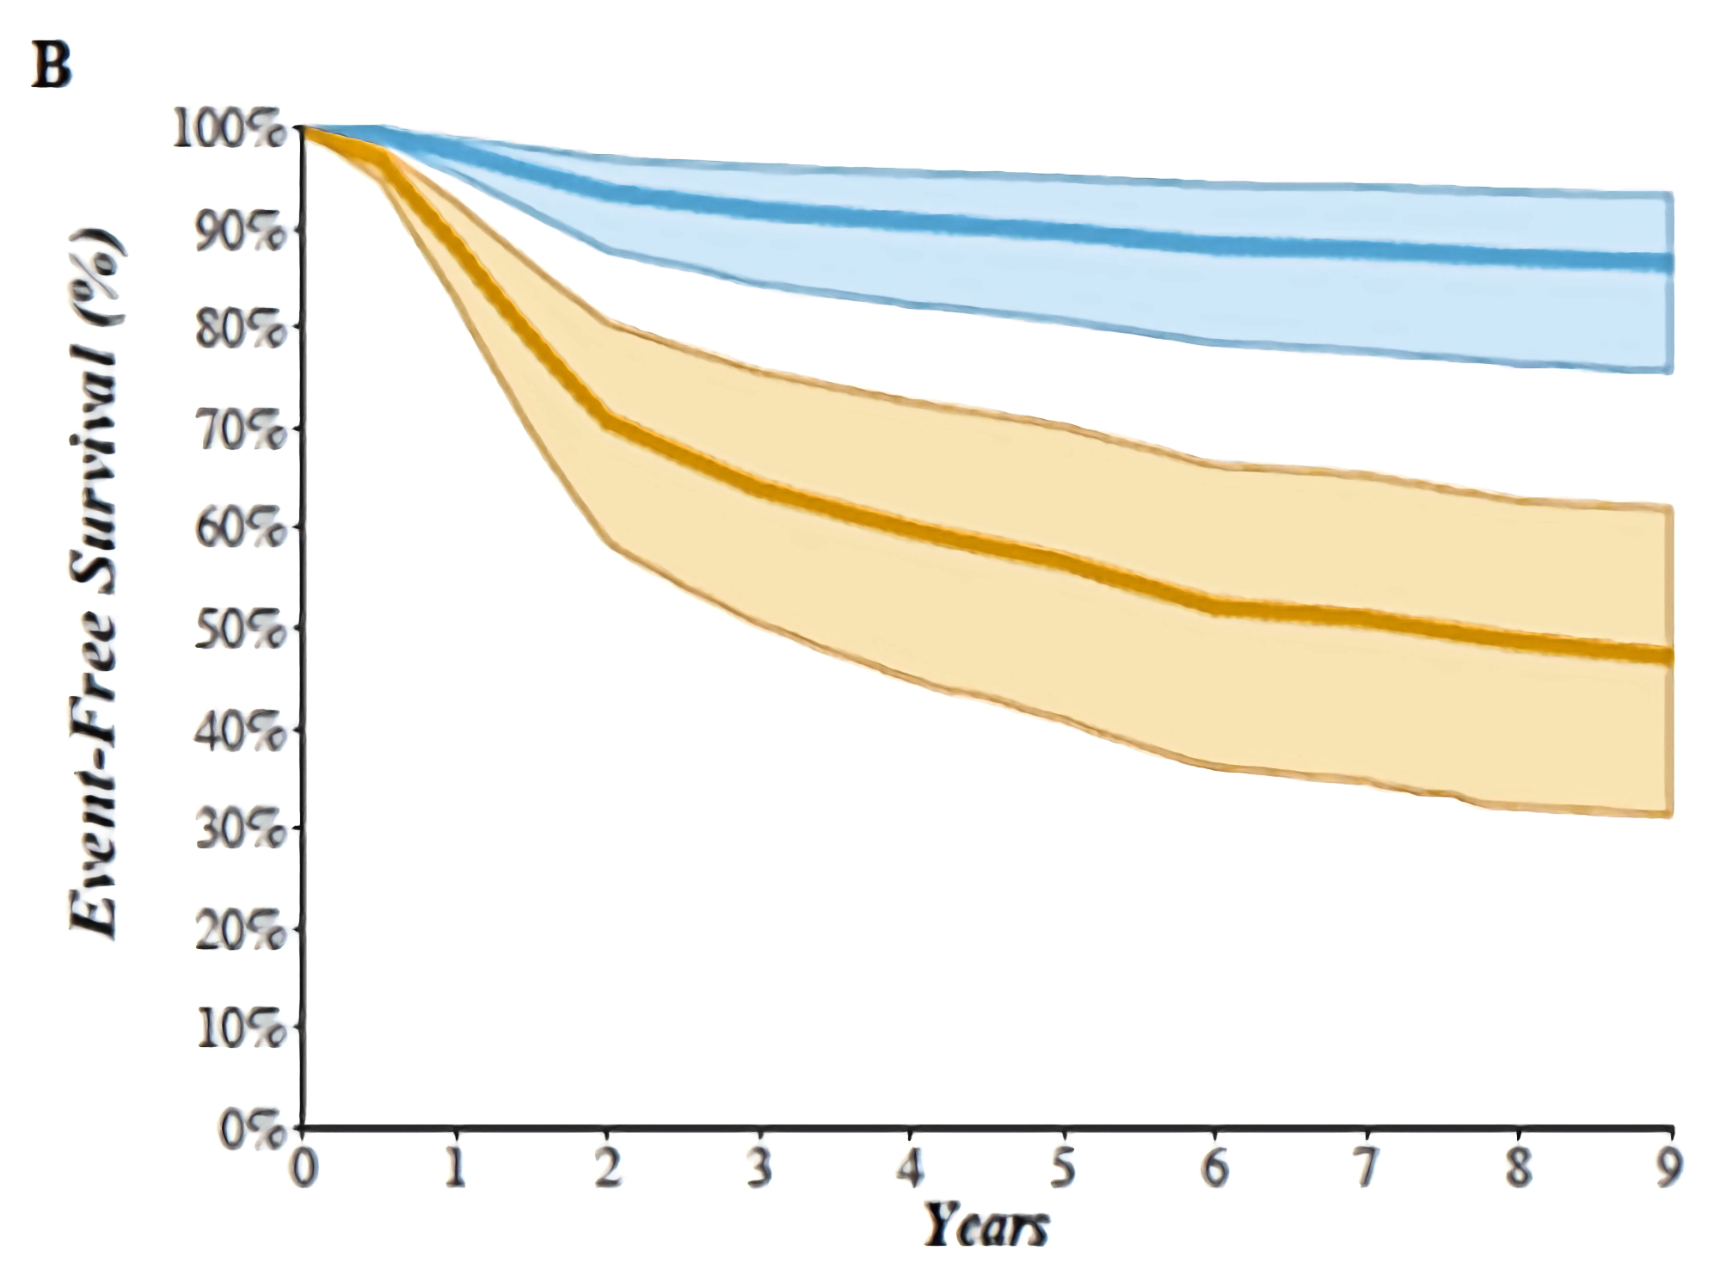
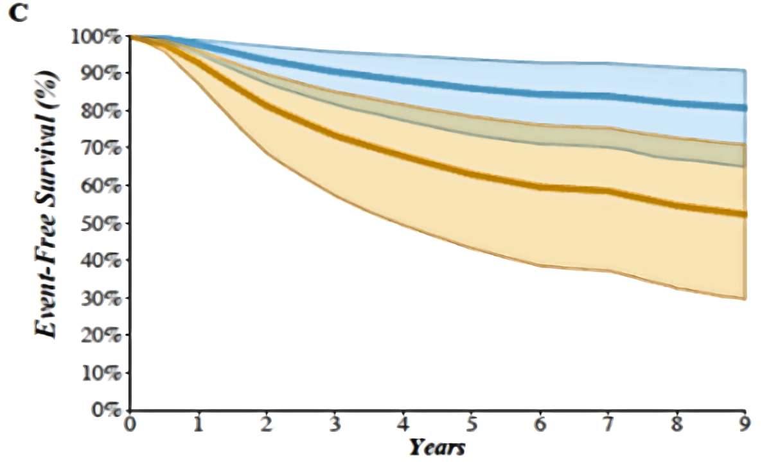
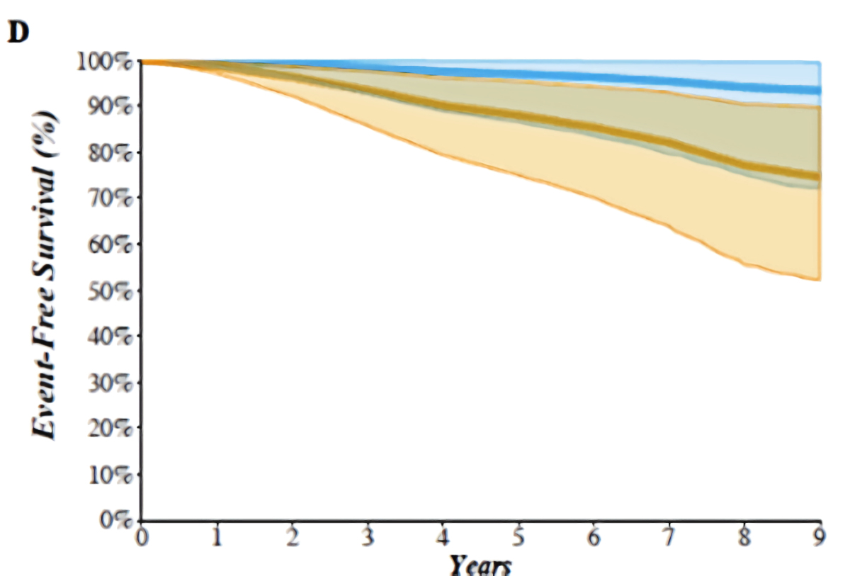
Event Free Survival Path CR vs Residual Disease: Subtypes
Triple negative BC
HER2 positive BC
Hormone Receptor positive BC
5yr EFS pCR vs RD
90% vs 57%
86% vs 63%
97% vs 88%
Similar results seen with OS
Notes:
Figure 3. A-D. Relationship between pCR and EFS overall and among the major breast cancer subtypesKaplan-Meier curves depicting the relationship between pathologic complete response (pCR) and event free survival (EFS) overall (A), in triple negative breast cancer (B), HER2-positive breast cancer (C), and hormone receptor-positive breast cancer (D), based on hazard ratio data from the studies. The blue line represents the pCR group and the orange line represents the residual disease group. The shaded regions represent the 95% pointwise probability interval for their respective colour.

Slide 23
Tumour size
Breast Size
Patient preference
Response/lack of response
Radiotherapy acceptance for BC
Breast Surgery and NACT
Mastectomy vs Breast Conservation

Slide 24
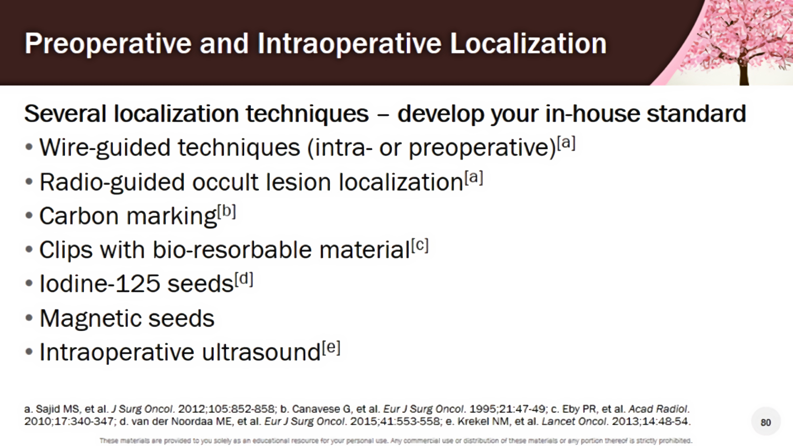
Notes:
Results from the ACOSOG Z1071 trial showed that clip placement prior to neoadjuvant therapy and removal of the clipped node during SLN biopsy reduces the false negative rate after neoadjuvant therapy from 13.4% to 6.8%.^{[22]} The targeted axillary dissection (TAD) technique, which involves removing SLNs and the clipped node via localization with iodine-125 radioactive seeds, achieved a false-negative rate of 1.4%, compared with 10.1% for SLN biopsy alone in patients who received neoadjuvant therapy for node-positive breast cancer.^{[23]} The ILINA trial also reinforced the feasibility and accuracy of ultrasound-guided removal of clipped axillary nodes in conjunction with SLN biopsy, allowing assessment of potential residual disease.^{[24}

Slide 25
The Axilla and NACT: Timing of Axillary Surgery
SNB Pre NACT – not recommended, Sentina Trial FNR 52%
Axilla after NACT
- originally negative axilla =>SNB +/- AND
- originally nodes ++ and even with good MRI /clinical resolution =>AND
- originally only few positive nodes (N1) and resolution on MRI – targeted axillary dissection (TAD) + SNB +/- AND. Or go directly to AND
NOTE
1. If micro or macro metastases in SN =>AND
2. Removal of the clipped node during SLN biopsy reduces the false negative rate (FNR) after neoadjuvant therapy from 13.4% to 6.8%
3. Dual localization and 3-4 nodes to reduce FNR
Notes:
Targeted axilla dissection - clipped node alone FNR 4.2%, clipped node + SN FNR = 1.4%, clipped node not the SN in 23%

Slide 26
When to give additional chemotherapy?
NACT – only way to identify patients who need additional chemotherapy
pCR – nil further chemotherapy except complete Herceptin
Residual disease (HER2 positive or negative) - 20-30% chance of relapse
HER2 negative – Capecitabine – oral prodrug of fluorouracil
HER2 positive – T-DM1 (in NZ funded for advanced BC and not as adjuvant Rx)

Slide 27
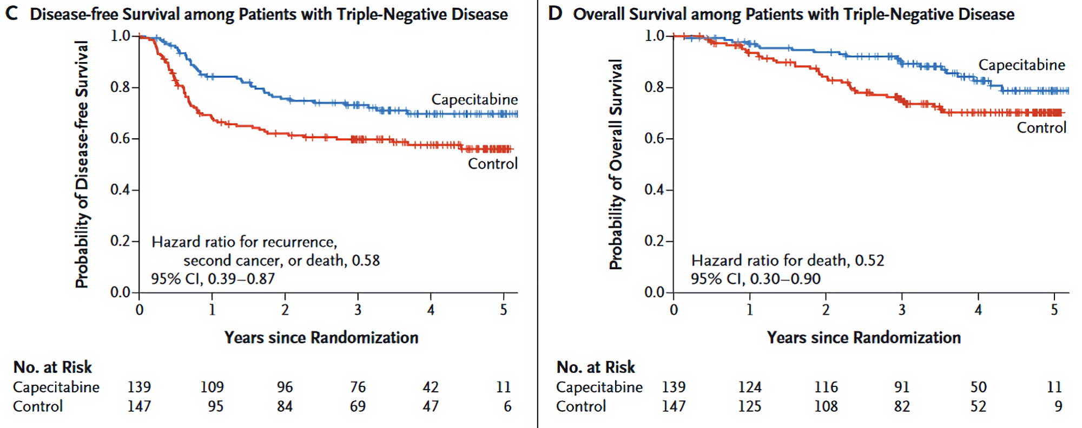
Study of Post NACT in Her2 Negative (Triple Negative) Patients without pCR
Capecitabine vs Control (CREATE-X trial):455 patients in each arm of study at initial randomization. Masuda N Engl J Med 2017; 376: 2147-59

Slide 28
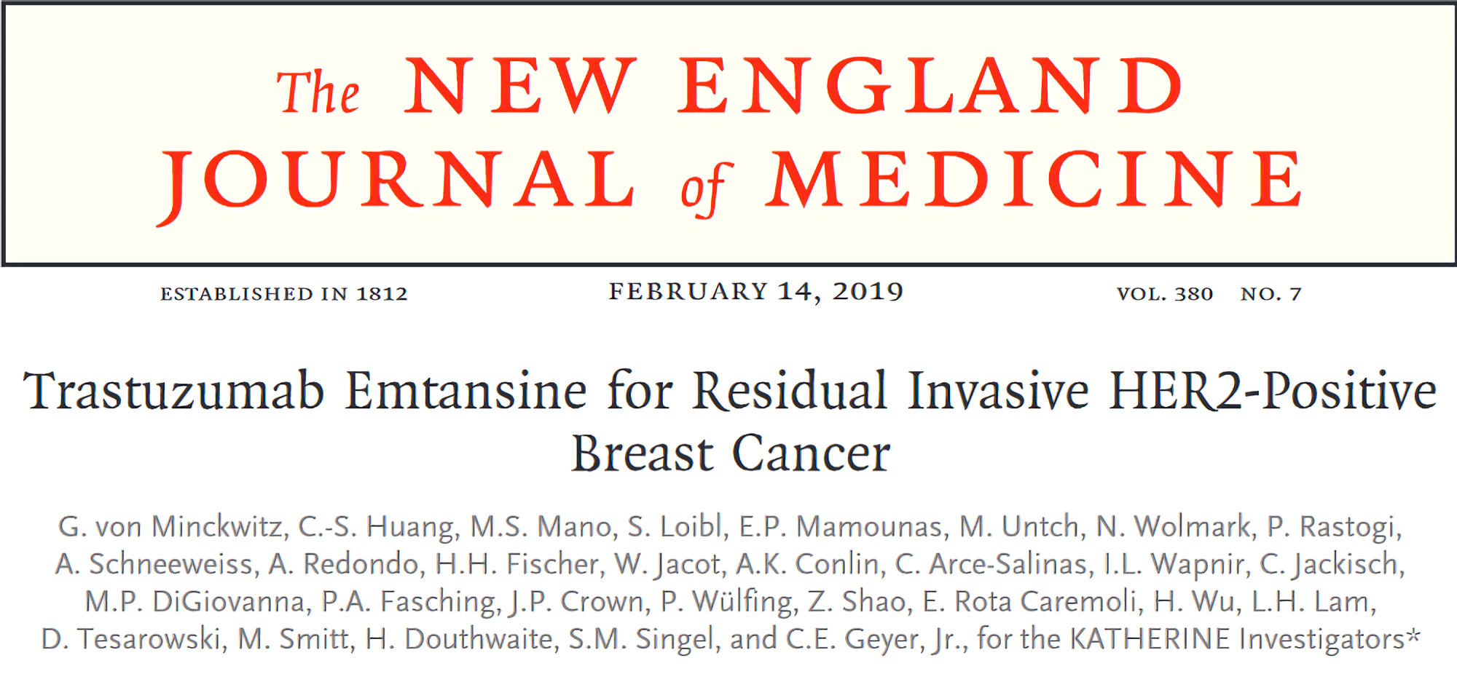
Notes:
Trastuzumab emtansine (T-DM1) is an antibody-drug conjugate currently approved for patients with early-stage and metastatic HER2-positive breast cancer.^{[45]} This agent combines trastuzumab with the microtubule inhibitor DM1 via a stable, non-cleavable linker, allowing targeted delivery of the cytotoxic agent to HER2-positive tumor cells. The phase 3 KATHERINE trial compared 14 cycles of adjuvant T-DM1 with 14 cycles of trastuzumab in patients with HER2-positive early breast cancer who had residual invasive disease following neoadjuvant trastuzumab-based therapy.^{[46]} T-DM1 reduced the risk of invasive disease by 50%, increasing invasive disease-free survival at 3 years from 77.0% to 88.3% (HR 0.50; P < .001) (Table 5). The rate of distant recurrence as the first invasive event was reduced from 15.9% with adjuvant trastuzumab to 10.5% with T-DM1.

Slide 29
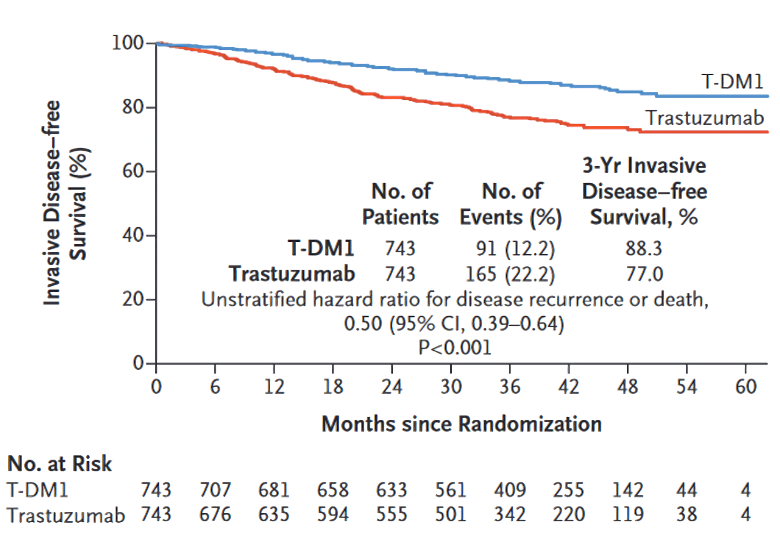
Katherine study: Trastuzumab Emtansine for Residual Invasive HER-2 Positive Breast Cancer
A subgroup with residual disease can benefit from TDM1
Notes:
Trastuzumab emtansine (T-DM1) is an antibody-drug conjugate currently approved for patients with early-stage and metastatic HER2-positive breast cancer.^{[45]} This agent combines trastuzumab with the microtubule inhibitor DM1 via a stable, non-cleavable linker, allowing targeted delivery of the cytotoxic agent to HER2-positive tumor cells. The phase 3 KATHERINE trial compared 14 cycles of adjuvant T-DM1 with 14 cycles of trastuzumab in patients with HER2-positive early breast cancer who had residual invasive disease following neoadjuvant trastuzumab-based therapy.^{[46]} T-DM1 reduced the risk of invasive disease by 50%, increasing invasive disease-free survival at 3 years from 77.0% to 88.3% (HR 0.50; P < .001) (Table 5). The rate of distant recurrence as the first invasive event was reduced from 15.9% with adjuvant trastuzumab to 10.5% with T-DM1.

Slide 30
Katherine Study Design and Conclusions
Initial Her2+ BC Rx Chemo, Trastuzumab +/- Pertuzumab
Subgroup with residual disease in breast or axilla
Randomized to T-DM1 (Trastuzumab emtansine = Kadcyla) v Trastuzumab after surgery
50% reduction of breast cancer recurrence at 3 years
Increase of DFS 77.0% to 88.3%
Reduced distant recurrence 15.9% to 10.5%
Without NACT this group would not have been identified
Notes:
Efficacy of Adjuvant T-DM1 for Residual Disease After Neoadjuvant Therapy: The KATHERINE Study
Based on these data, T-DM1 is approved as adjuvant therapy for patients with residual invasive disease at the time of surgery after trastuzumab-based neoadjuvant therapy and is recommended by current St Gallen and ESMO guidelines.^{[12,13,45]} Trastuzumab/pertuzumab and extended adjuvant therapy with neratinib are not recommended in patients with residual disease after neoadjuvant therapy

Slide 31
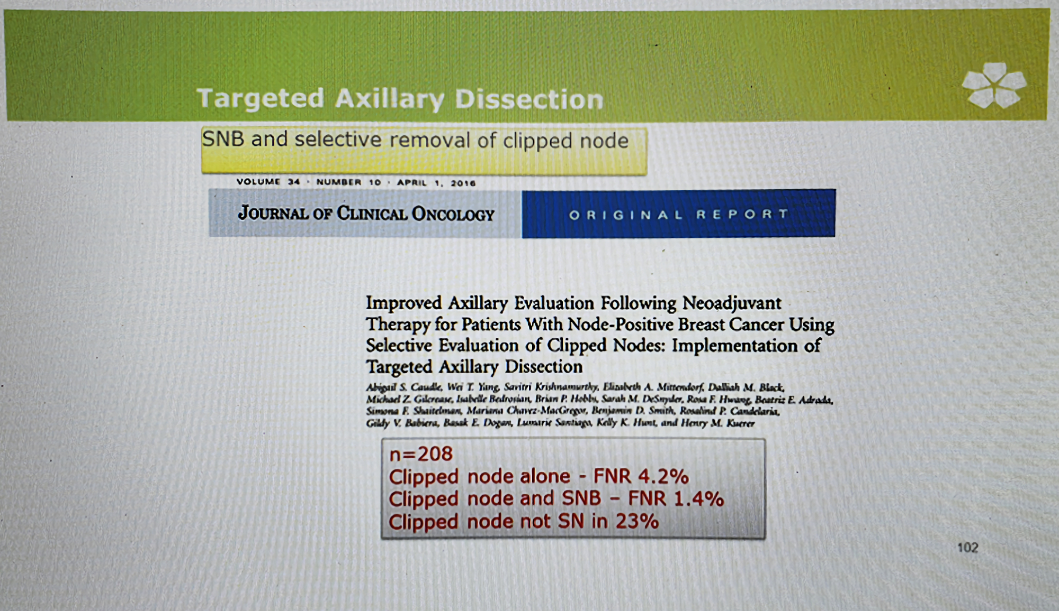

Slide 32
Conclusions
Neoadjuvent therapy is not a risk factor for local failure
Resection within the new margins after NACT seems to be safe and is a major goal in multidisciplinary treatment
No patient should be excluded from BCT, as long as negative margins can be obtained
Surgeons have to learn to trust in the capabilities of neoadjuvant therapy to reduce the extent of surgery for better cosmetic outcomes without oncologic compromise

Slide 33
Gene Expression Assays Assessment of Risk

Slide 34
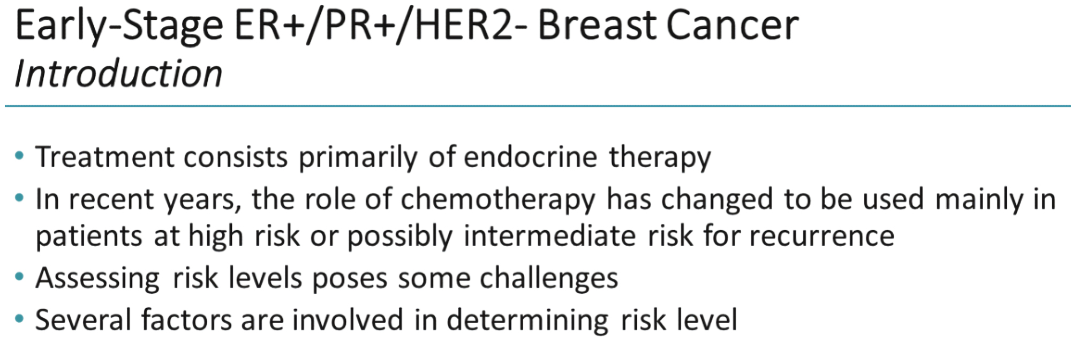

Slide 35
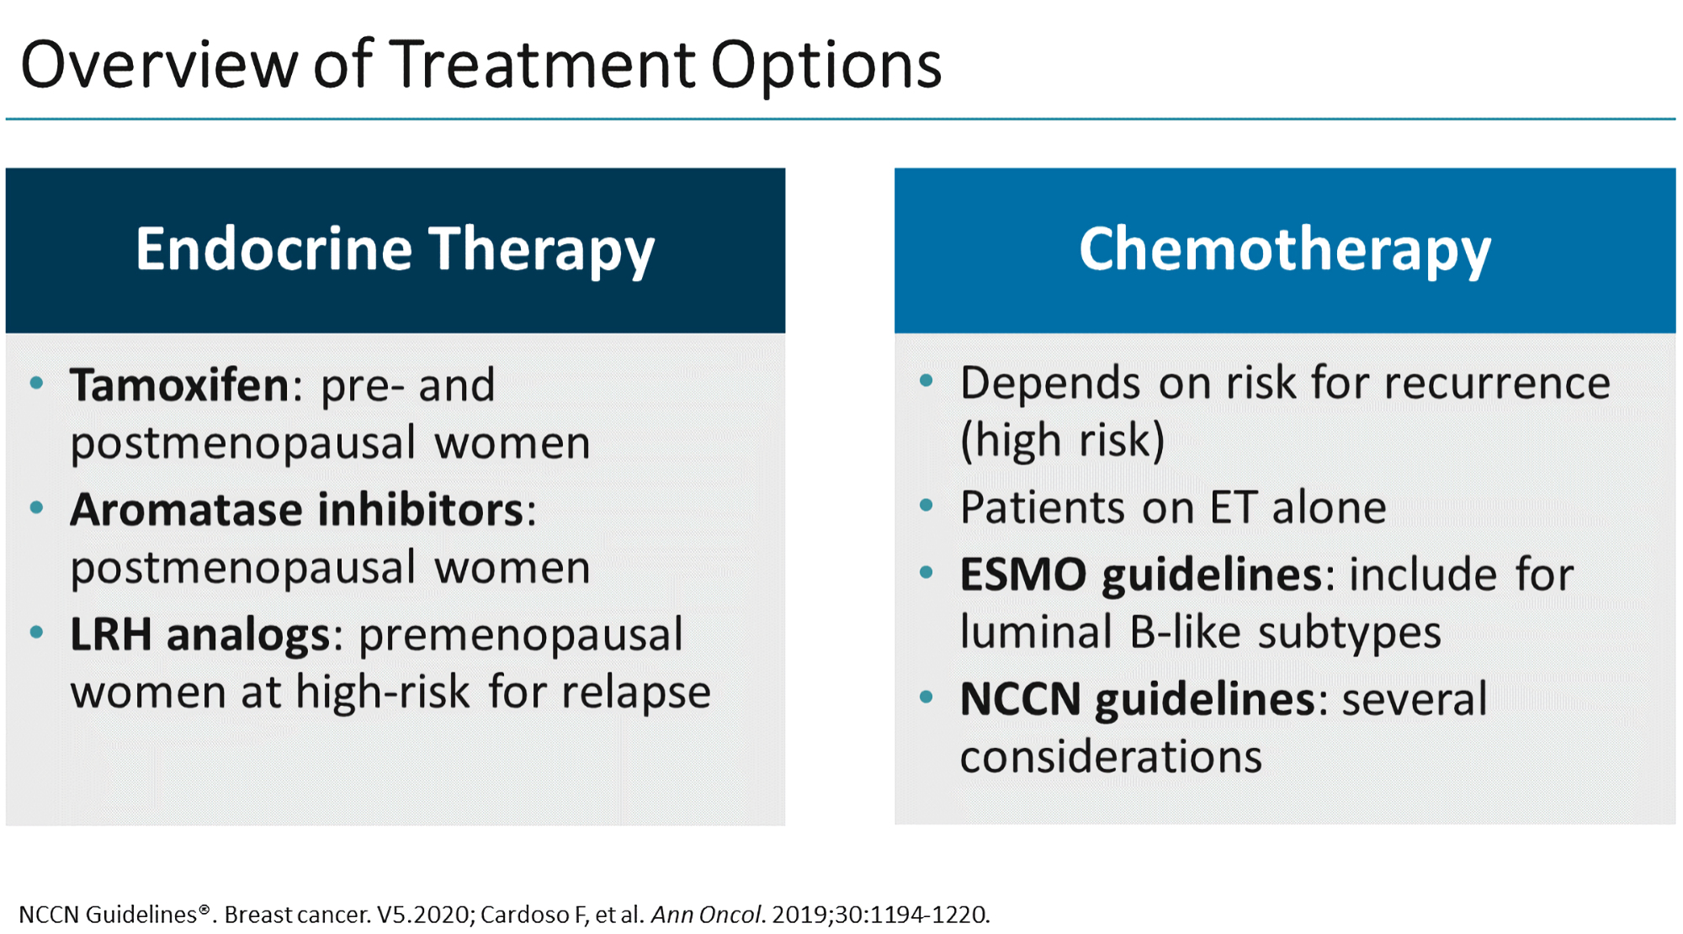

Slide 36
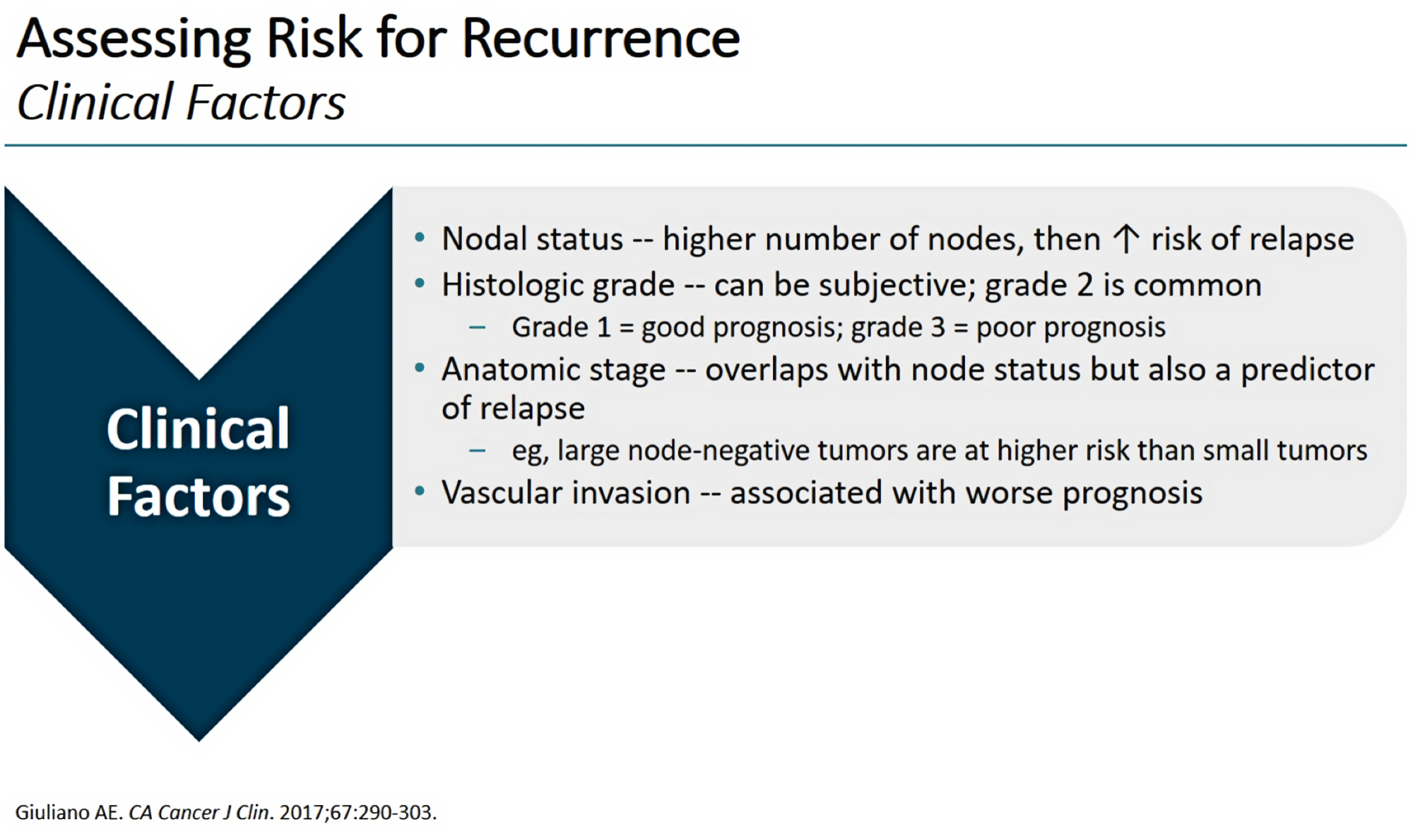

Slide 37
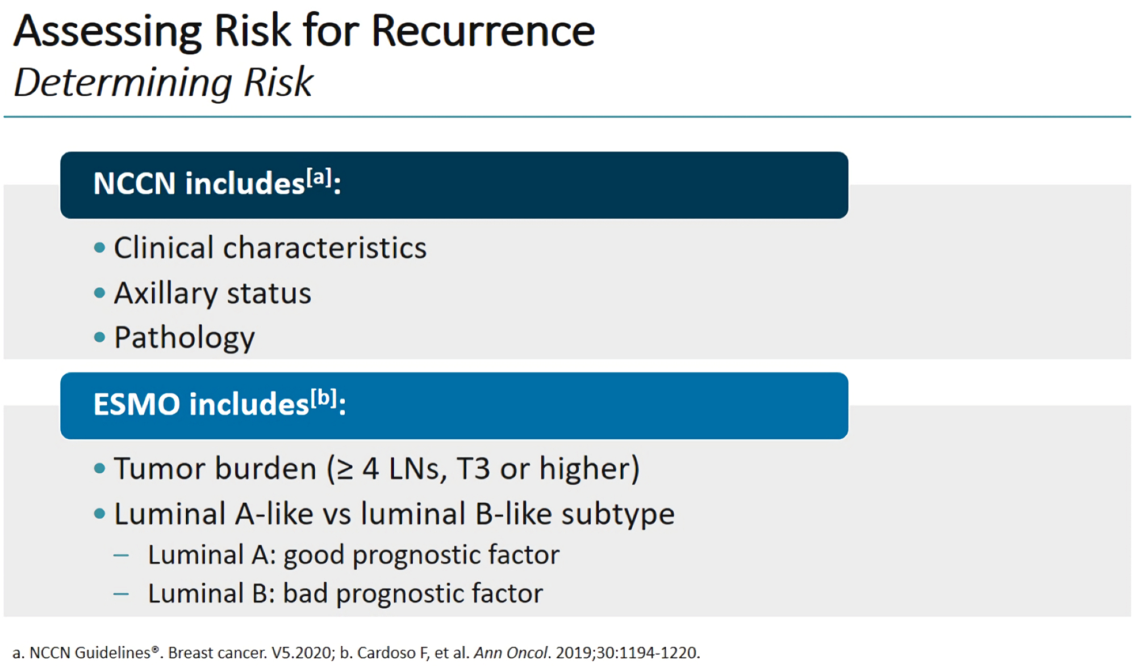

Slide 38
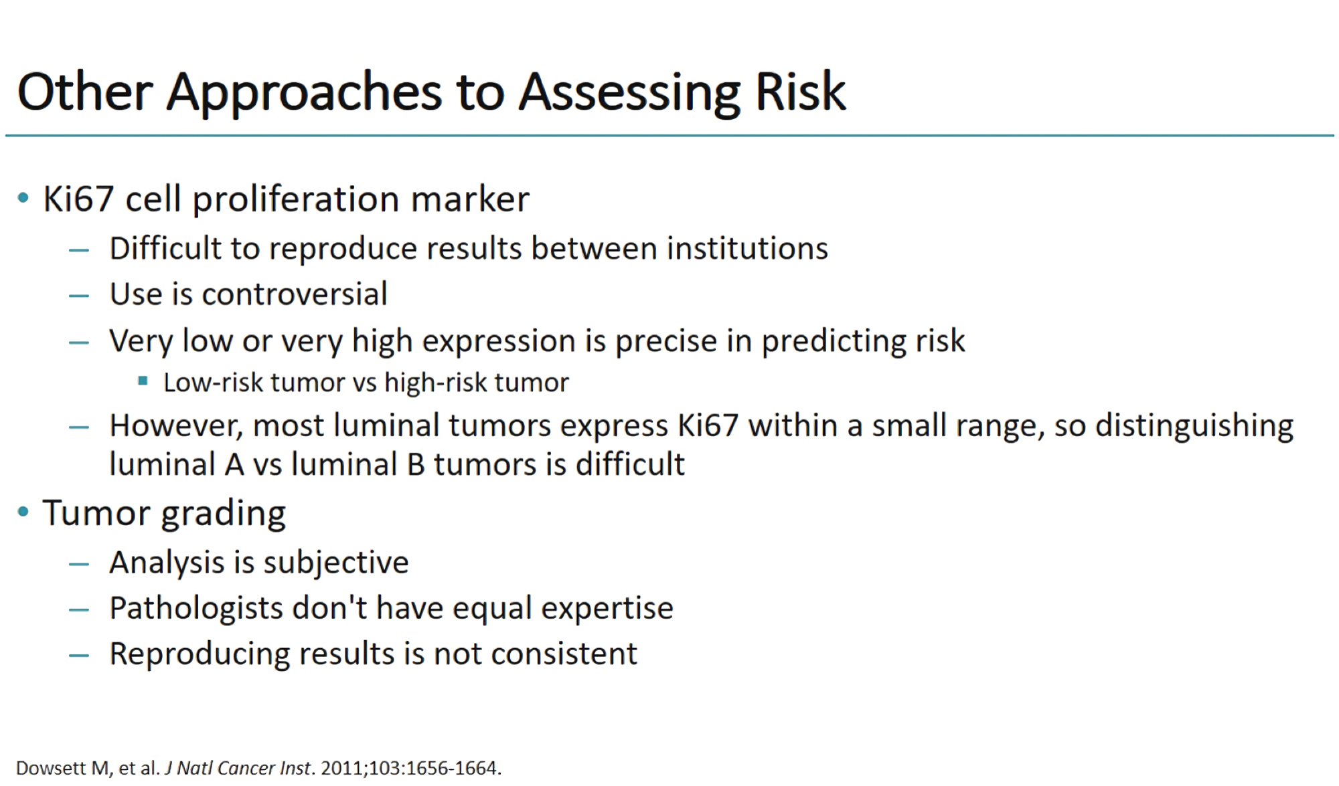

Slide 39
Gene Expression Assays in ER-Positive, HER2-Negative Breast Cancer: The Latest Evidence, Guidelines, and Implications
Commonly used gene expression assays for early stage breast cancer include:
• Oncotype DX® (21-gene panel).
• MammaPrint® (70-gene panel; "Amsterdam signature").
• EndoPredict® (EP and EPclin scores).
• Prosigna® PAM50-ROR® (Breast Cancer Intrinsic Classifier)

Slide 40
Luminal Early Breast Cancer Pn0-1: Chemotherapy Indications
Need to be well substantiated clinical by tumour burden and tumour biology (ER, PR, HER2, Ki67, grade)
Gene expression assays may help in decision-making.
  Several assays are evidence-based, but not all are well validated for all patient groups
  Utilization and reimbursement differ in different countries.
  Prospective data for chemotherapy decision-making are available for Oncotype DX®,(21-gene panel) and MammaPrint® (70-gene panel; "Amsterdam signature").

Slide 41
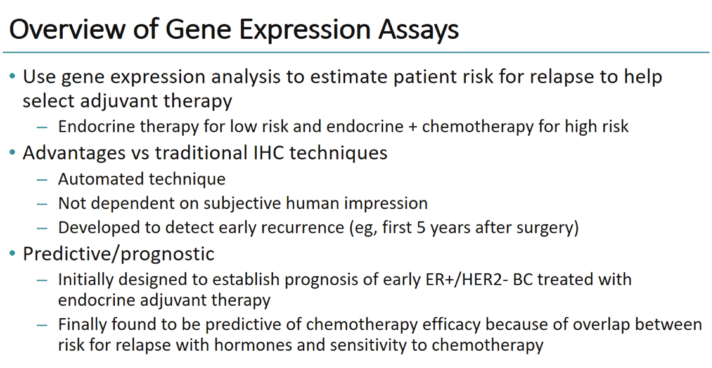

Slide 42
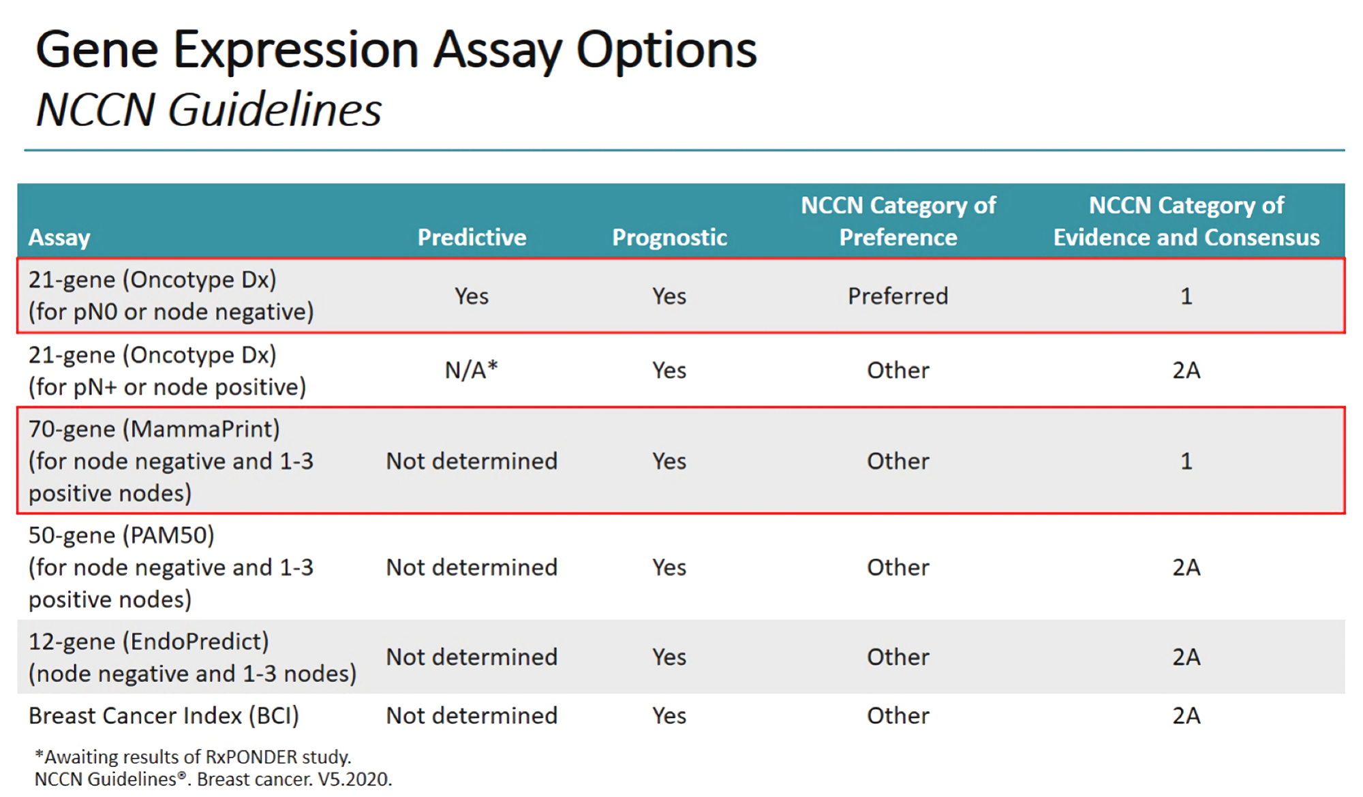
Notes:
Level’s of evidence

Slide 43
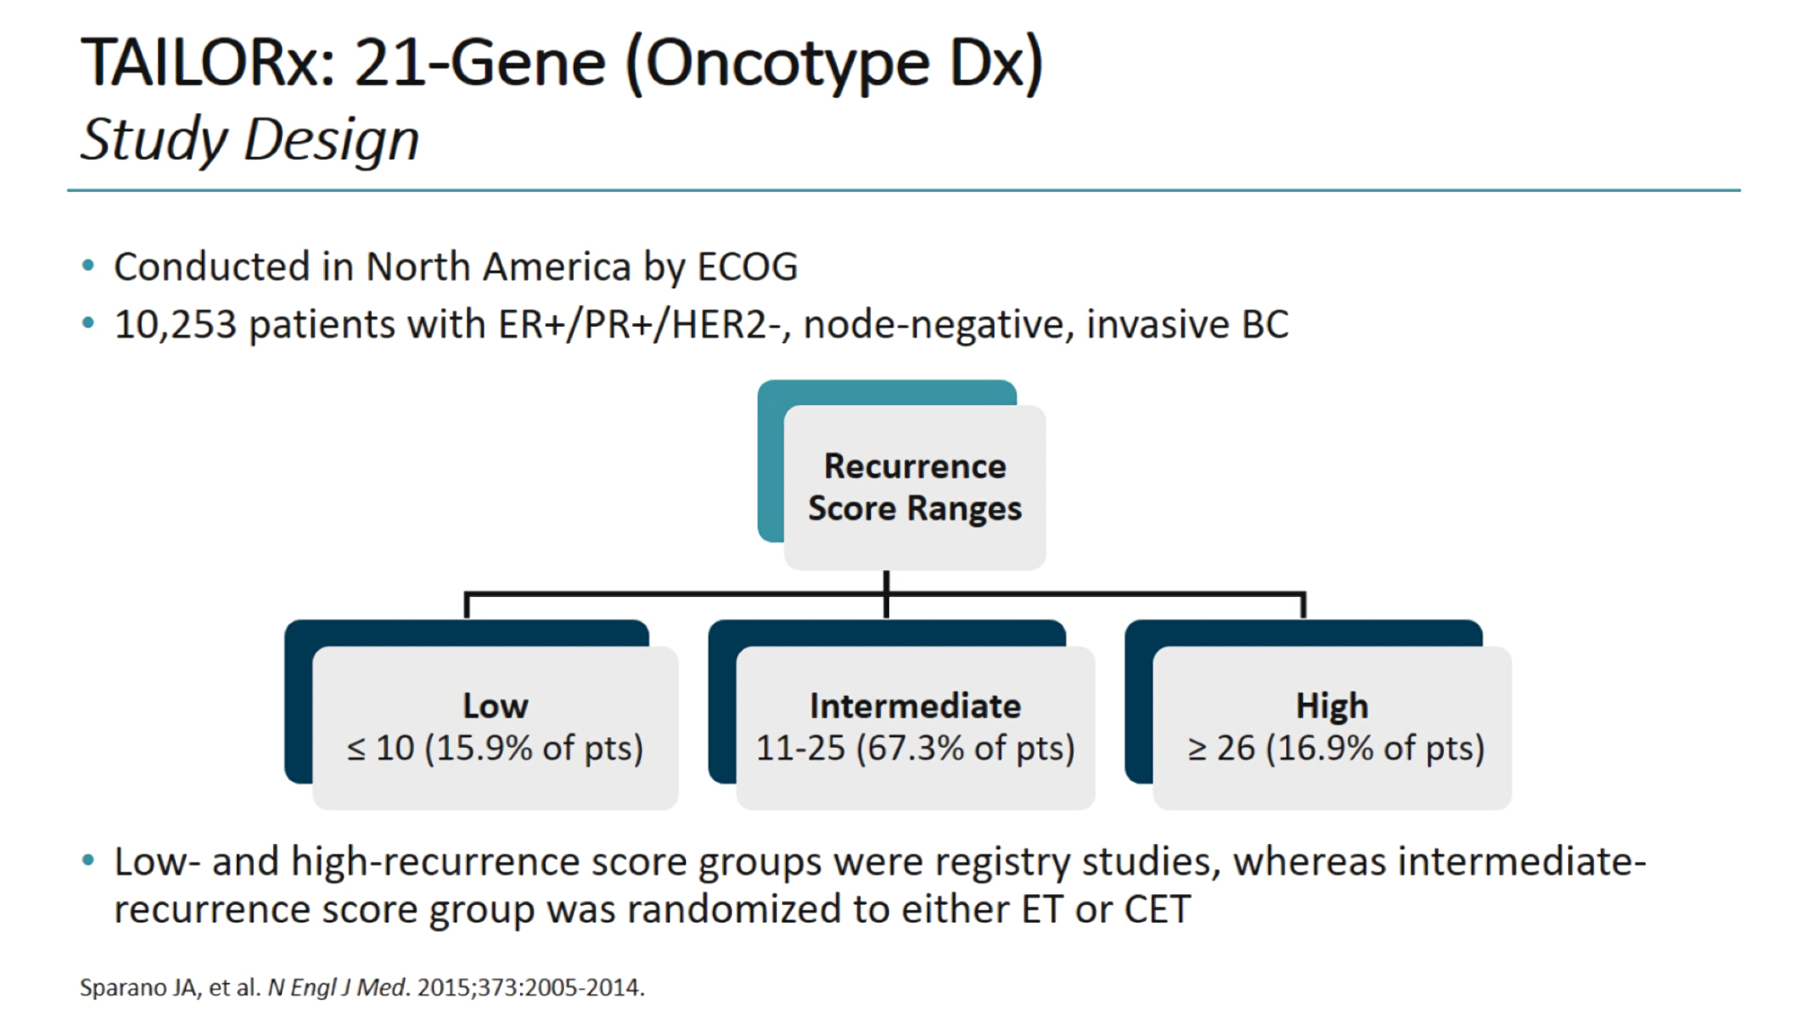

Slide 44
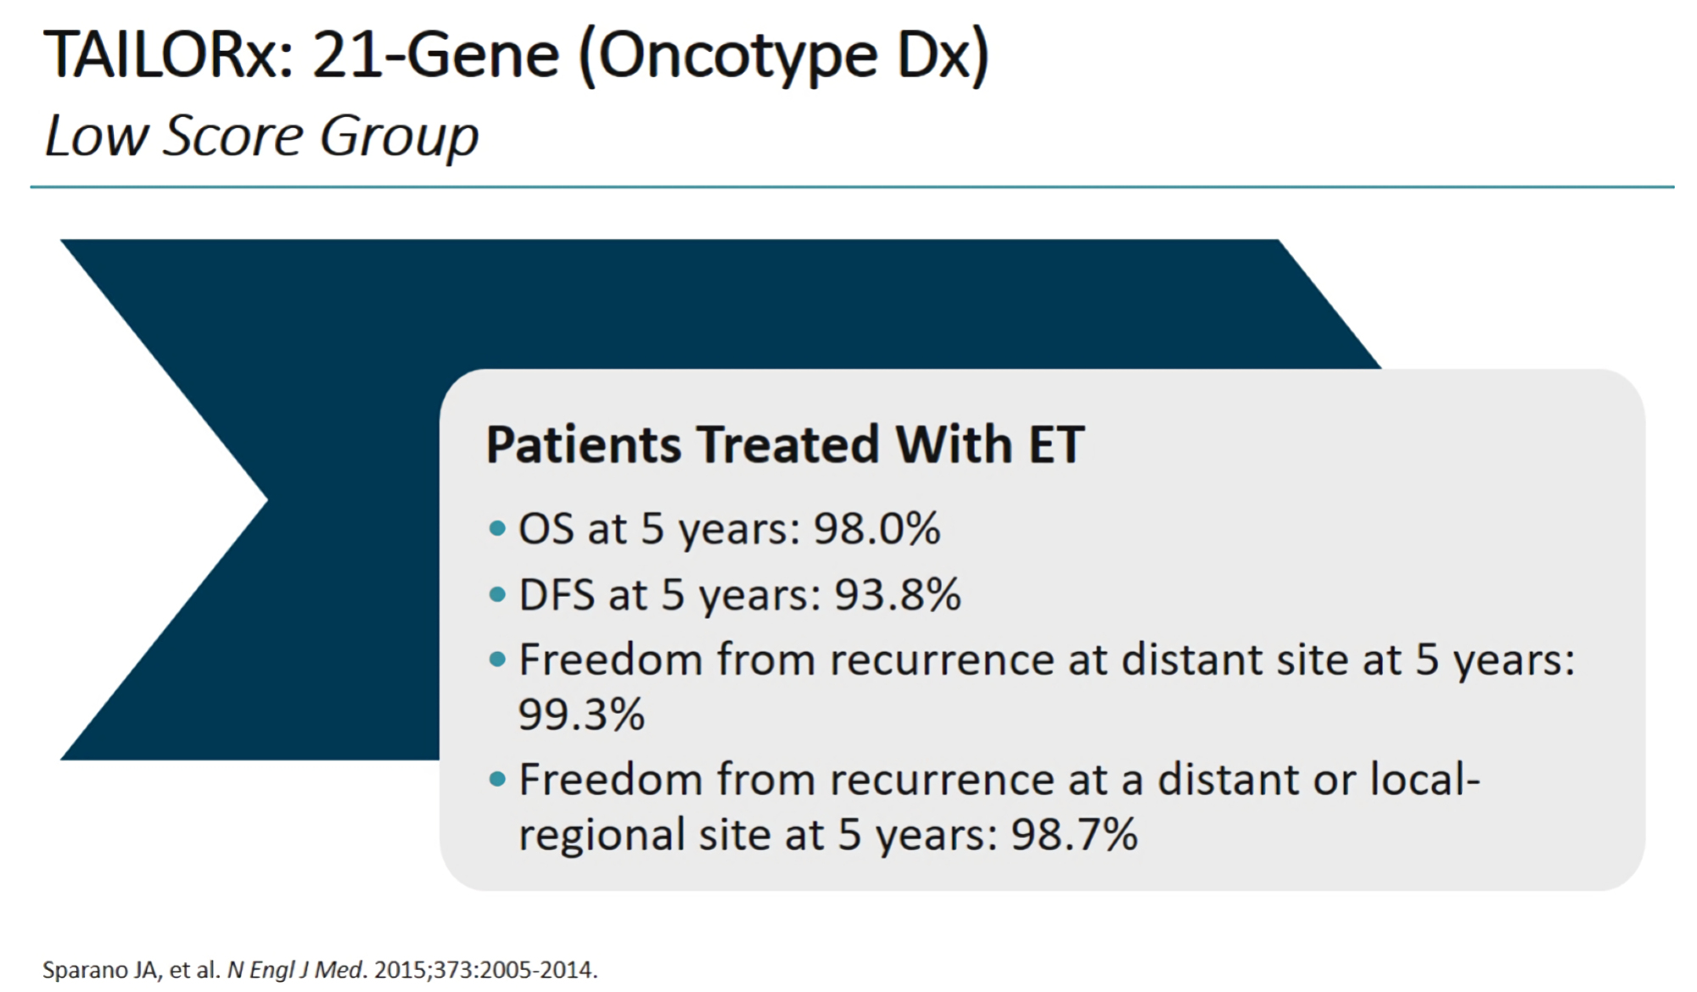

Slide 45
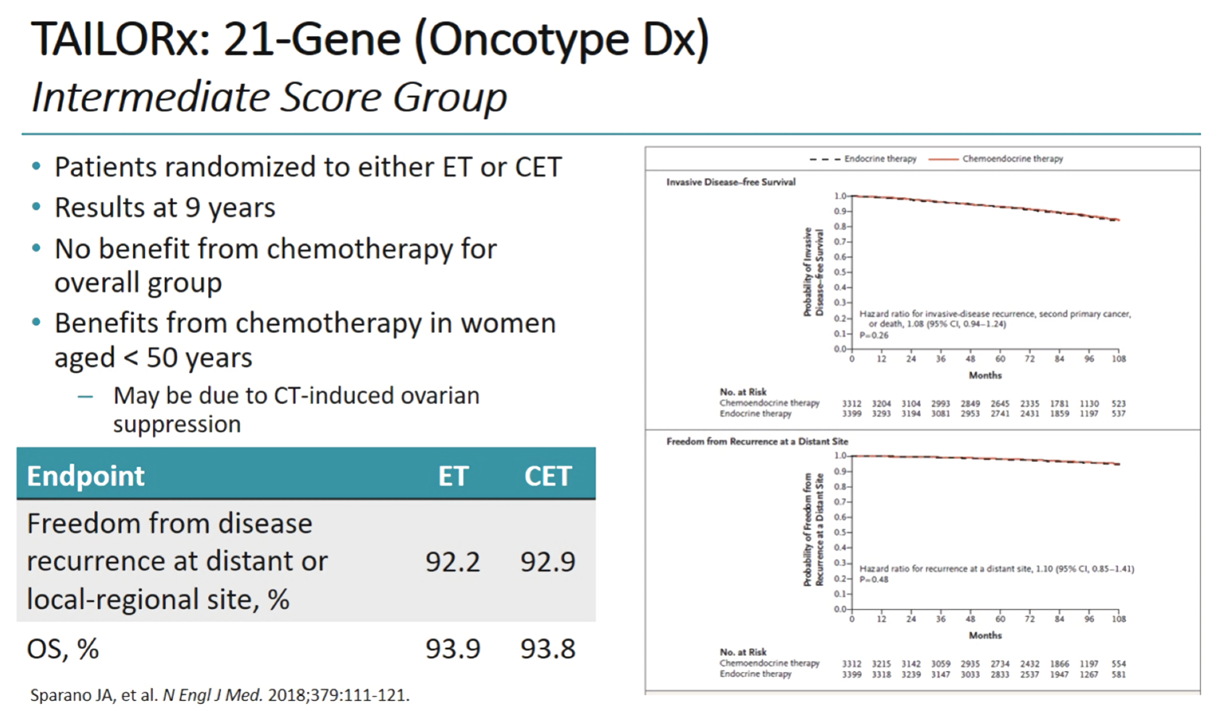
Notes:
The TAILORx trial found that assessing risk through use of the 21-gene (Oncotype Dx) gene expression assay correlated with outcomes with endocrine and chemoendocrine therapy. Patients who were at low risk of recurrence (≤ 10) did not benefit from chemotherapy in addition to endocrine therapy, while patients who were at high risk (≥ 26) benefited from chemoendocrine therapy. For the most part, patients who were at intermediate risk (11 to 25) also did not benefit from the addition of chemotherapy (exceptions included patients younger than 50 years).

Slide 46
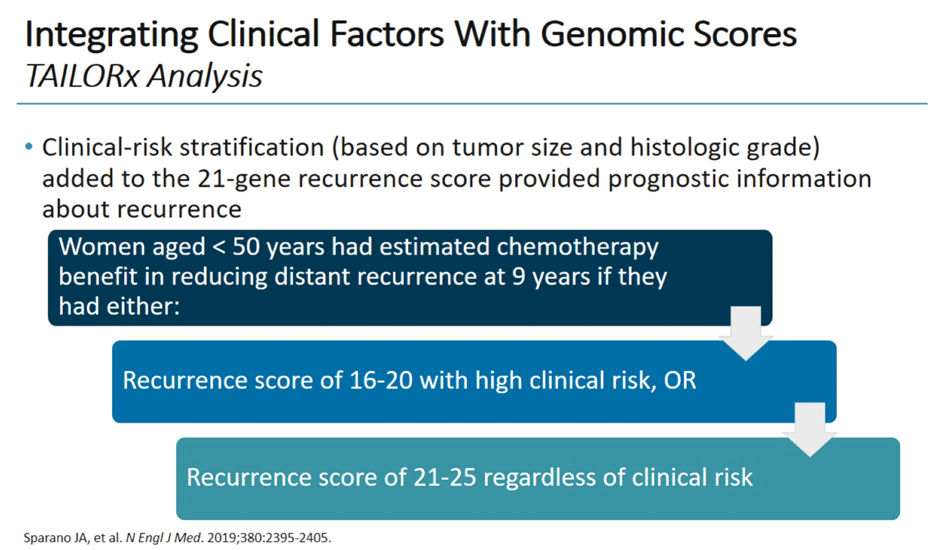

Slide 47
The TAILORx trial found that assessing risk through use of the 21-gene (Oncotype Dx) gene expression assay correlated with outcomes with endocrine and chemoendocrine therapy. Patients who were at low risk of recurrence (≤ 10) did not benefit from chemotherapy in addition to endocrine therapy, while patients who were at high risk (≥ 26) benefited from chemoendocrine therapy. For the most part, patients who were at intermediate risk (11 to 25) also did not benefit from the addition of chemotherapy (exceptions included patients younger than 50 years).

Slide 48
Oncotype DX test costs about $4,000.00

Slide 49

1
Public Summary Document
Application No. 1342.5 Gene expression profiling of 21 genes in
breast cancer to quantify the risk of disease recurrence and predict
adjuvant chemotherapy benefit
Applicant: Specialised Therapeutics Australia Pty Ltd
Date of MSAC consideration: MSAC 76th Meeting, 1-2 August 2019

Slide 50
After considering the strength of the available evidence in relation to comparative safety, clinical effectiveness and cost-effectiveness, MSAC did not support public funding for this gene expression profiling test for patients with breast cancer primarily because its ability to identify those who could safely be spared the addition of chemotherapy to endocrine therapy was not demonstrated by the new trial. The re-analysis of previously provided evidence was also insufficient to change the previous conclusion that the test could not satisfactorily identify those intermediate-risk patients who would benefit from the addition of chemotherapy to endocrine therapy.

Slide 51
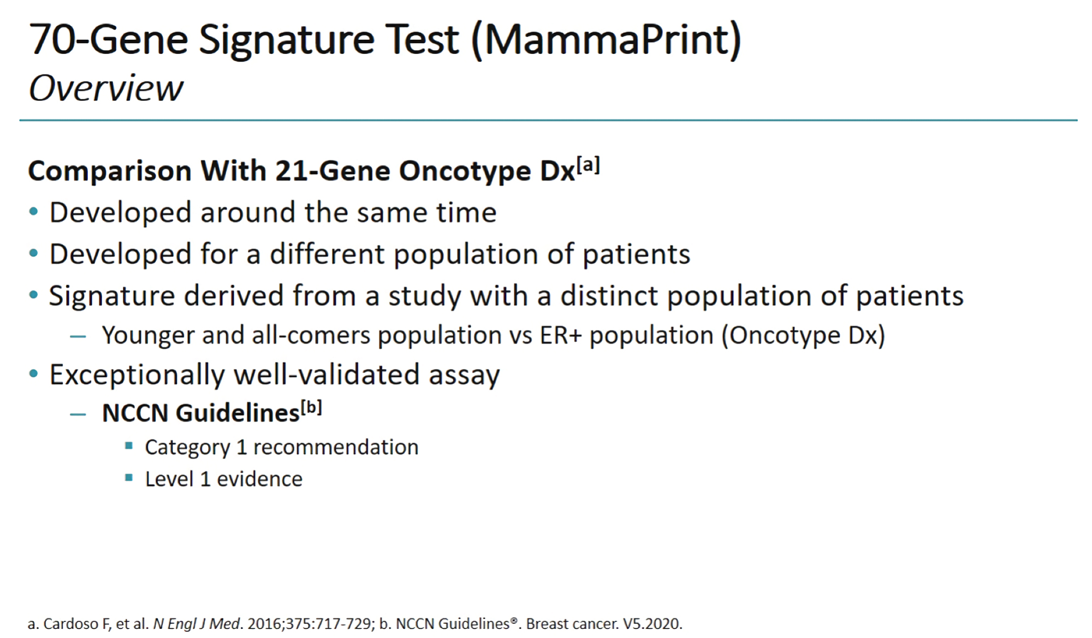

Slide 52
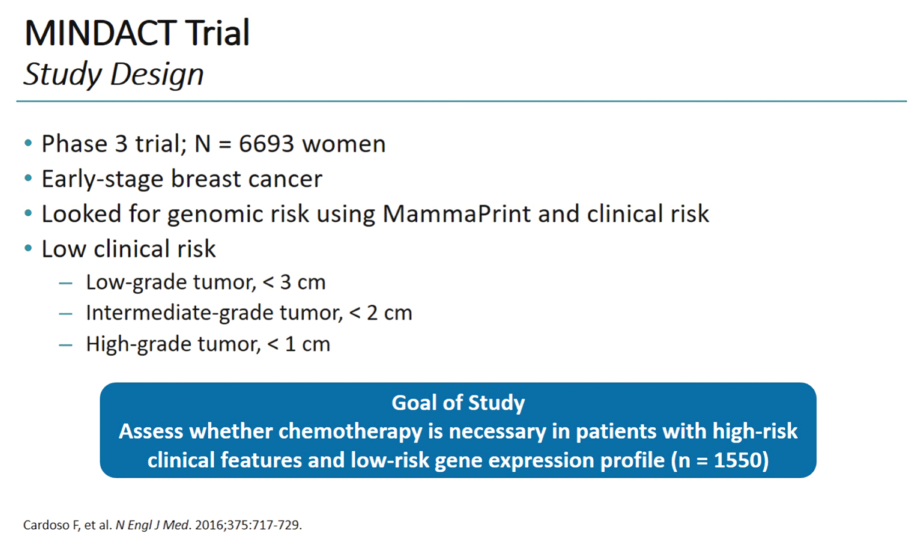

Slide 53
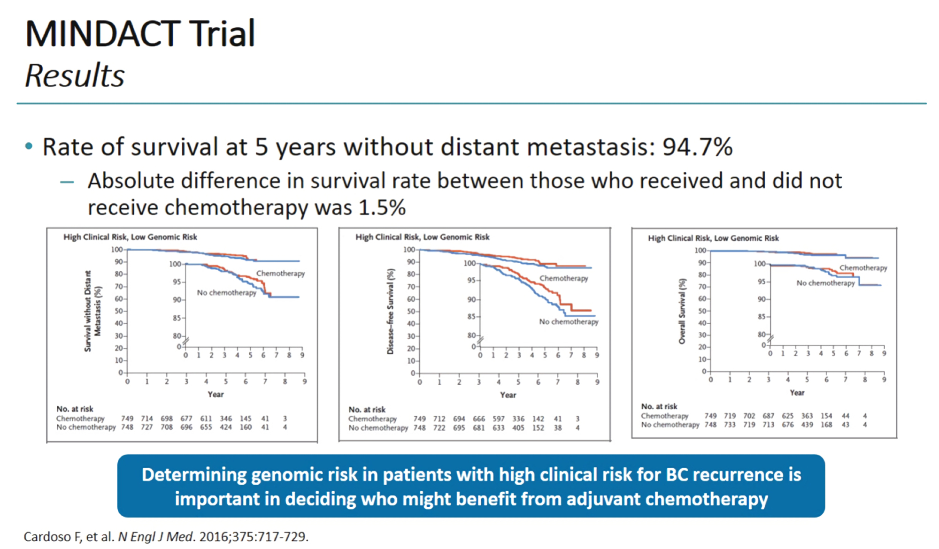
High Clinical Risk + Low Genomic Risk
Survival & No
Distant Mets
DFS
OS

Slide 54
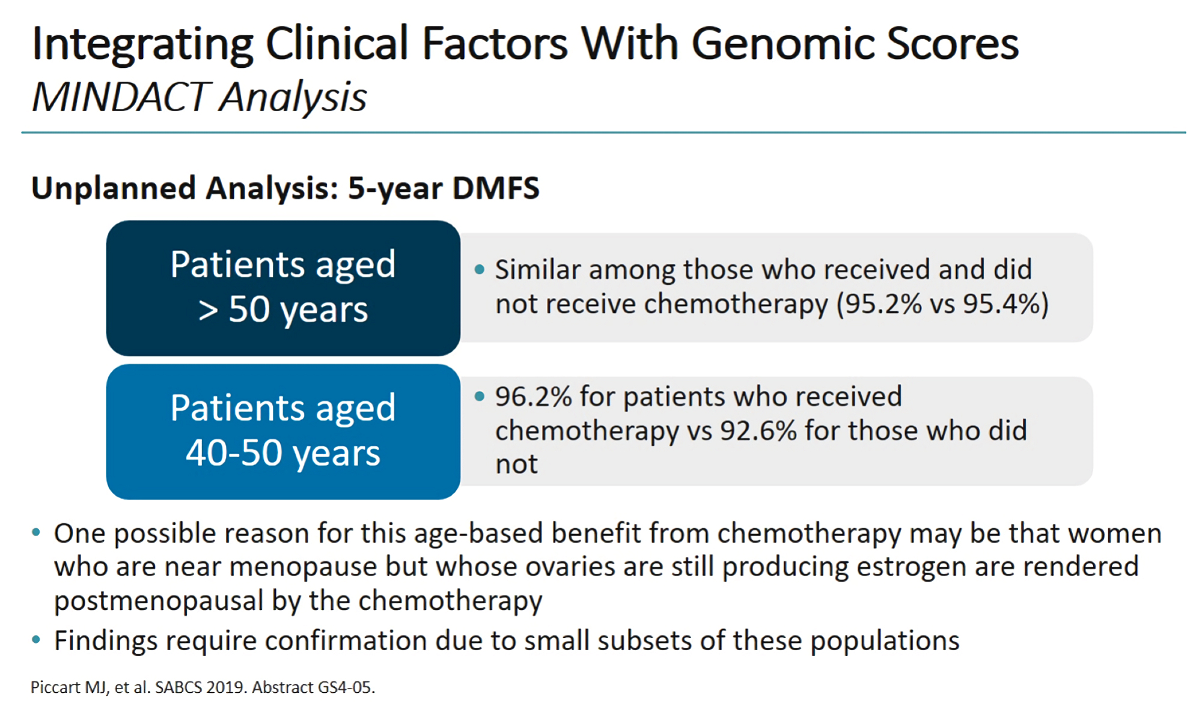

Slide 55
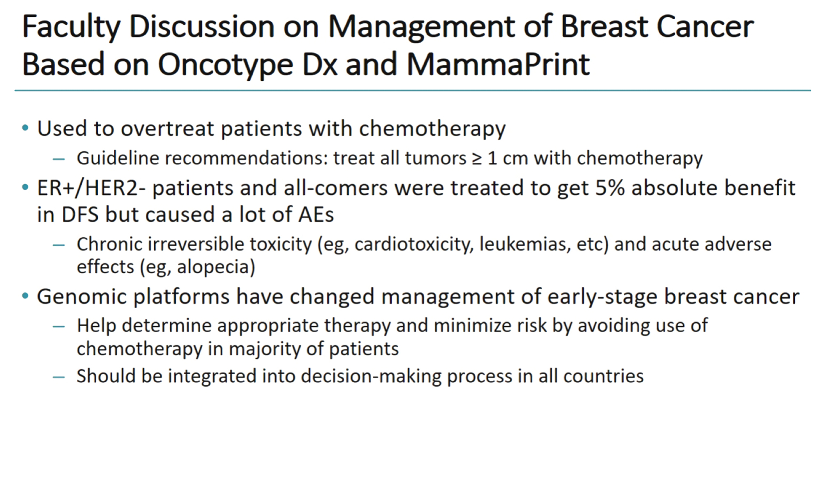

Slide 56
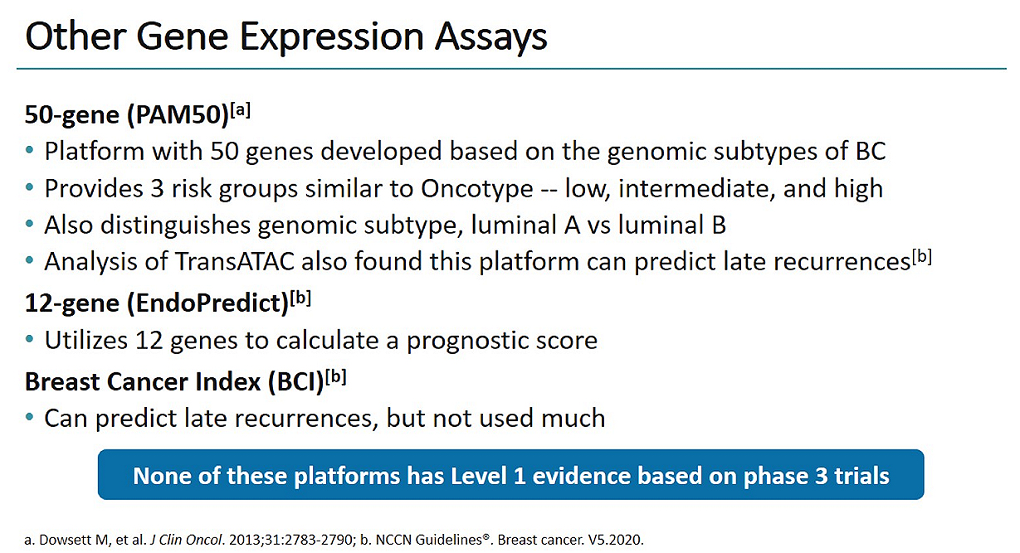

Slide 57
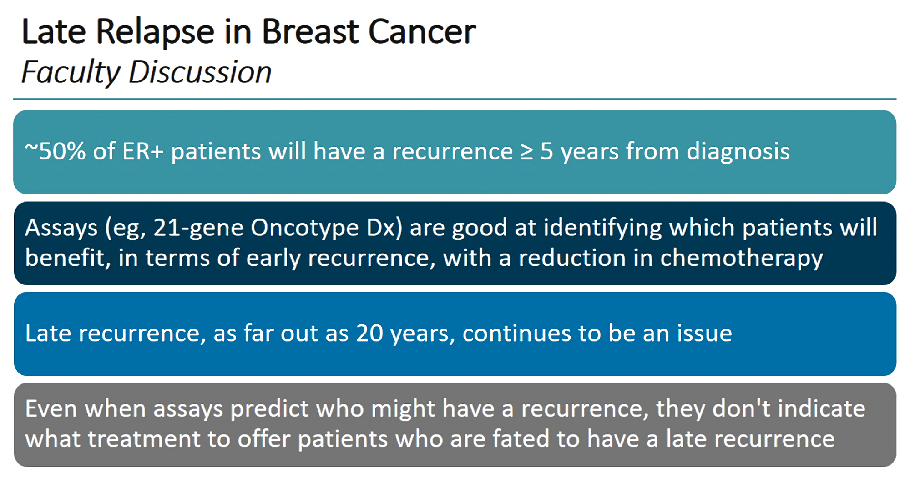

Slide 58
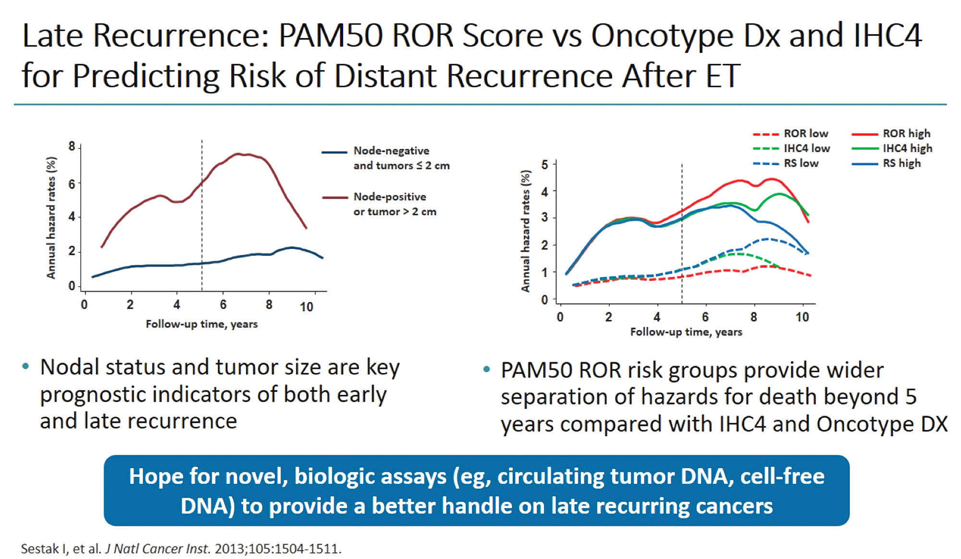

Slide 59
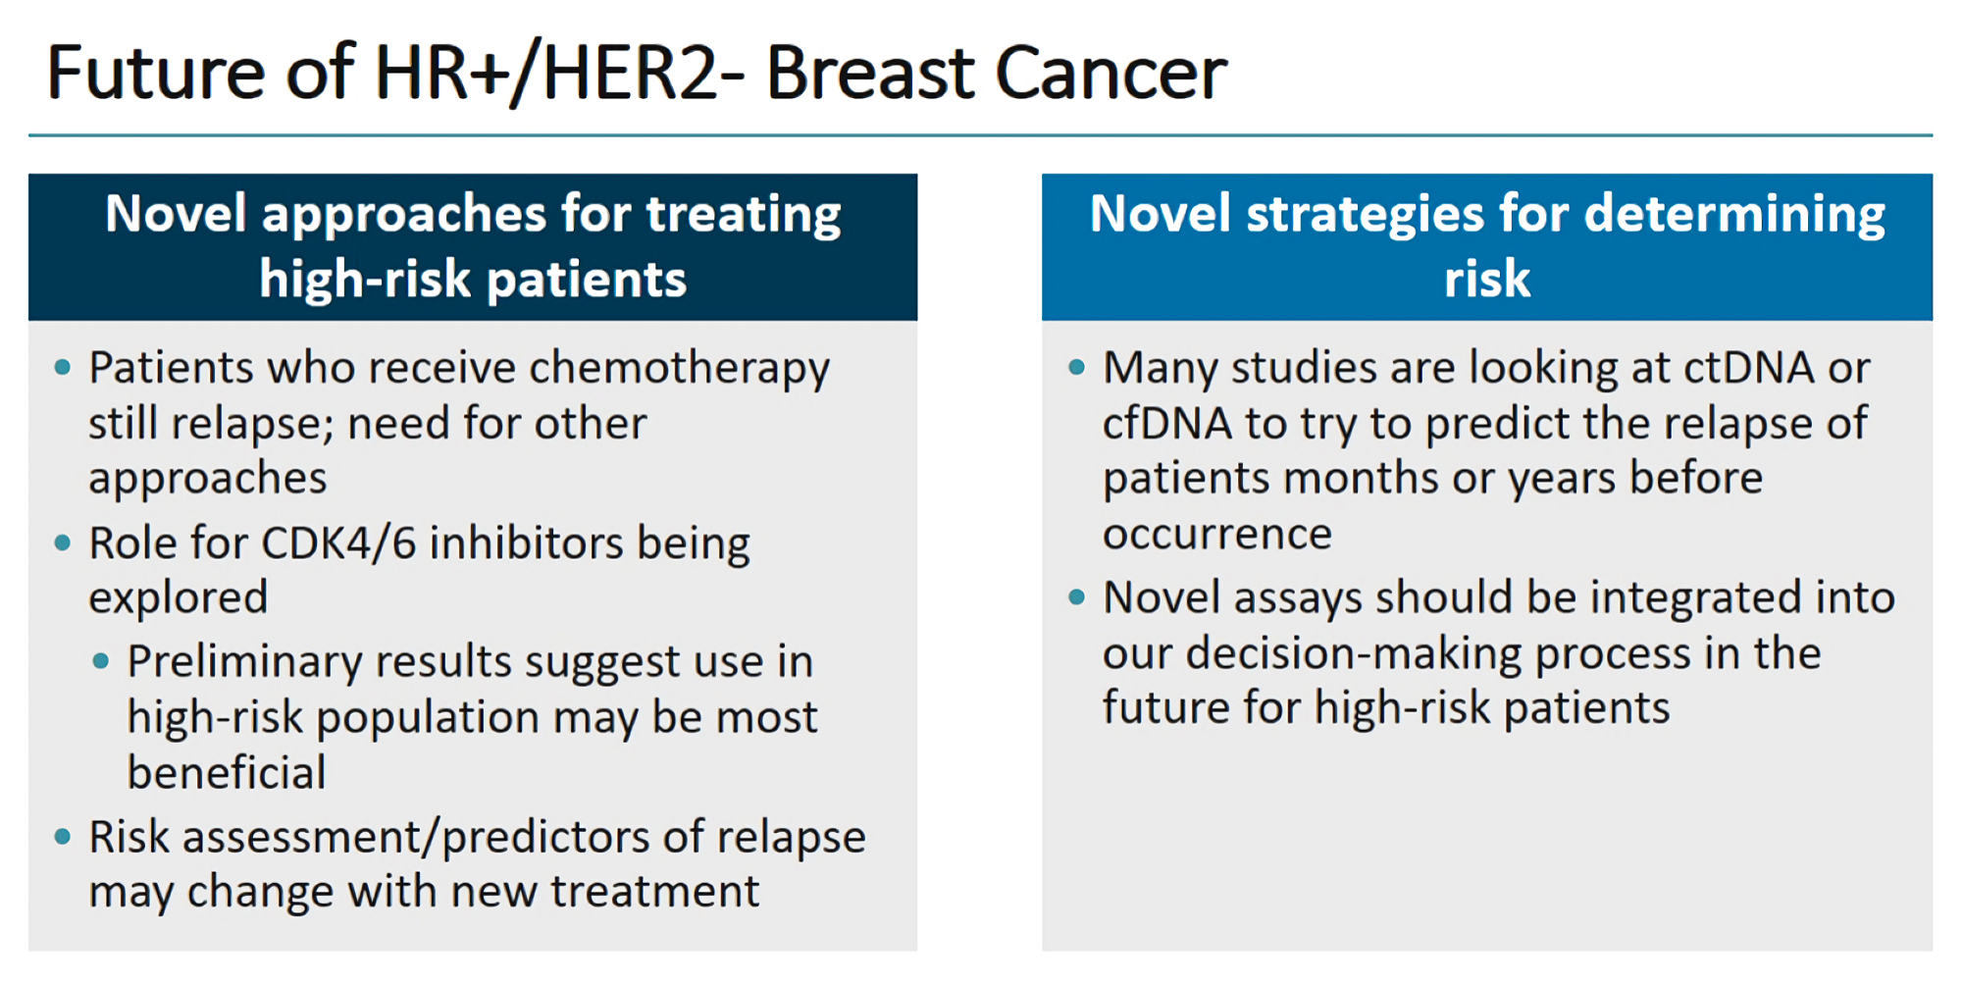

Slide 60
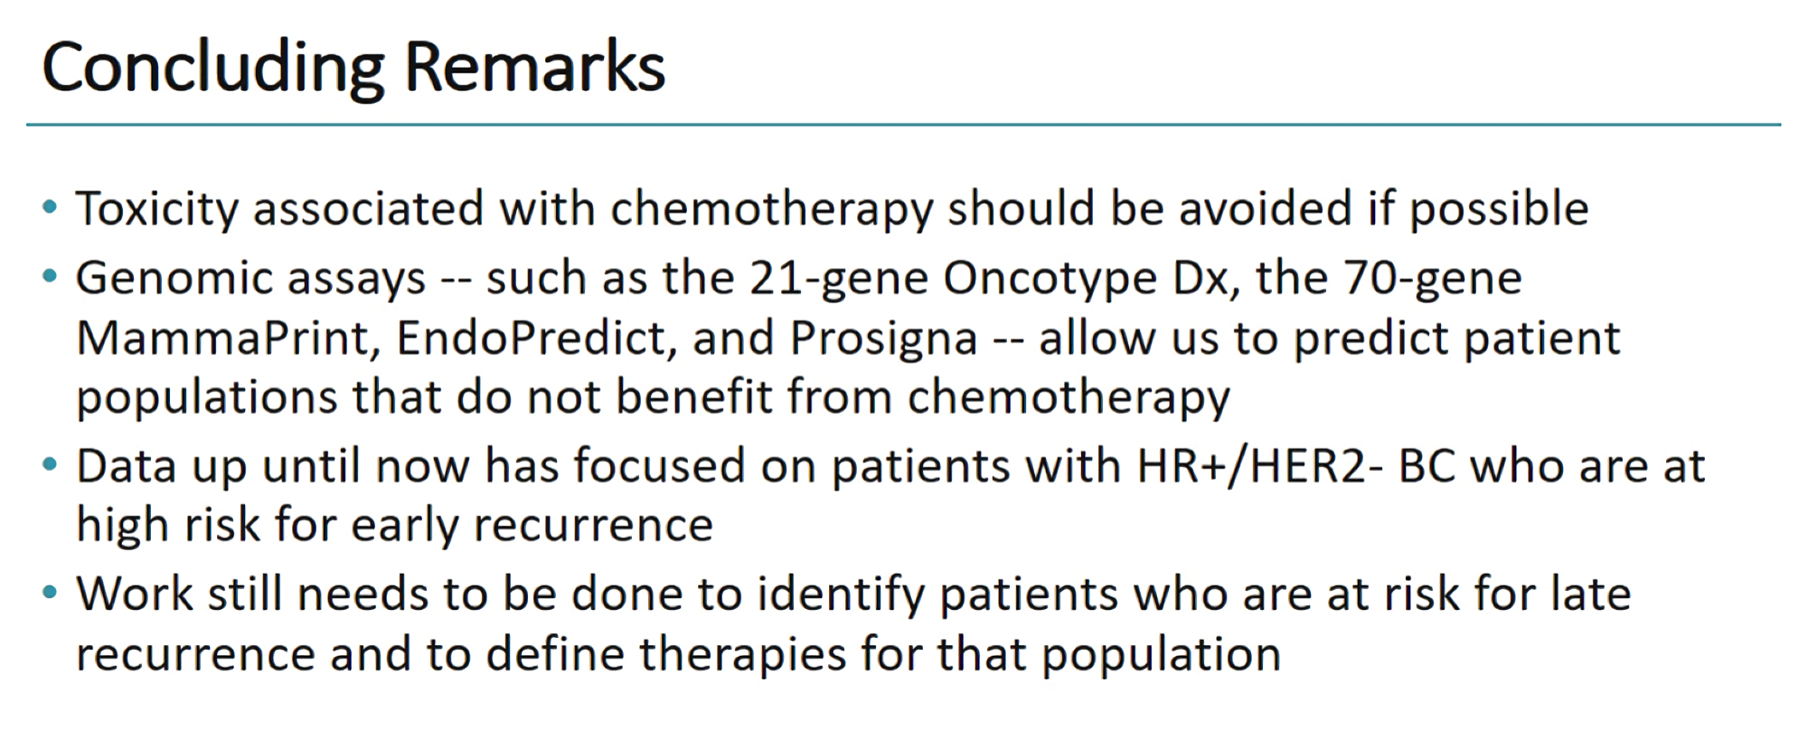

Slide 61
