Slide 1
Skin Pathology

Slide 2
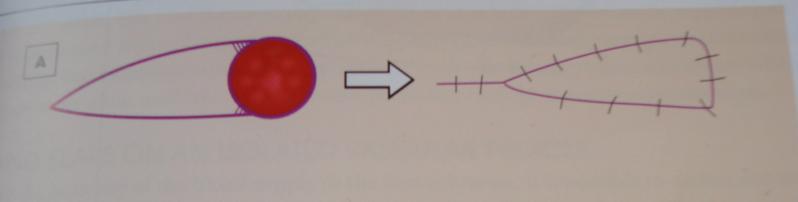
Skin Flap
What type of skin flap is this?
How do you perform it?

Slide 3
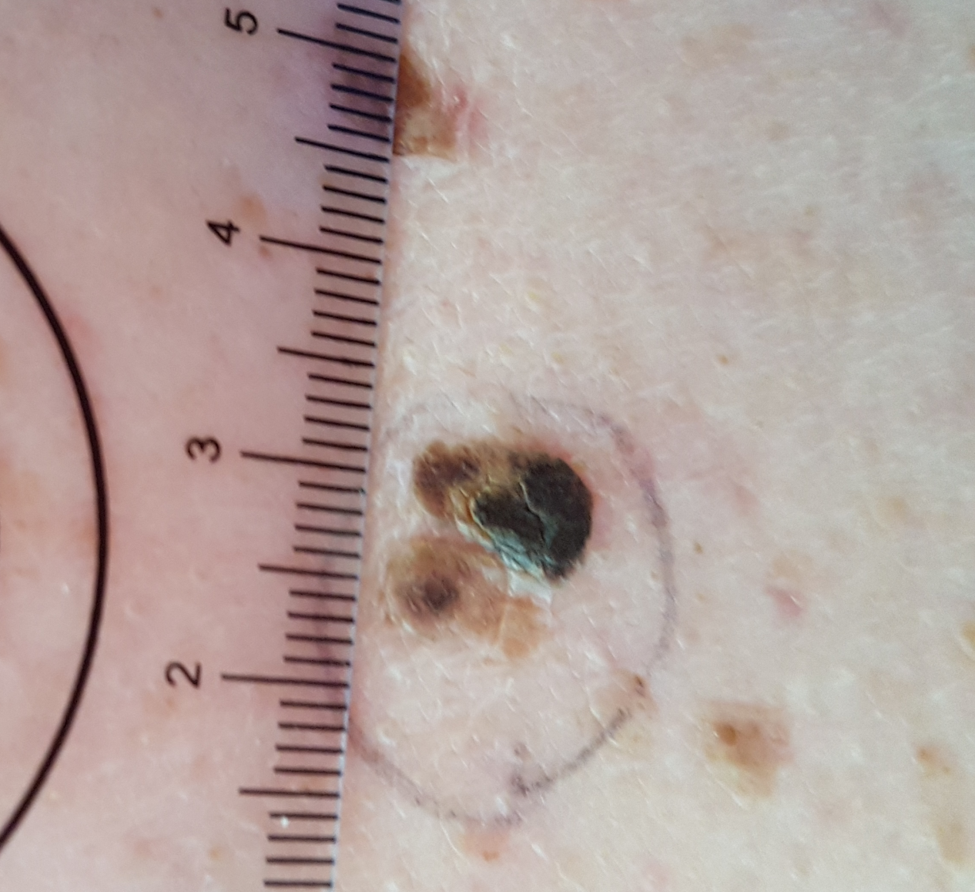
Q1: Describe this lesion

Slide 4
Q2: What are you most concerned with?

Slide 5
Q3: How would you make a definitive diagnosis?

Slide 6
Q4: What is the histological classification of melanoma?

Slide 7
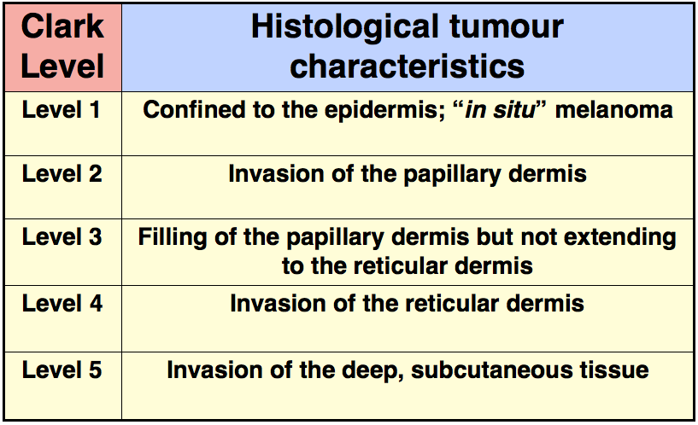
For your learning

Slide 8
Q5: Histology: Your patient has a 0.4mm deep melanoma Clarke level 3 … what is your next step?

Slide 9
Q6: What definitive safety margins required for melanoma?

Slide 10
For your Learning Thickness safety margin In situ: ………………. 5mm Invasive < 1mm ………………. 10mm Invasive 1mm & more ………………. 20mm + SLN

Slide 11
Q7: What are the risk factors for developing melanoma?

Slide 12
Q8: Point out what are the risk factors you look for in the histology report shown next?

Slide 13
CLINICAL DETAILS Pigmented lesion. MICROSCOPY Sections of skin show superficial spreading melanoma, Clark level 3, Breslow's thickness 0.40mm. There is a crowded proliferation of melanocytes along the dermal epidermal junction, which extend into and fill the papillary dermis. Melanocytes have an epithelioid appearance and show sustained significant cytological atypia. Dermal mitoses are not identified. There is no ulceration or evidence of regression. Lymphovascular space invasion is not seen. There is no neurotropism. There is no desmoplastic melanoma. There are no microsatellite lesions. There is no co-existent benign melanocytic lesion. Surgical margins: Excision margins are free of malignancy in these sections. In-situ melanoma - peripheral margin 1.5mm. Invasive melanoma - peripheral margin 2.5mm, deep margin >5mm.

Slide 14
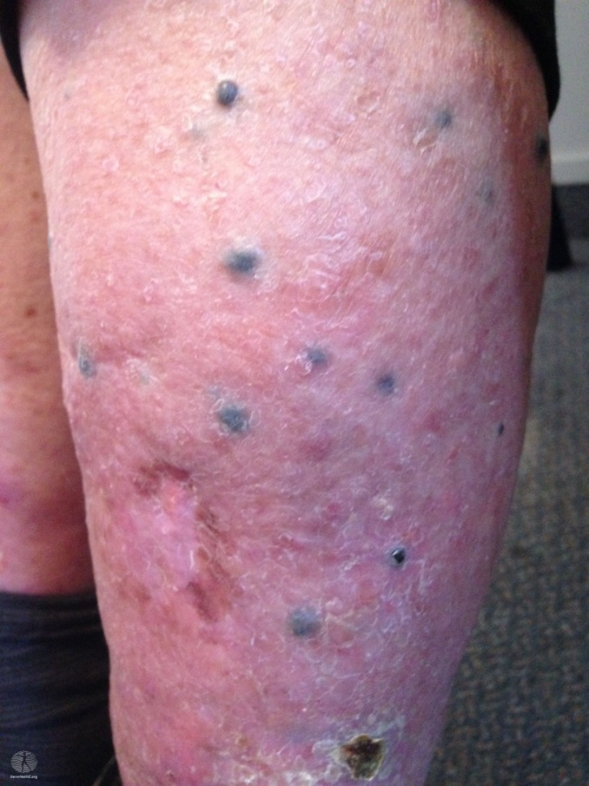
Q9: What do you think this is?

Slide 15

Q10: How would you manage this patient and what are the treatment options

Slide 16
Q11: What is the BRAF and what is its clinical significance

Slide 17
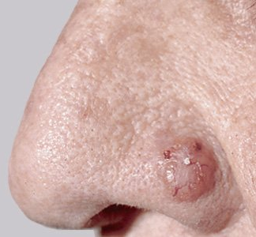
Q 12: Describe this lesion and what is your differential diagnosis? Can you give a specific diagnosis? Q:13 How would you treat this lesion?
.

Slide 18
Q:14 what are the different modalities used for the treatment of Non-Melanoma Skin cancers?

Slide 19
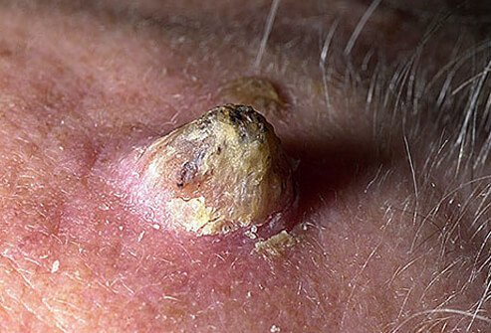
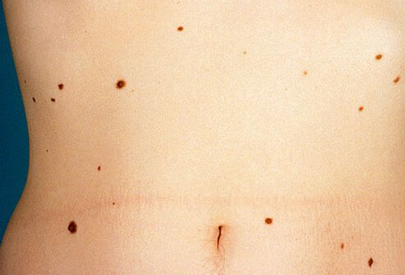
Spot Diagnosis
1.
2.

