Slide 1
Neck Trauma
NZAGS21
New Plymouth
March 27th, 2021
Professor Ian Civil
Clinical Director, National Trauma Network

Slide 2
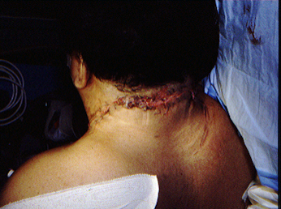
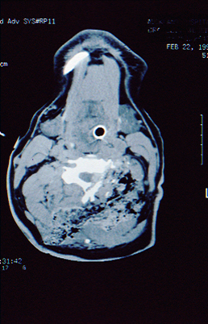
Challenging neck trauma….

Slide 3
Blunt versus penetrating
Blunt trauma may cause visceral or vascular injury – seldom immediately life threatening
May be immediately life threating if airway involved or critical haemorrhage occurs
Penetrating trauma may involve visceral or vascular structures
Blunt trauma to the neck commonly reflects potential for spinal injury – an ortho issue which is not part of this presentation

Slide 4
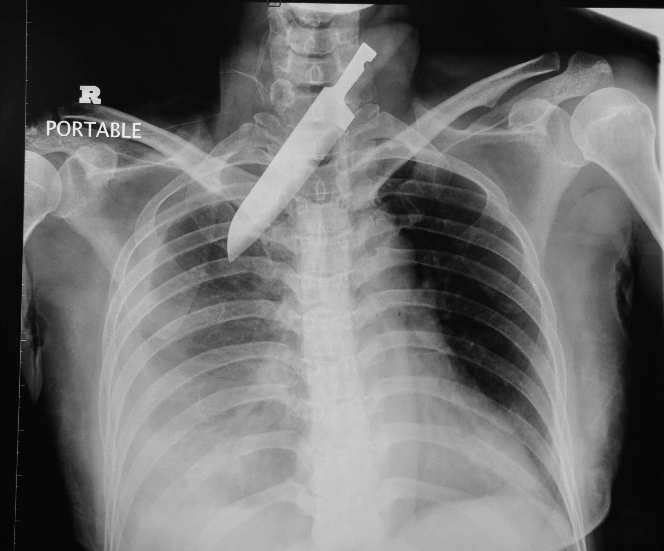
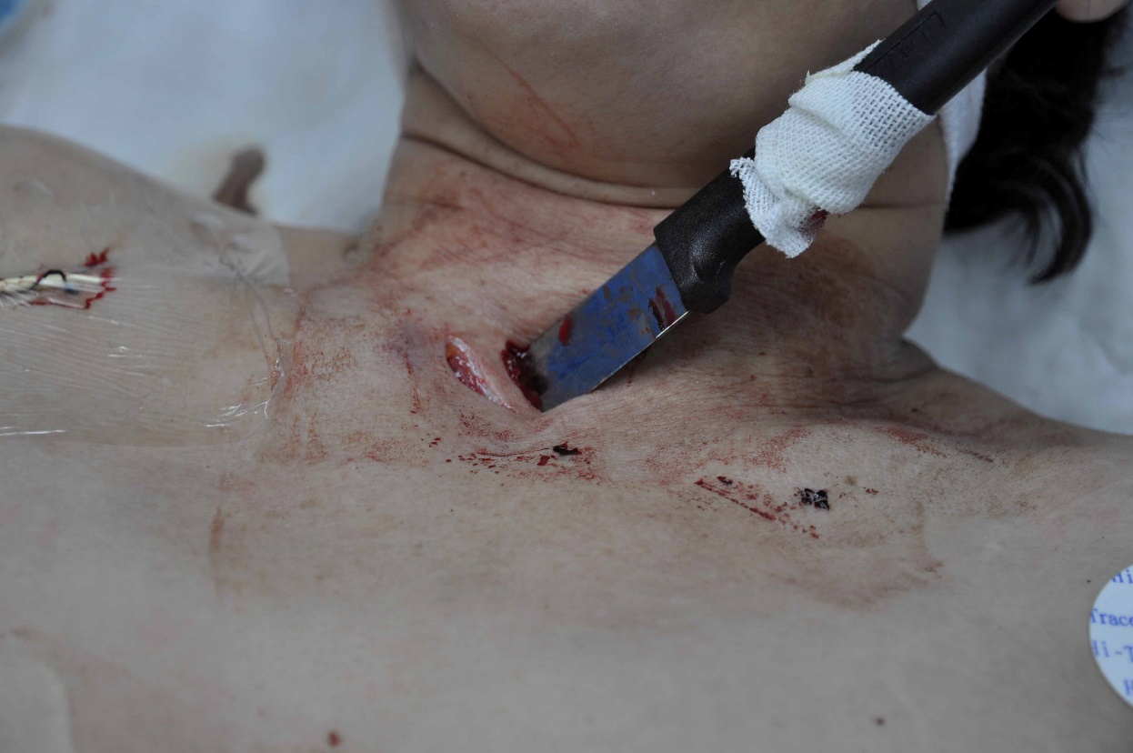
Penetrating neck trauma

Slide 5
Penetrating neck trauma
Where are the potential injuries?
What would be required to treat them?
What are the issues here?

Slide 6
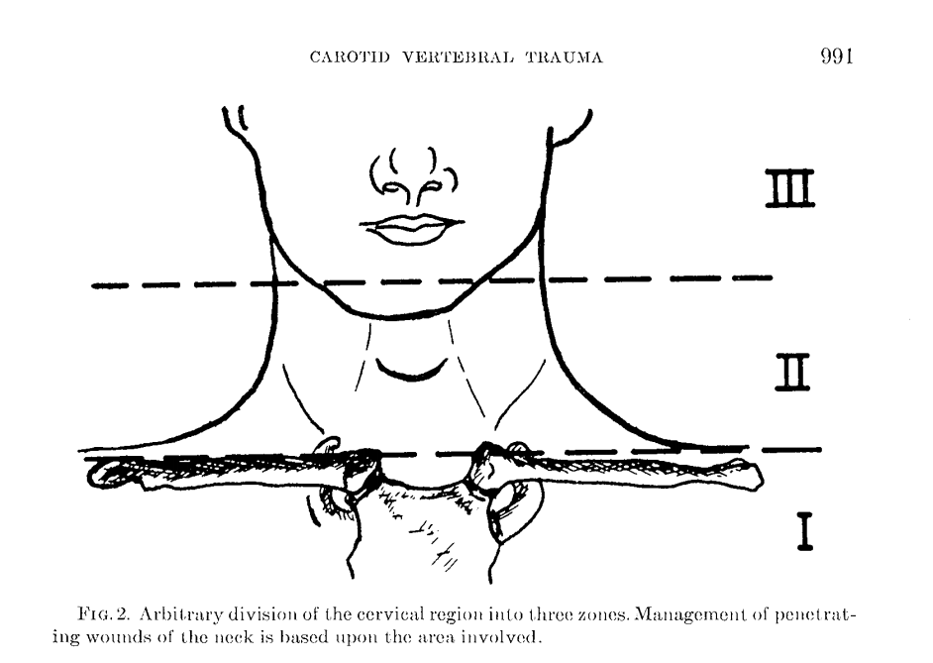
Zones….

Slide 7
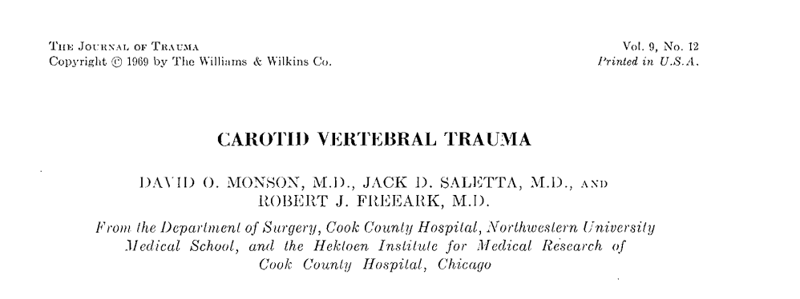
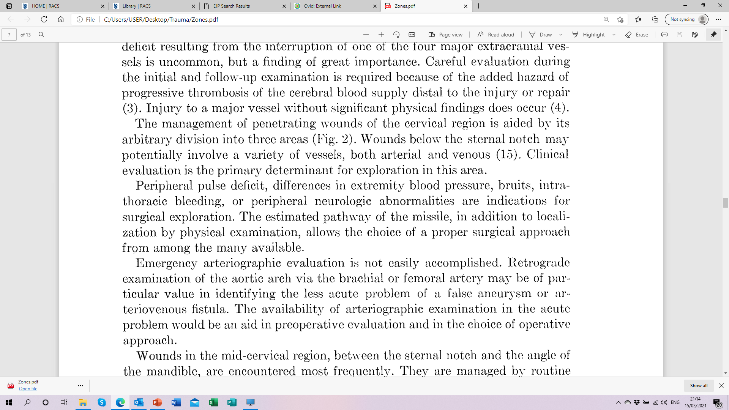
Who came up with the idea of zones?

Slide 8
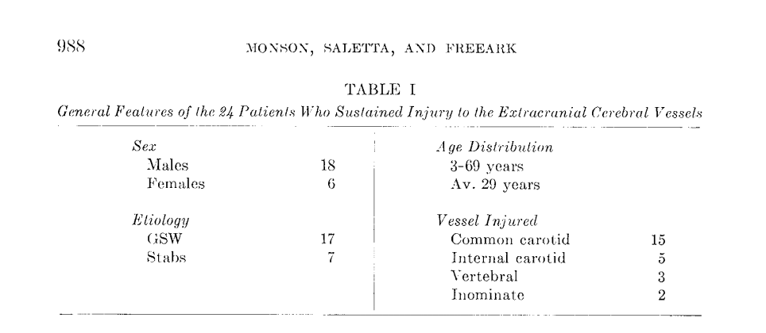
Who came up with the idea of zones?

Slide 9
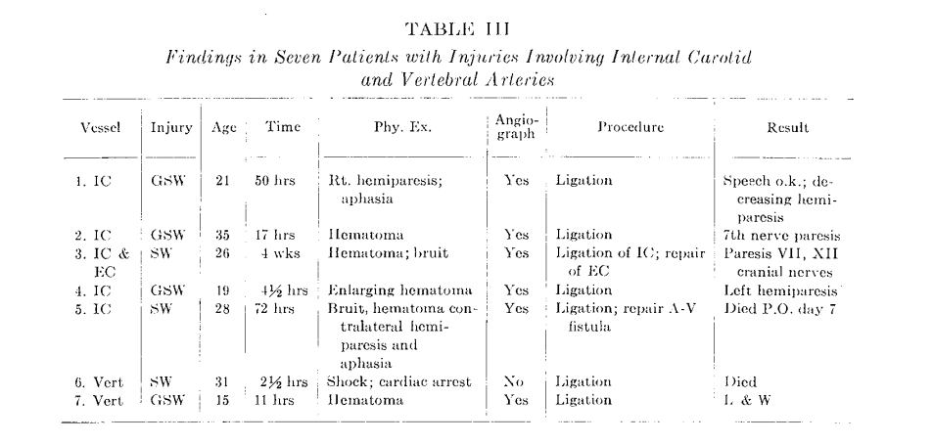
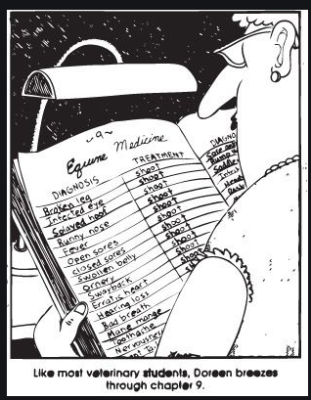

Slide 10
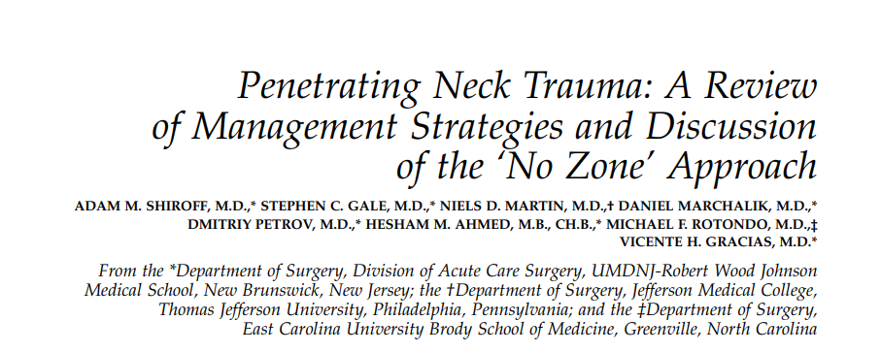
The American Surgeon; Atlanta Vol. 79, Iss. 1, (Jan 2013): 23-9.
Further, we propose a ‘‘No Zone’’ approach to imaging triage for these patients using multidetector CTA (Fig. 1) as a safe and very effective modality for the initial evaluation, trajectory determination, injury identification, and subsequent decision-making in patients presenting with penetrating neck trauma.

Slide 11
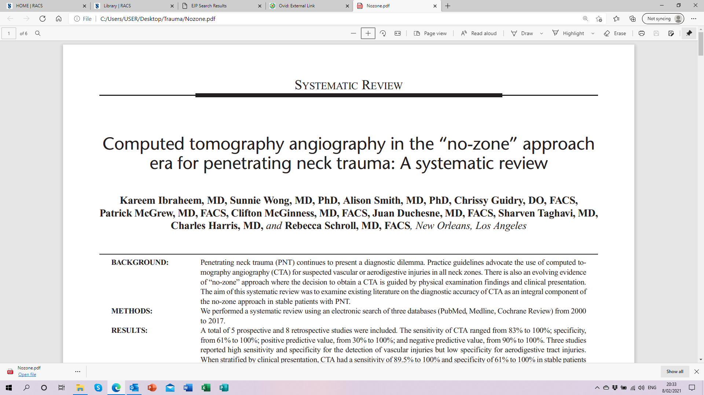
J Trauma Acute Care Surg. 2020;89: 1233–1238

Slide 12
This is the first systematic review to examine the role of CTA in PNT.
In combination with physical examination, CTA demonstrated a reliable high sensitivity and specificity for detecting injuries in PNT in stable patients with soft signs of injury and select patients with hard signs of injury.
Unstable patients with hard signs should always undergo immediate neck exploration.
The results of this review support the management of PNT using no-zone approach based on physical examination and the use of CTA in stable patients

Slide 13
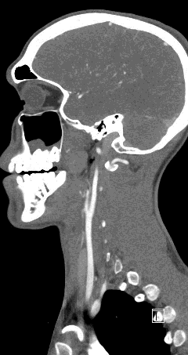
Diagnostic accuracy of CTA
  Sensitivity 85-100%
  Specificity 95-100%
  PPV 85-100%
  NPV 98-100%

Slide 14
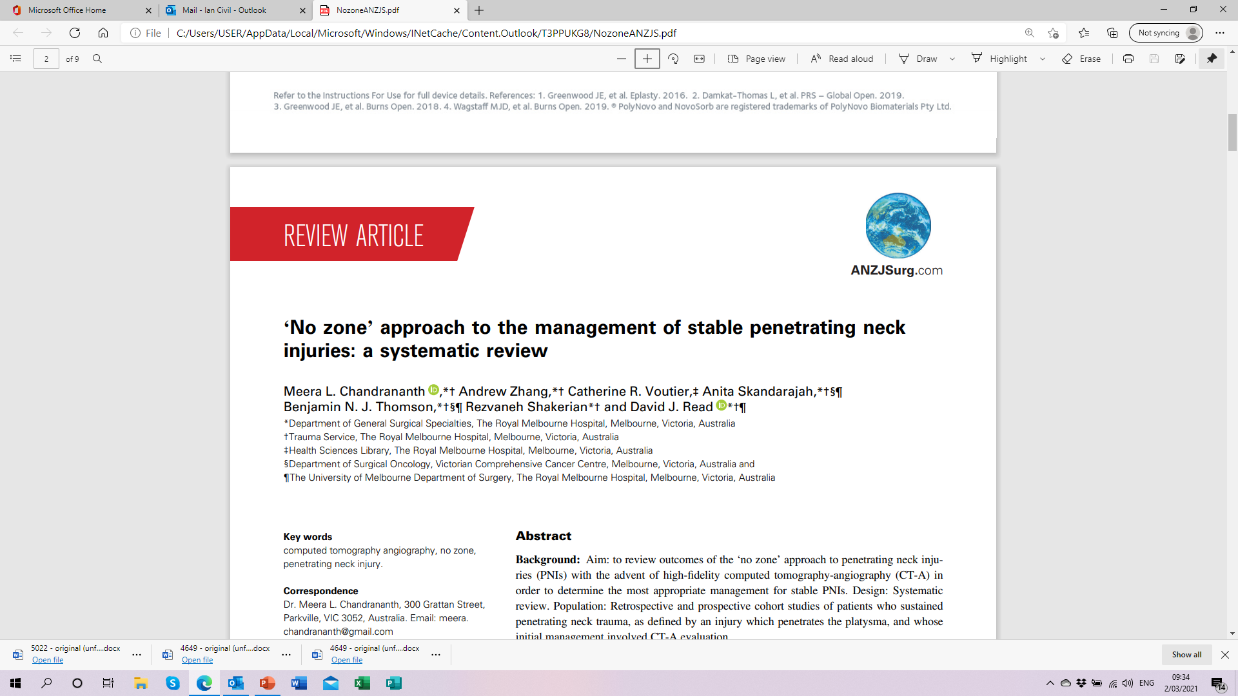
Accepted for publication 5 January 2021. doi: 10.1111/ans.16600

Slide 15
This systematic review provides level 2A evidence that the ‘no zone’ approach to PNI management through the use of highly sensitive and specific CT-A imaging coupled with thorough clinical examination is a safe algorithm, which reduces rates of negative neck exploration.
Clinical assessment remains important for stratification of patients into hard, soft and asymptomatic groups, with some allowance for clinician discretion with regards to haemodynamically stable patients with hard signs, and asymptomatic patients with a high impact mechanism or concerning features.

Slide 16
But who is safe to have a CTA?
Patients with soft signs
Stable patients with hard signs
SO…..
What are hard and soft signs?
Hard signs
  Pulsative haemorrhage
  Expanding haematoma
  Bruit/thrill
  Absent pulses
  Extremity ABI<0.9
Soft signs
  History of haemorrhage
  Wounds and unexplained haemorrhagic shock
  Neurologic deficit
  High risk fx, dislocation or proximity wound

Slide 17
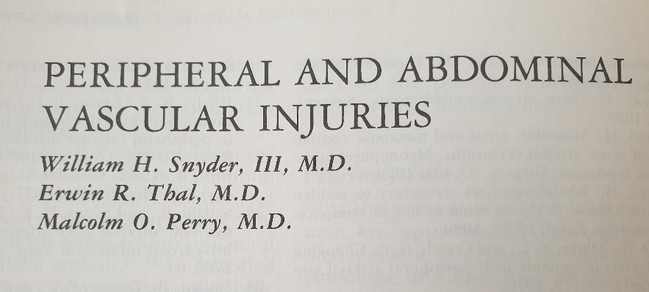
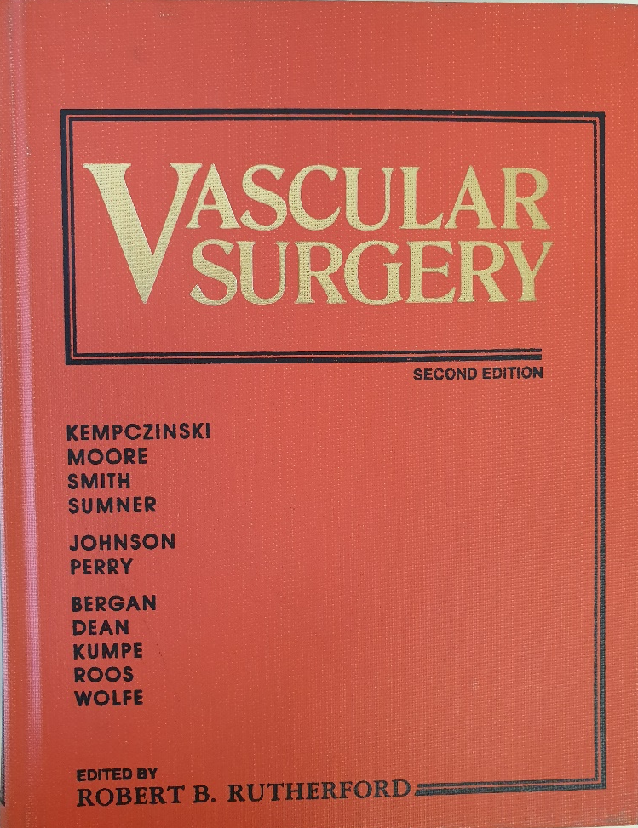
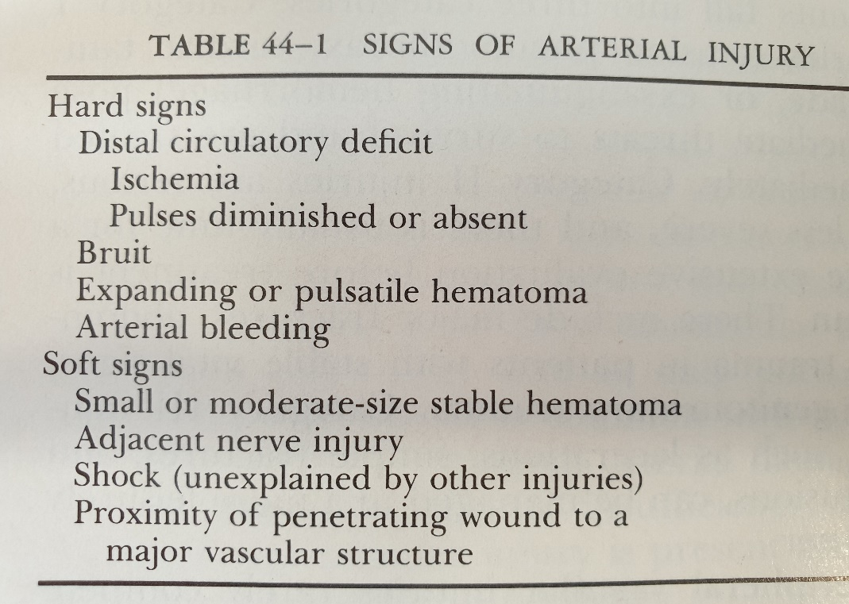
Hard signs versus soft signs

Slide 18
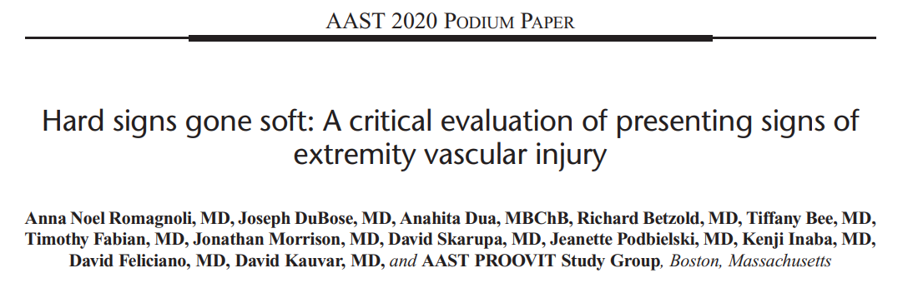
(J Trauma Acute Care Surg. 2021;90: 1–10)
In the era of readily available CT imaging, using hard and soft signs as a decision-making strategy is outdated
These signs do not provide a useful clinical distinction and a strategy of using haemorrhagic and ischaemic signs of vascular injury is of far greater utility

Slide 19
Haemorrhagic and Ischaemic signs
Haemorrhagic signs
  Hemorrhage
  Expanding hematoma
  THESE PATIENTS NEED TO GO TO THE OR
Ischaemic signs
  Absent or diminished pulses
  Neurologic deficit
  THESE PATIENTS CAN HAVE CT
Hard signs
  Pulsative haemorrhage
  Expanding haematoma
  Bruit/thrill
  Absent pulses
  Extremity ABI<0.9

Slide 20
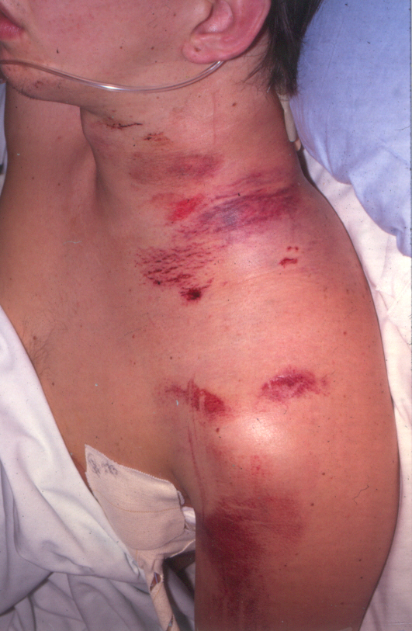
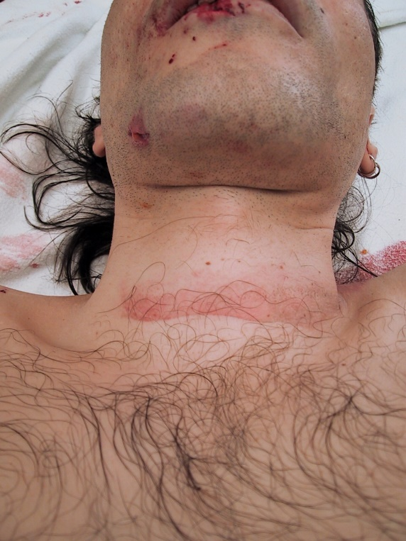
Blunt neck trauma
Apart from cervical spine injuries the potential is for
  BCVI
  Laryngeal injury
  Pharyngeal injury
  Oesophageal injury

Slide 21
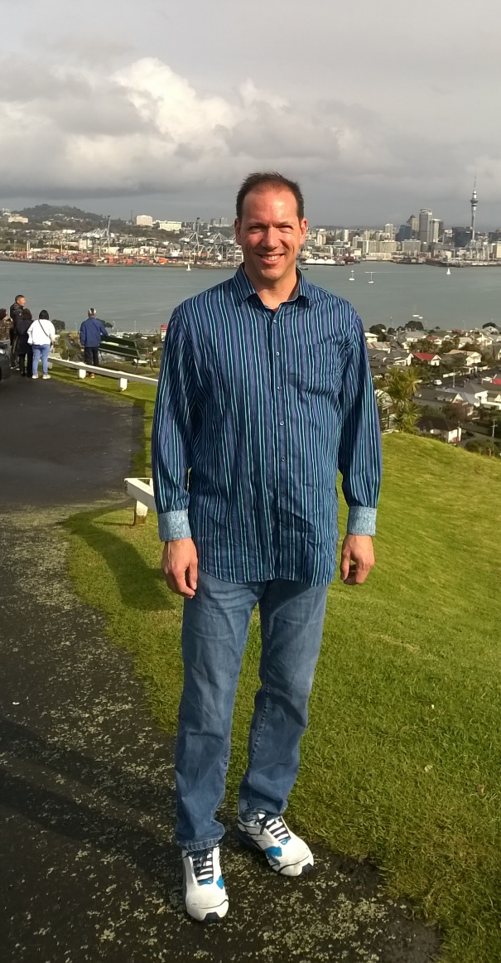
The new Denver Health Medical Center BCVI screening guideline.
Risk Factors for BCVI
  High energy transfer mechanism associated with:
    Displaced mid-face fracture (LeFort II or III)
    Mandible fracture
    Complex skull fracture/basilar skull fracture/occipital condyle fracture
    CHI consistent with DAI and
    GCS < 6
    Cervical subluxation or ligamentous injury, transverse foramen fracture, any body fracture, any fracture C1-3
    Near hanging with anoxic brain injury
    Clothesline type injury or seat belt abrasion with significant swelling, pain, or altered MS
    TBI with thoracic injuries
    Scalp degloving
    Thoracic vascular injuries
    Blunt cardiac rupture

Slide 22
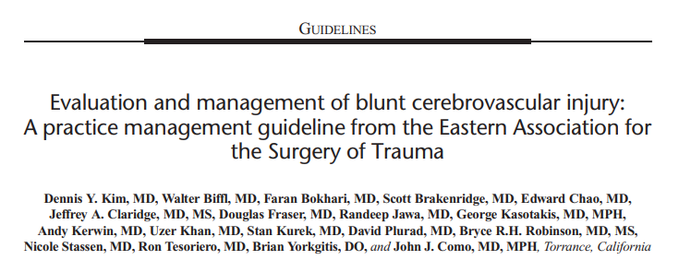
(J Trauma Acute Care Surg. 2020;88: 875–887)

Slide 23
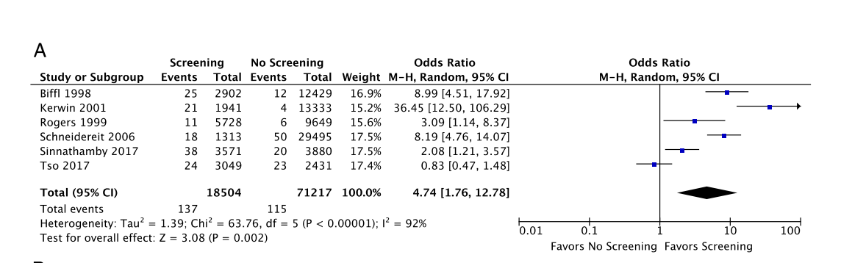
Screening or not for detection of BCVI?
With no screening protocol 0.2%, with screening protocol 0.7% OR 4.74
Note old studies. Current accepted incidence with effective screening 1.6-2%

Slide 24
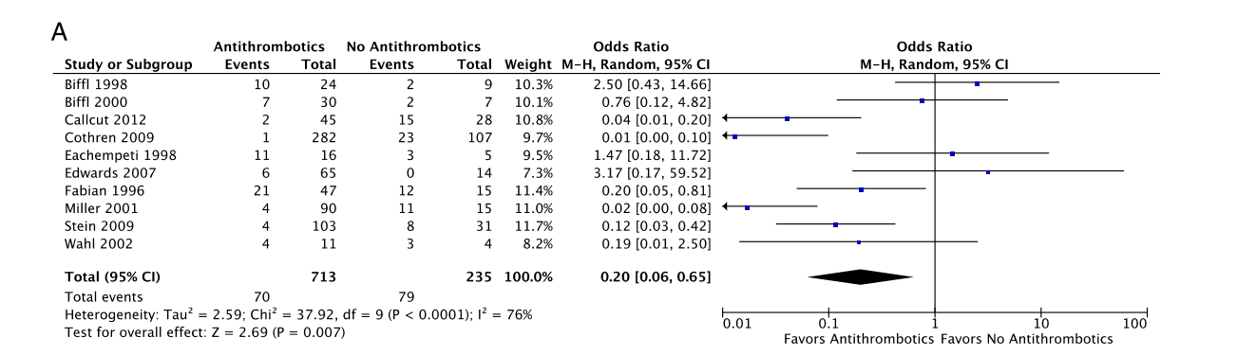
Antithrombotic therapy or not to prevent stroke?
Strokes in 79/235 (33.6%) vs 70/713 (9.8%) RR 0.2

Slide 25
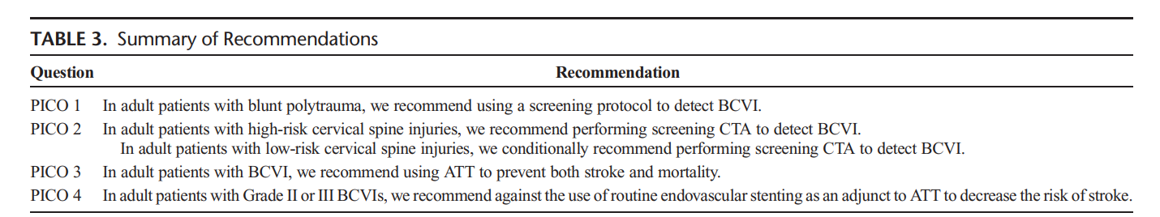
Recommendations

Slide 26
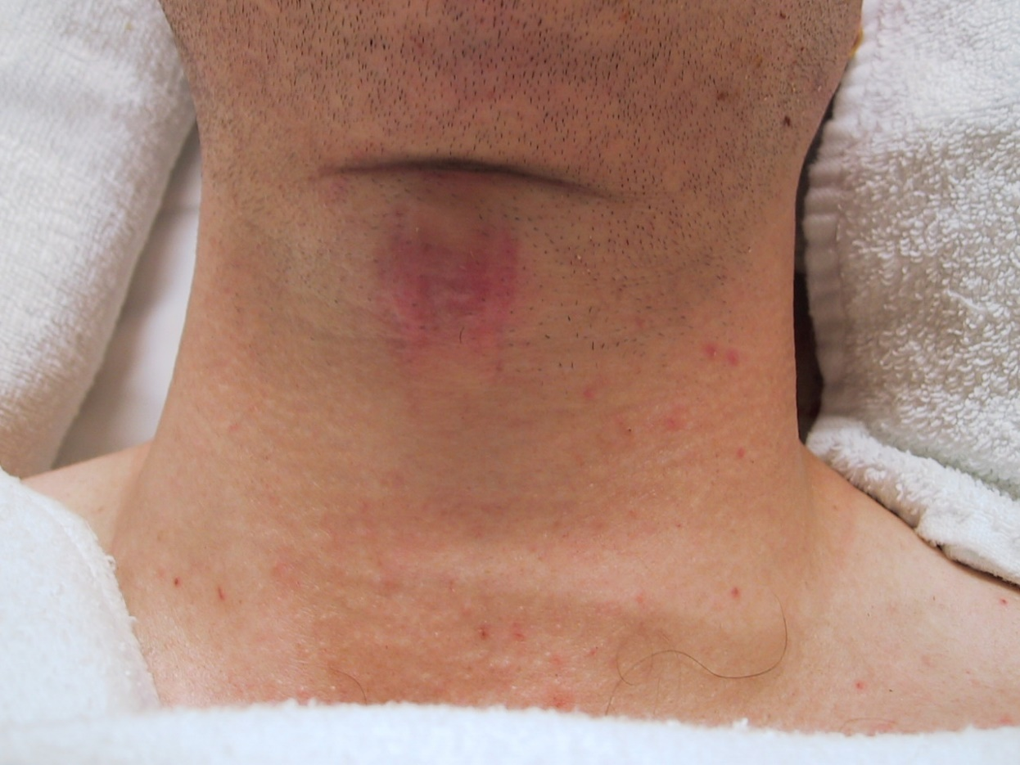
Laryngeal trauma
Has the patient got an airway problem?
Have they got a hoarse voice?
Even if initially normal, problems may develop over 24hrs

Slide 27
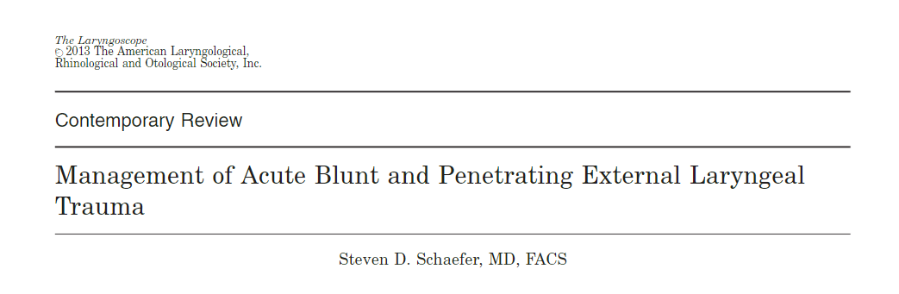
Laryngoscope, 124:233–244, 2014

Slide 28
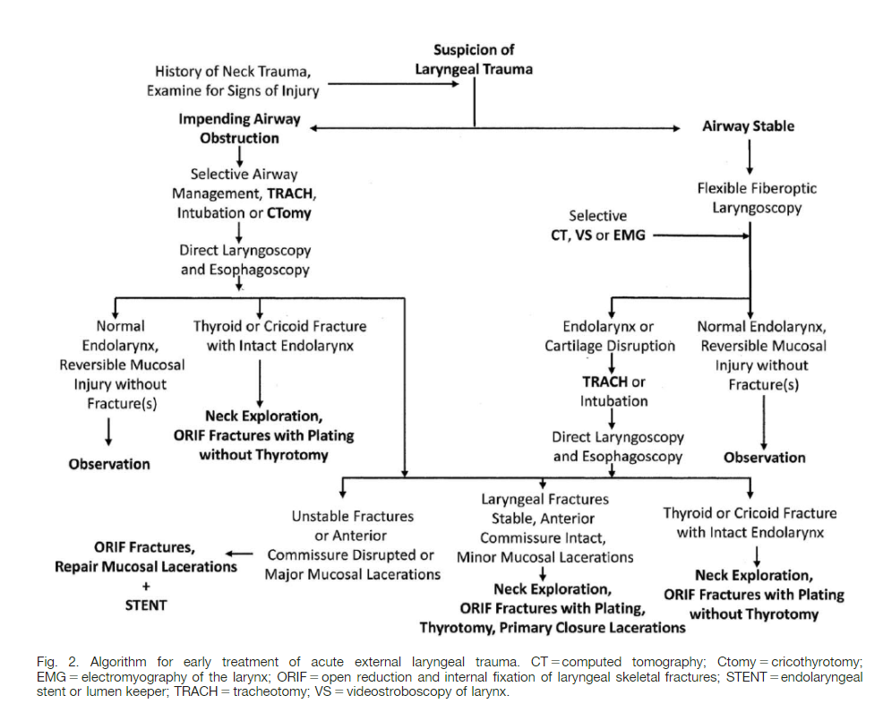

Slide 29
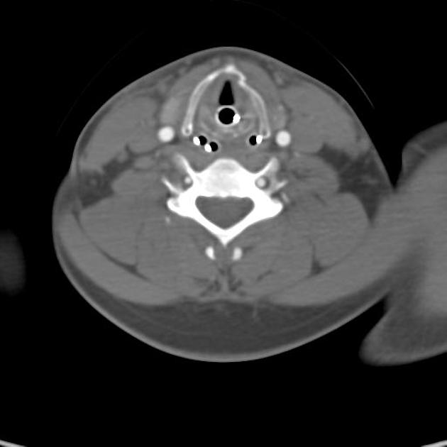
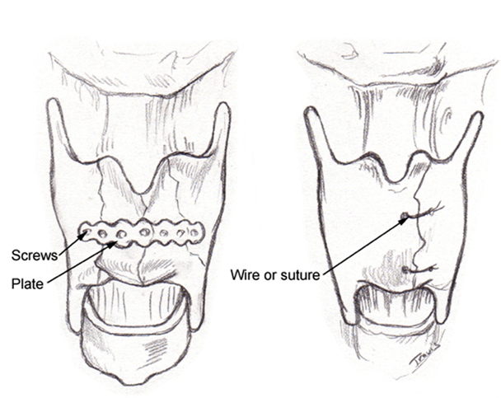

Slide 30

Pharyngeal and oesophageal trauma
Blunt pharyngeal or oesophageal injury
Penetrating pharyngeal or oesophageal trauma
  Usually iatrogenic
  Follow the trajectory
  Other injuries usually determine approach
  Repair and drain

Slide 31
