Slide 1
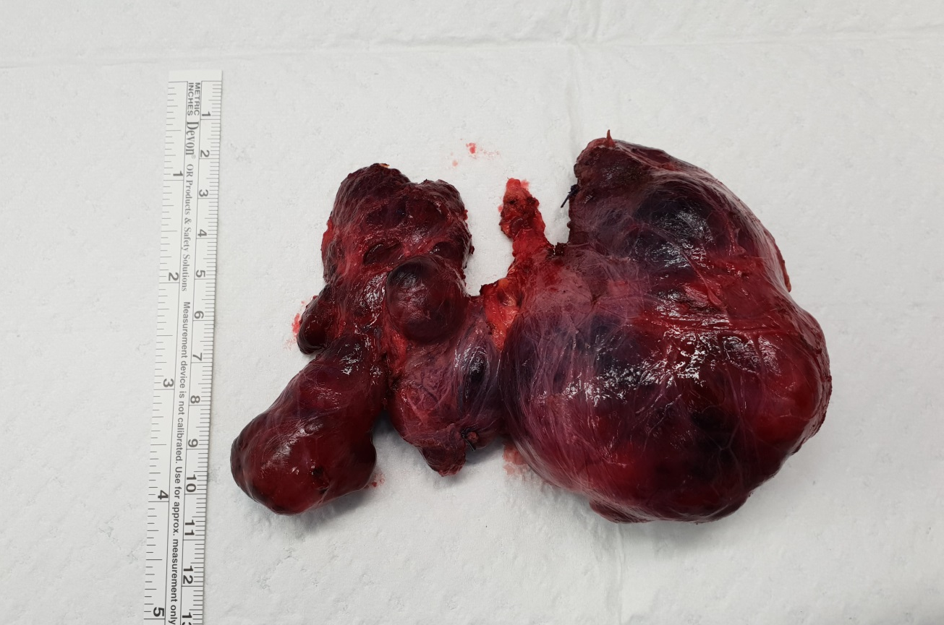
What is this Operative specimen?
What pathology it demonstrate?

Slide 2
What are the indications for total thyroidectomy?

Slide 3
What are the possible complications associated with Total Thyroidectomy ?

Slide 4
Describe the course of the recurrent laryngeal nerve.

Slide 5
How would you deal with a post Op bleeding

Slide 6
What is the incidence and what are the symptoms and signs of hypocalcaemia?
How would you treat it?

Slide 7
What is the incidence and types of thyroid cancer?

Slide 8
What are the features suspicious for thyroid malignancy

Slide 9
What are the risk factors for thyroid cancer?

Slide 10
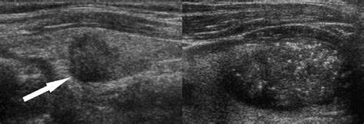
Describe this lesion in the left thyroid of a 32 year old female.
How would you further assess the lesion above?

Slide 11
What are the thyroid cancer diagnosed by an FNA?
And which can not be diagnosed with FNA ,… why?

Slide 12
Back to the 32 Y old female with thyroid lesion.
- Ultrasound demonstrated no abnormal nodes.
- FNA performed, showed Bethesda 4.
What is the Bethesda Classification?

Slide 13
How would you manage that patient ?

Slide 14
Hemithyroidectomy demonstrated a 1.5cm Papillary thyroid cancer.
How would you proceed?

Slide 15
A 60 Y old patient with 3.5 cm lesion right thyroid with 3 ipsilateral enlarged Lymph nodes.
FNA Bethesda 6
How would you proceed?

