Slide 1
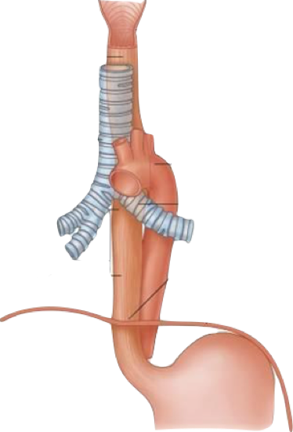
Question 1
a. What is the length of the oesophagus?
b. Where are the points of narrowing?
c. What muscle types make up this structure?

Slide 2
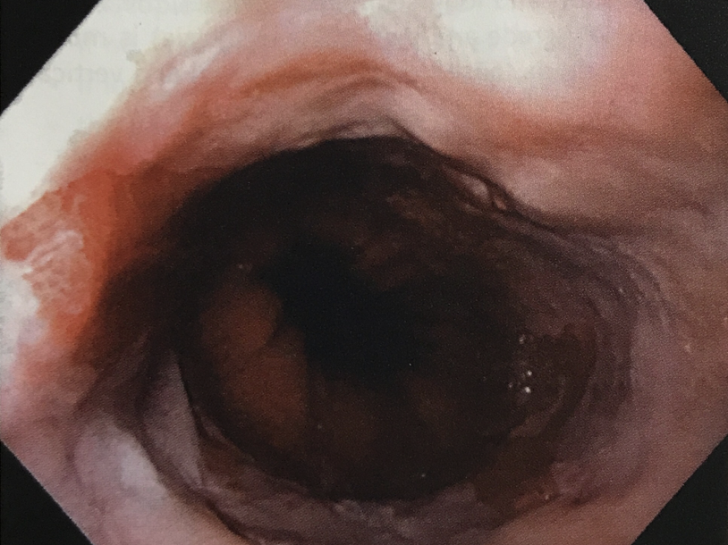
Question 2
This is an endoscopic view of a 60-year-old man’s distal oesophagus. He reports a history of reflux symptoms for many years. Please describe the picture.

Slide 3
Question 3
How do you define Barrett’s oesophagus?

Slide 4
Question 4
What is the difference between the Z-line and the gastro-oesophageal junction (GOJ)?

Slide 5
Question 5
What are the risk factors for Barrett’s?

Slide 6
Question 6
How would you perform biopsies for Barrett’s?

Slide 7
Question 7
How would you treat this patient?

Slide 8
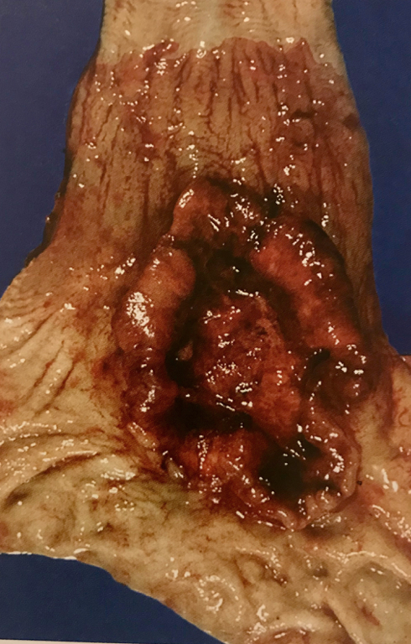
Question 8
This specimen was resected from a 70 year old man with dysphagia on a background of worsening symptoms of reflux.
Please describe the picture.

Slide 9
Question 9
What are the risk factors for oesophageal
SCC
adenocarcinoma?

Slide 10
Question 10
How would you treat a patient with lower oesophageal cancer?

Slide 11
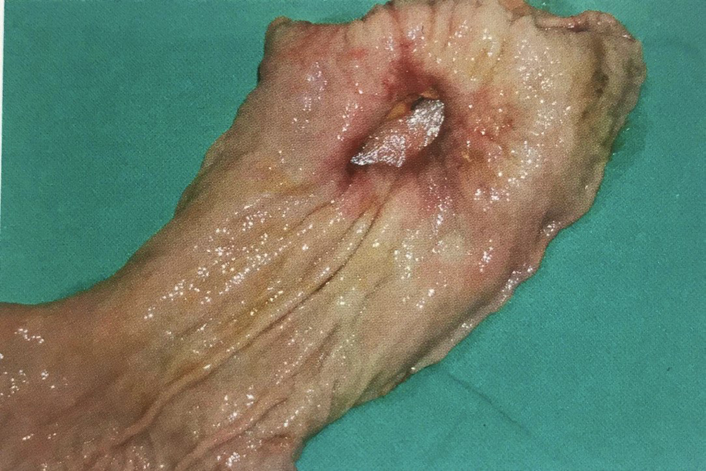
Question 11
Describe this photo. What are the differentials?

Slide 12
Question 12
What is the treatment of a perforated gastric ulcer?
How is it different from perforated duodenal ulcer?

