Slide 1
Presentation Skills
NZAGS Training day
26 August 2022

Slide 2

“ The human brain starts working the moment we are born, and stops the moment we stand to speak in public”
Sir George Jessel

Slide 3
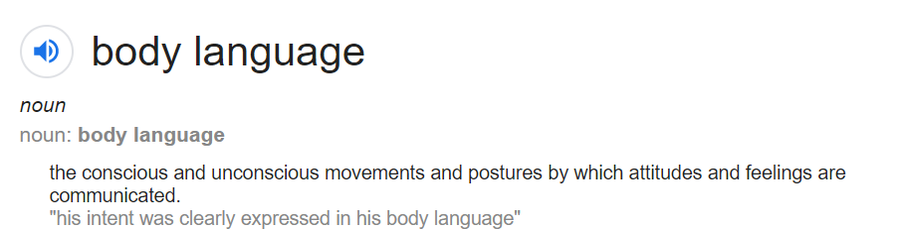
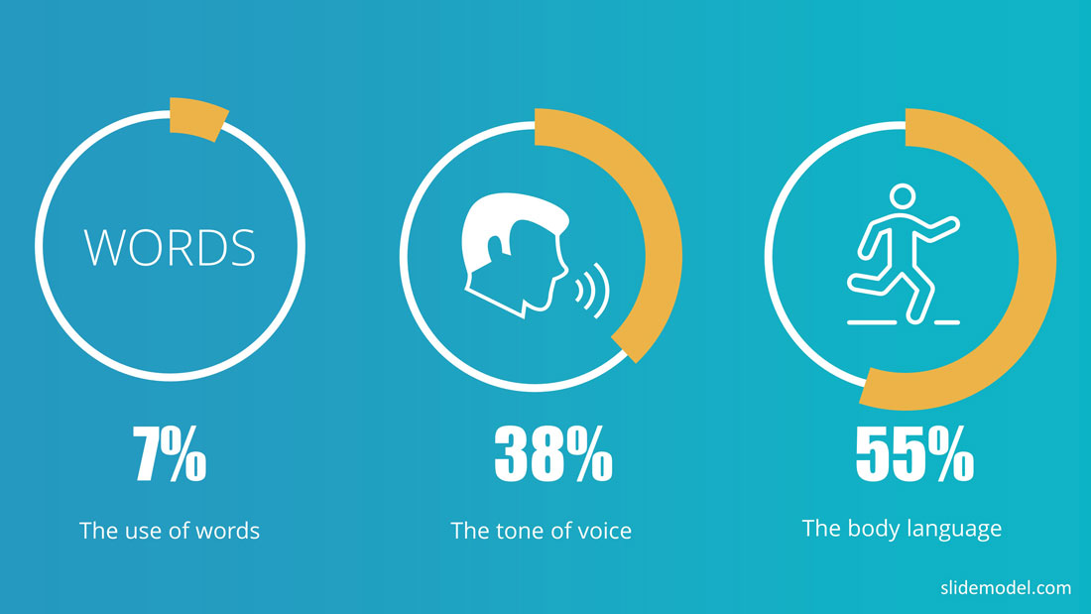
Albert Mehrabian
Notes:
Comm 1

Slide 4
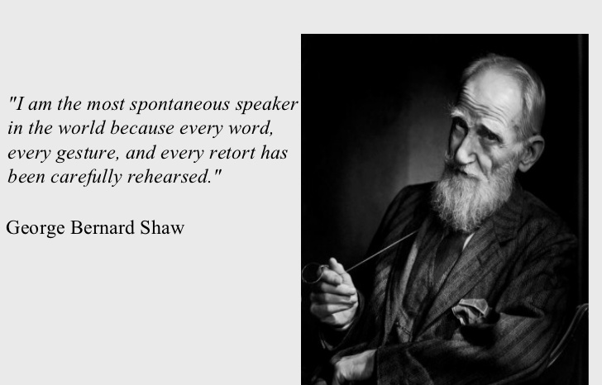

Slide 5

Prepare, Practice, Present.

Slide 6

Start with the Why (the hook)

Slide 7

Know your audience
Notes:
Their Needs
Level of knowledge
Their attitude twds the subject – protagonists and antagonists
What they want out of this

Slide 8

Say what you’re going to say, say it, say what you’ve said

Slide 9

Practice with clock counting up.
Practice with clock counting down.
Notes:
The first few times, rehearse with the clock counting up. That’s because if you go over, you need to know how much you’re over.

Slide 10

Rule of 3’s
Barack Obama’s Inaugural Speech
Homes have been lost; jobs shed; businesses shuttered.
Notes:
Information presented in a group of three sticks in our head better than other groups

Slide 11

Know your key takeaways
And be prepared to get them across at short notice!

Slide 12

Questions
During or at the end

Slide 13

Use the Car Park for off topic topics

Slide 14
When using bulleted lists…
Use one concept per slide
Emphasise key words and phrases
Use font types and sizes consistently (make sure the text can be read form the back of the room)
6 bullet points per page (max)

Slide 15

Attending College
Overall, our findings provide a combined retention rate of 92.4% for students who attended TCO. This is very close to the previous year's rate of 92.45%. It should be noted that these results should be interpreted on a tentative basis as it is clear that a number of other outside factors impact on a student's ability to sustain and progress in their chosen area of study at third level.
15,000 students .come to Trinity every year There are 3 Faculties
Morgan 2001 A study of non-completion in undergraduate University courses
The average non-completion rate across Irish Universities is 16.8%
Improve all students chances of achieving their maximum potential
Connect with students - building relationships, departmental receptions
51% of college students leave college because of lack of effective supports

Slide 16

51% leave college because of lack of supports

Slide 17
51%

Slide 18
Visualise!
Notes:
Visualise the prefect scenario .. You are confident, know your content, the audience are receptive, smiling and nodding etc

Slide 19
Notes:
Comm 1

Slide 20


On the Move
Don’t sit if you can help it
Straighten yourself from feet up
DO NOT unnecessarily adjust your clothes when you stand up
DO NOT adjust stuff on your desk/shift your chair
DO NOT look at the floor as you walk to the front
Maintain eye contact from getting up to reaching your spot
Walk with right arm left leg swing pattern
Arrive at your spot before you start speaking
Stand front and centre of the room - The Power Position!

Slide 21






On the Move
Don’t sit if you can help it
Keep your head up as you walk to the front
Walk with right arm left leg swing pattern
Maintain eye contact from getting up to reaching your spot
Straighten yourself from feet up
Arrive at your spot before you start speaking
Stand front and centre of the room - The Power Position!
Adjust your clothes [unnecessarily] when you stand up
Adjust stuff on your desk/shift your chair

Slide 22
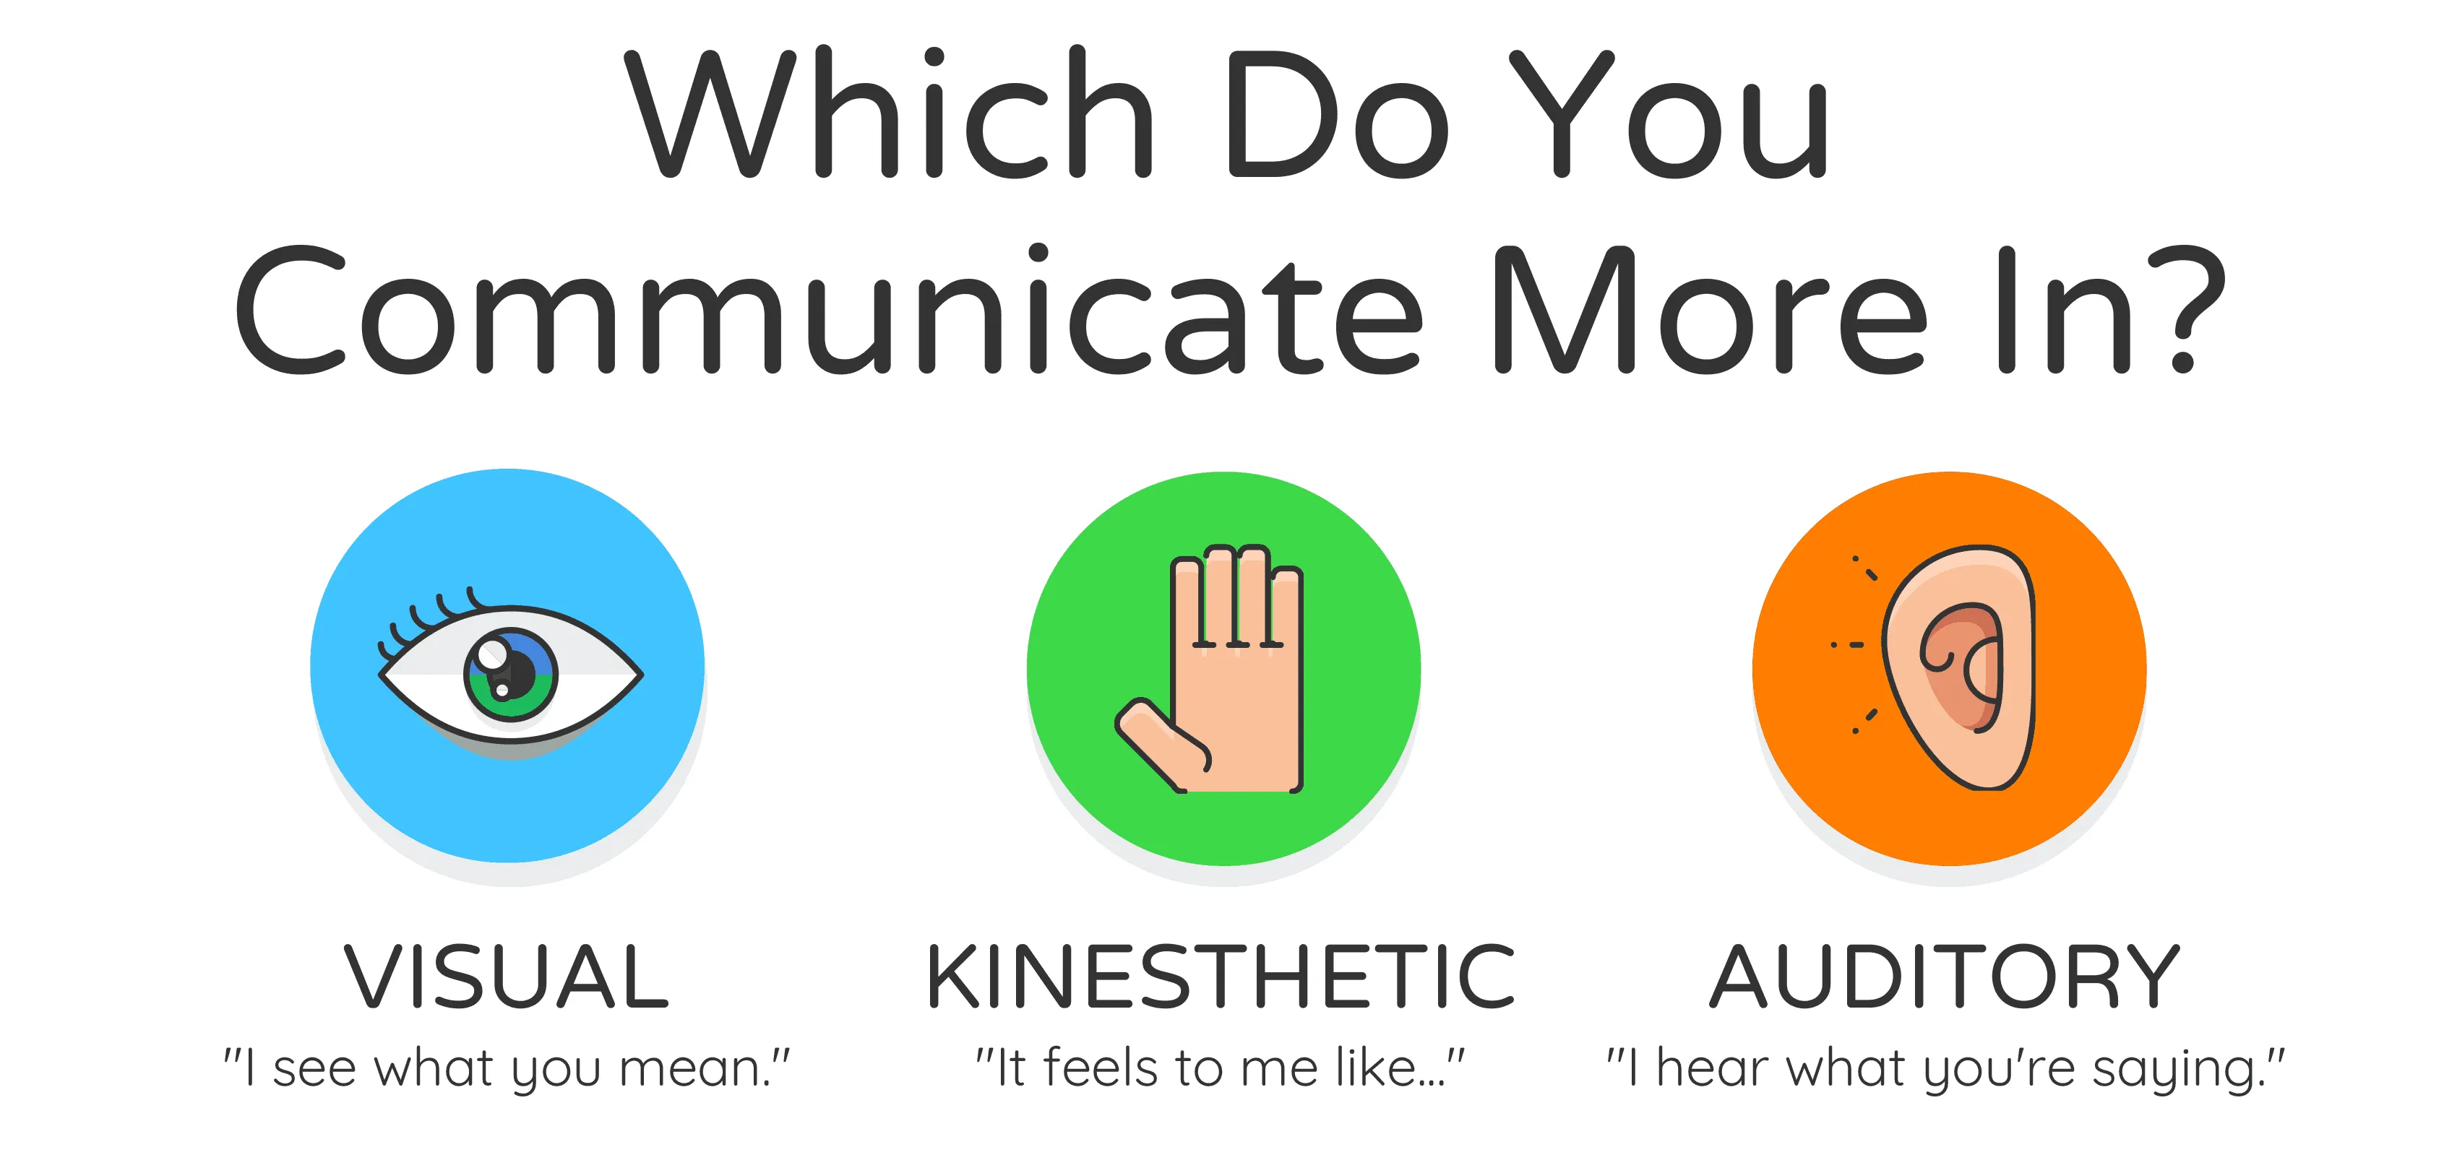
Acknowledging your audience’s preferences
VAKs

Slide 23

On Stage: Positioning
Front on = Facilitator; Side on = safe position
Do not lean in – maintain upright posture
Avoid Burmuda triangle. Try asymmetric hands
Both feet grounded - parallel hip width apart
Head forward

Slide 24

On Stage: Gestures
Do not cover or cross your body
Elbows away from body with arms out wide. Not T Rex, penguin or headlamps!
Arms gesture low to high - Air is guided by your arms
Palms always open and facing up
Avoid arms behind your back

Slide 25
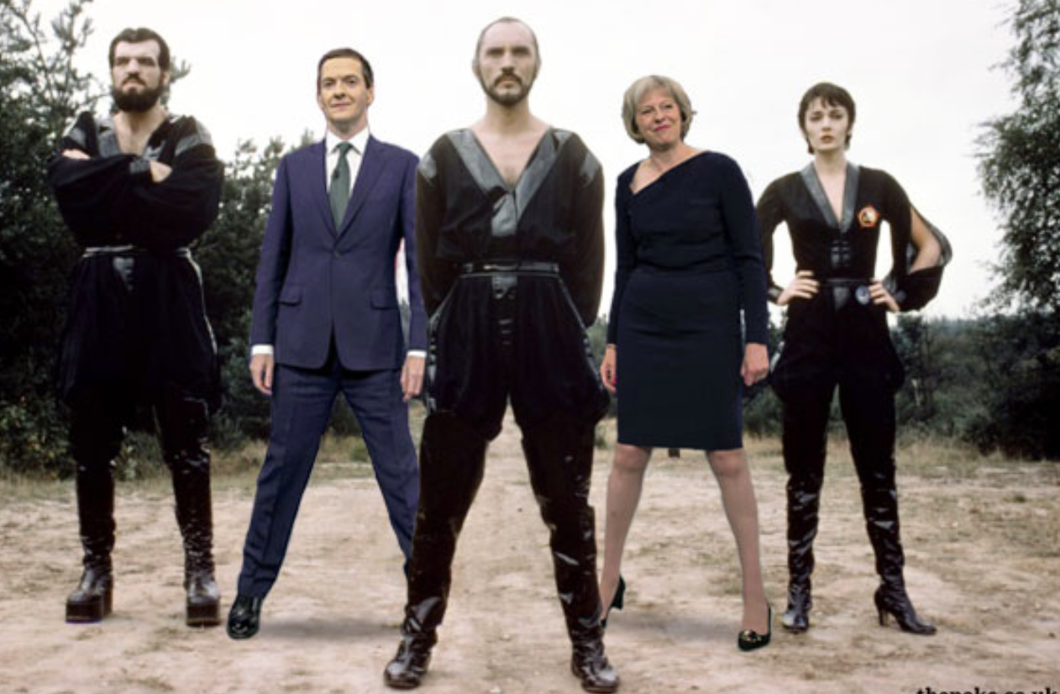

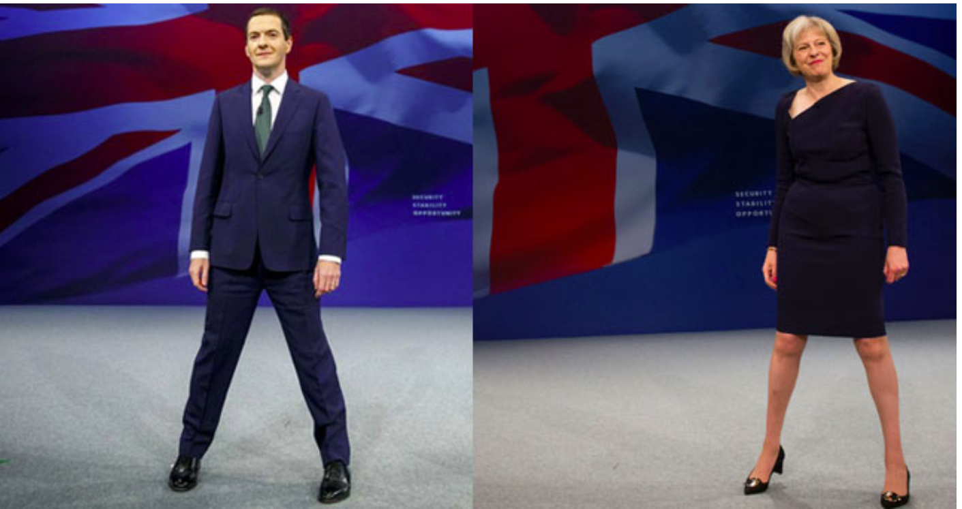
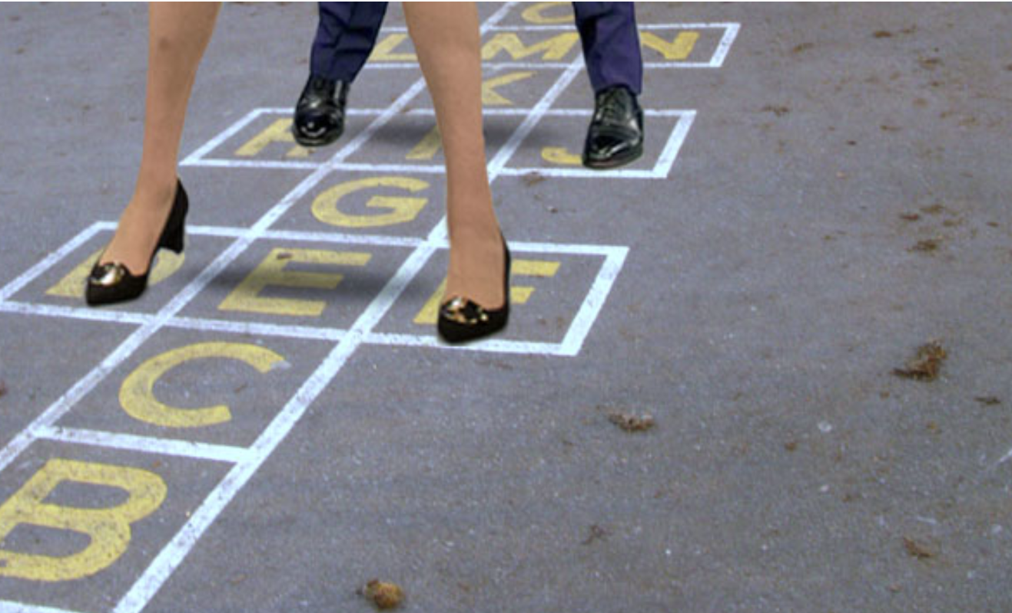
Notes:
George Osborne and Thersa May

Slide 26

Direct the audiences attention
Touch, Turn, Talk

Slide 27
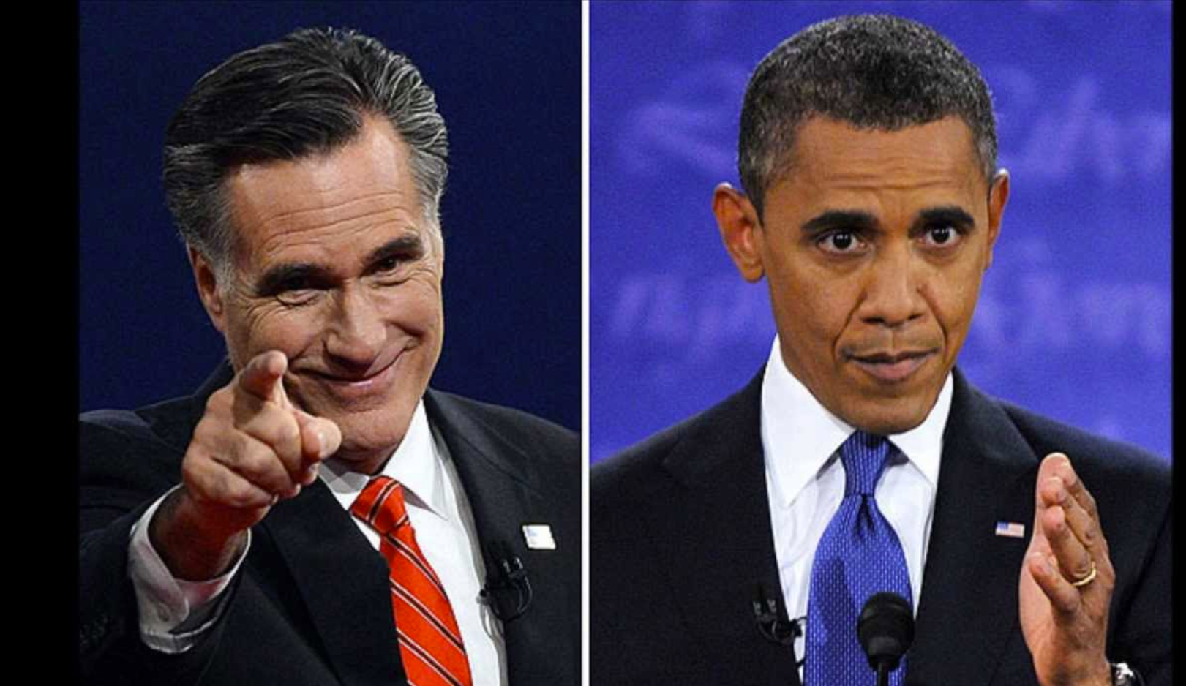
Notes:
How not to point at your audience - aggresive

Slide 28
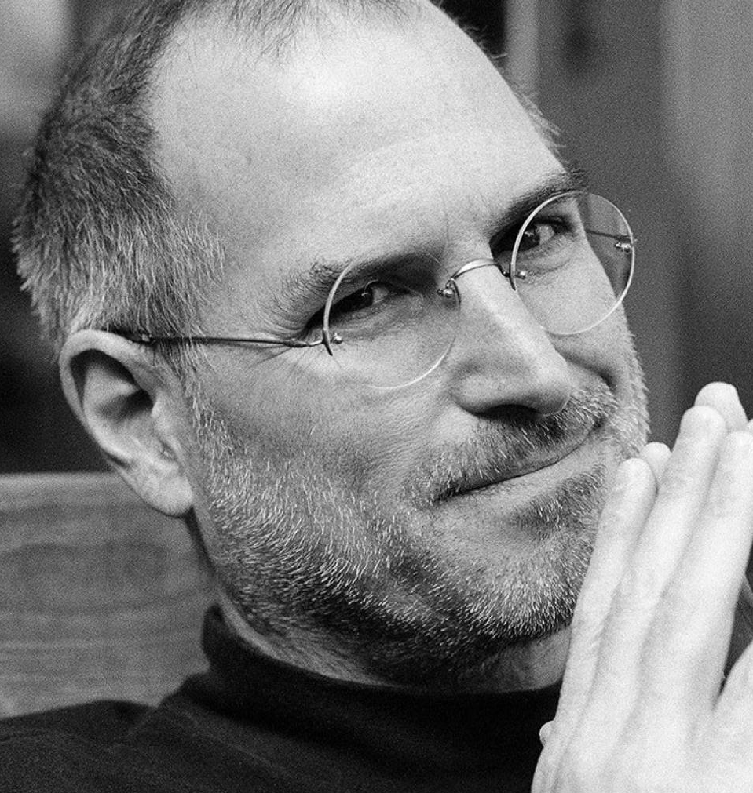
Notes:
Hands in power position known as the steeple

Slide 29
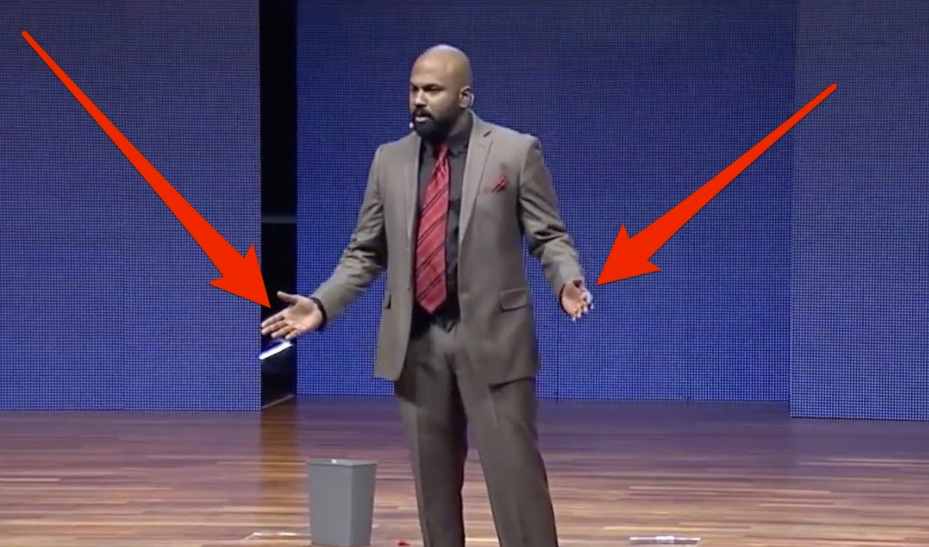

Slide 30
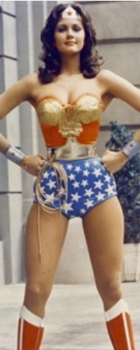
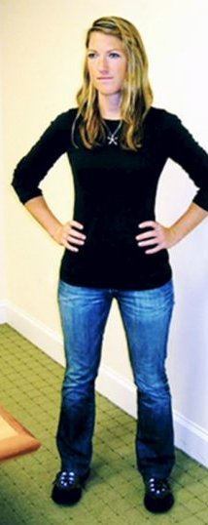
Notes:
Cuddy writes: “Body-mind approaches such as power posing rely on the body, which has a more primitive and direct link to the mind, to tell you you’re confident.”
Power posing is an example of what Cuddy calls a “body-mind nudge.” Body-mind nudges, she argues, allow you to skip over psychological stumbling blocks like trying to believe that you’re awesome, confident, and perfect, when you clearly don’t believe that at all — at least not right now.
In the book, Cuddy puts power posing in the broader context of what she calls “self-nudges,” or small tweaks to your body language and mindset that can produce psychological and behavioural improvements in the moment. She borrows the term “nudge” from economists and psychologists who discovered about a decade ago that you can spark significant behaviour changes by nudging people in the right direction.

Slide 31


Slide 32

Dealing with nerves and managing state
Avoid breathing in, use the magic cough breath – tummy pushes in with sharp breath out to release your diaphragm
Move to facilitator position, out of the line of fire and engage the group

Slide 33

Have Fun!

