Slide 1
Burns Management
Dr Keith Towsey BMedSci, MBBS (Hons) FRACS AFRACMA
Burns and General Surgeon
Royal Brisbane and women’s Hospital

Slide 2


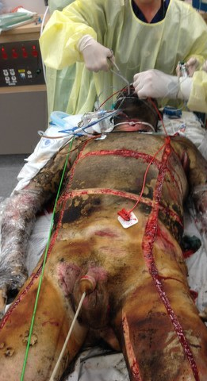



Burns Incidence
Approx 6000 burns admissions within Australia every year
  Approx 1% of all hospital presentations
  2.2% mortality
55% occur at home
20% at work
13% MVA
11% leisure related
Men 74% of presentations
  20% under age 20
  53% age 21-40
  19% 41-60
  8% >61

Slide 3
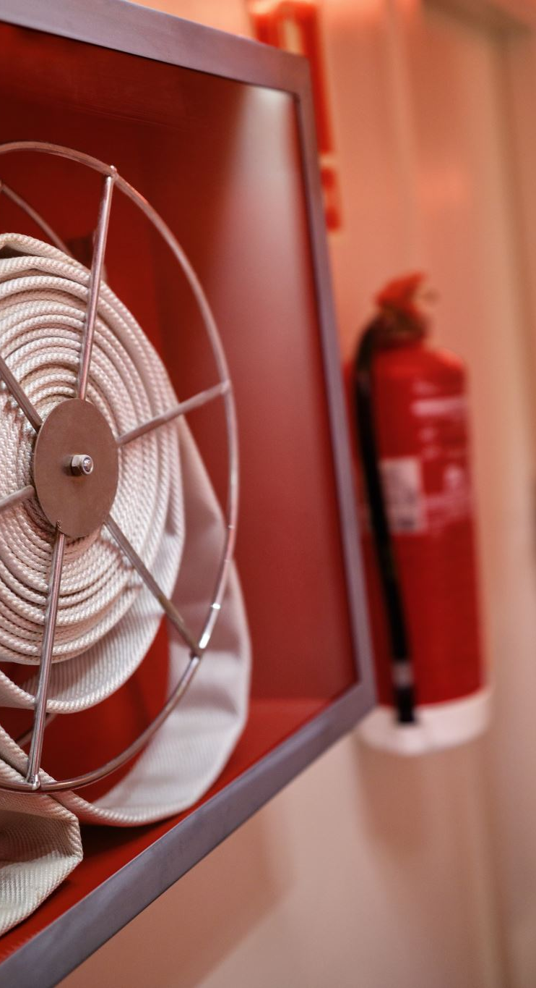
Burns Aetiology
Flame 56%
Hot water 26%
Oil 11%
Contact 9%
Chemical 5%
Electrical 2%
Friction and flash 1% ea
15% will have inhalation injury, 81% will need intubation

Slide 4
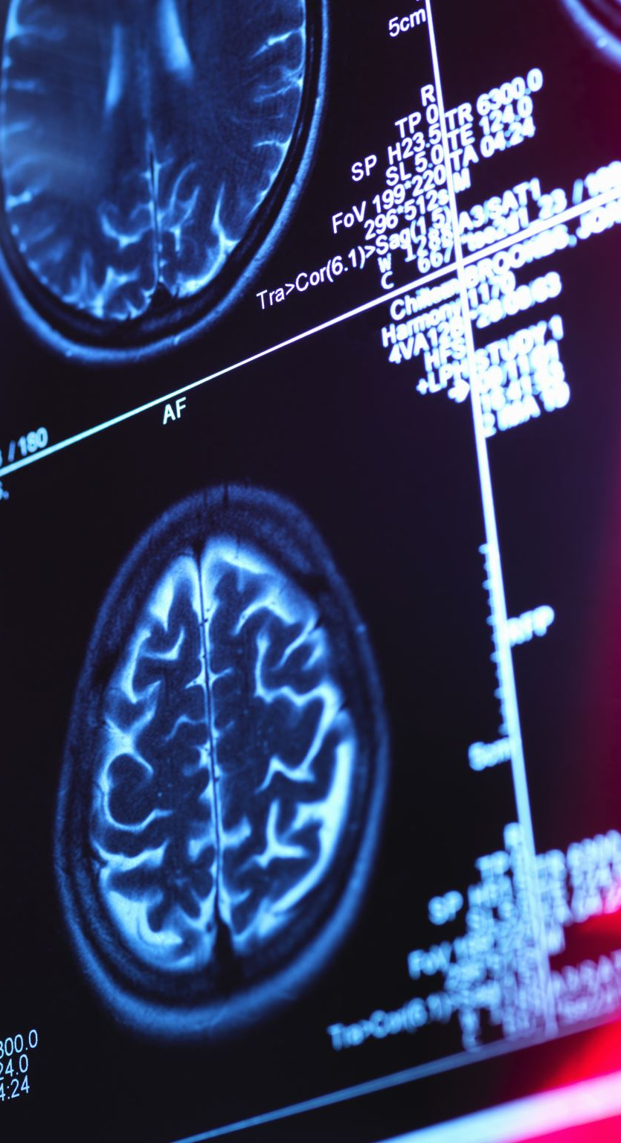
Burns Aetiology
Co morbidities
  Mental illness 9%
  Chronic disability 4%
  Diabetes 1%
  Epilepsy 1%

Slide 5
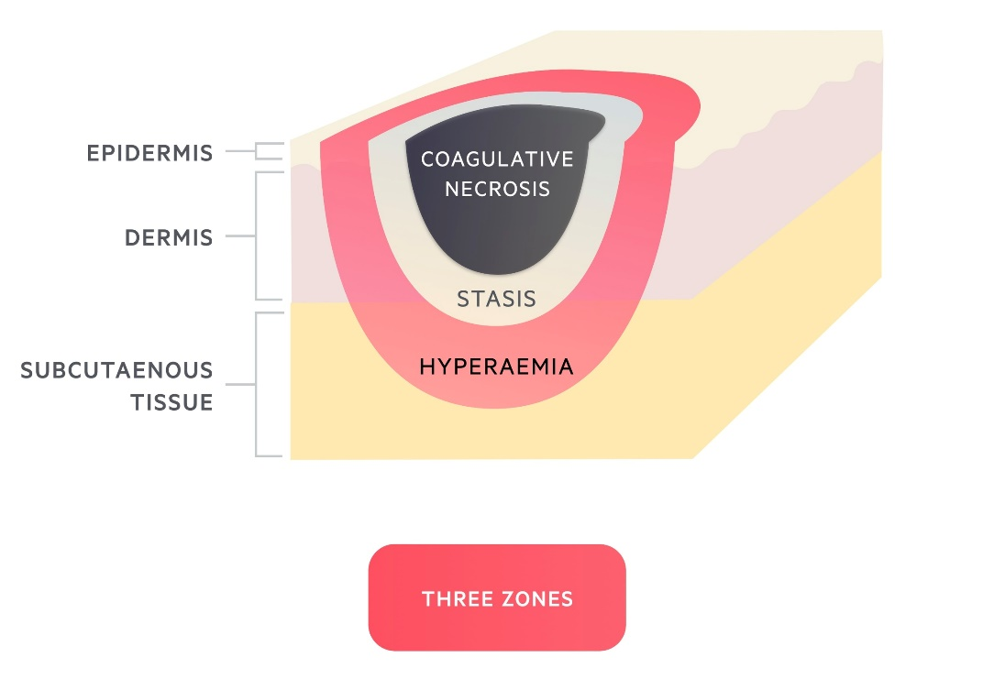
Burns Pathophysiology
Necrosis of epidermis and underlying tissue
Extent dependant on length and temperature of exposure
Three zones of tissue injury
  Zone of coagulation
    Irreversible tissue damage
  Zone of stasis
    Decreased tissue perfusion
  Zone of hyperaemia
    Vasodilatation secondary to inflammation

Slide 6
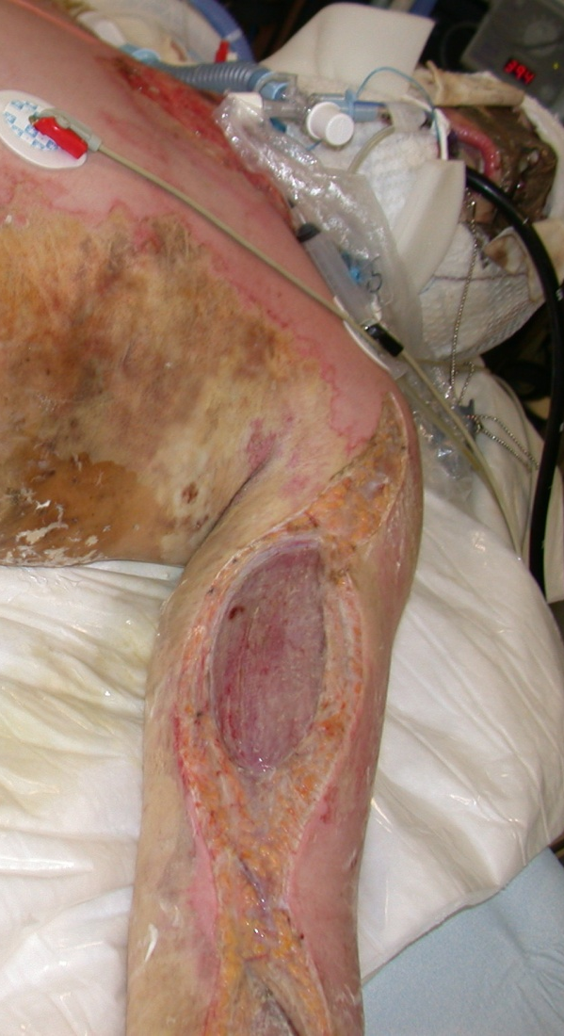
Burn Pathophysiology
Systemic Changes (burns >20% TBSA)
  Vascular permeability and oedema
  Immunosuppression
  Hyper metabolism
    Catecholamines
    Cortisol
    Gluconeogenesis/Peripheral lipolysis/Proteolysis
  Increased gut mucosal permeability
  Decreased renal blood flow
  Altered hemodynamic state

Slide 7
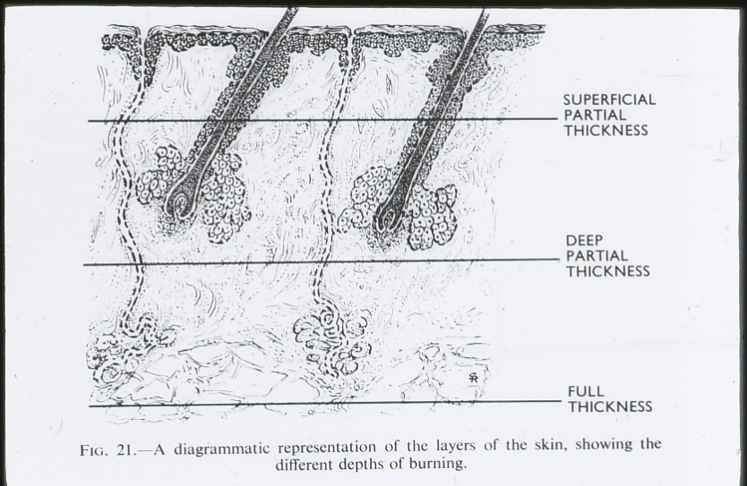
Burns Assessment
Depth

Slide 8
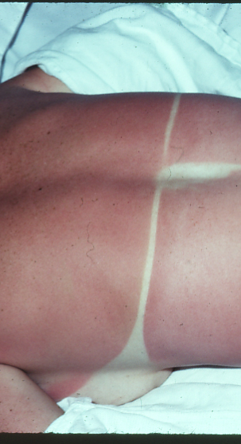
Burns Assessment
Epidermal burn
  Erythema, painful, no blistering
  Sunburn, needs no specialist treatment
  Doesn’t cause systemic response

Slide 9
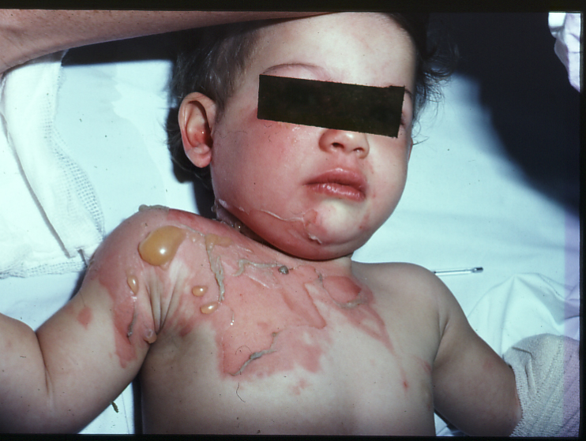
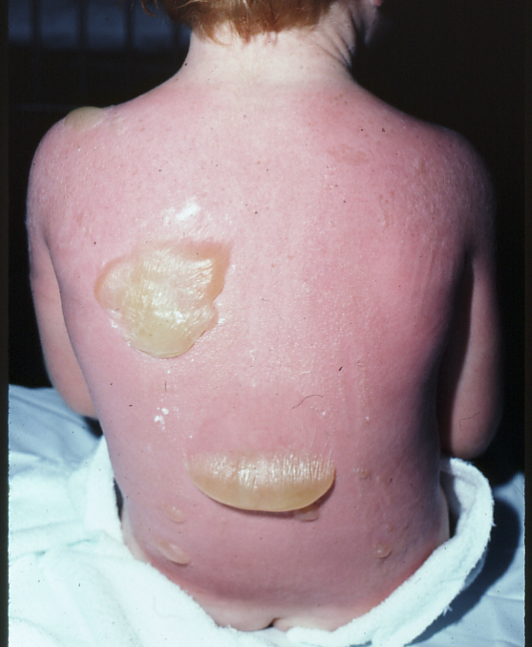
Burns Assessment
Superficial Dermal Burn
  Pale pink, painful, blisters, readily blanches
  Heals with minimal scar over 7-10 days

Slide 10
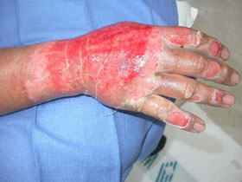
Burns Assessment
Mid Dermal Burn
  Salmon pink, punctuate haemorrhages, sl reduced sensation
  Sl sluggish cap return
  May have thick blisters
  Often will heal over 10-20 days, scar+/-

Slide 11
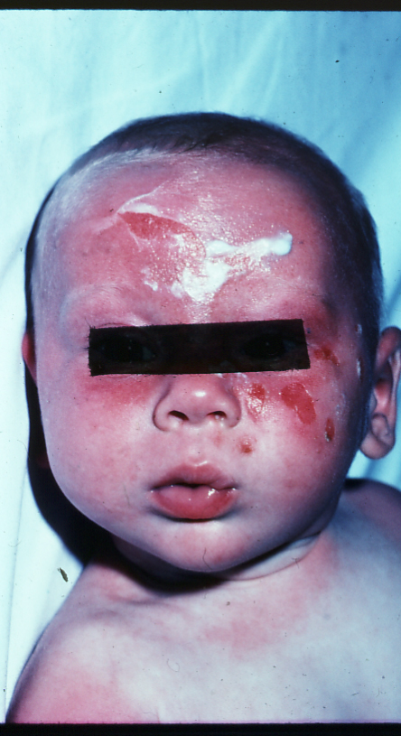
Burns Assessment
Deep Dermal Burn
  Blotchy red, poor capillary return,
  poor/absent sensation,
  usually needs surgery

Slide 12
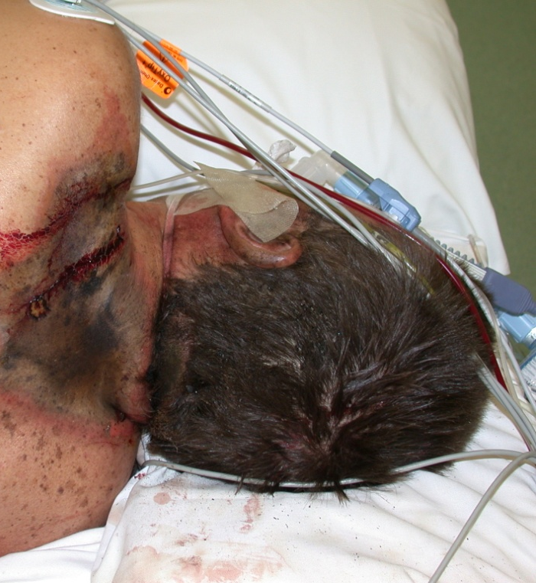
Burns Assessment
Full thickness Burn
  Leather skin
  White/black/charred
  Insensate/doesn’t blanch
  Almost always needs surgery

Slide 13
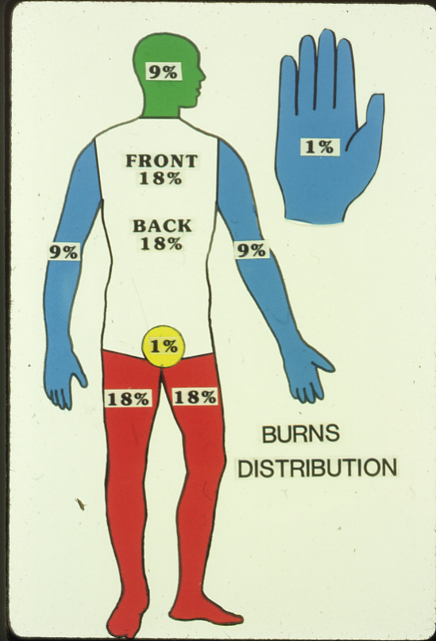
Burns Assessment
Burns Size
  Rule of Nines
    Palm of hand 1%
    Don’t include epidermal burn

Slide 14
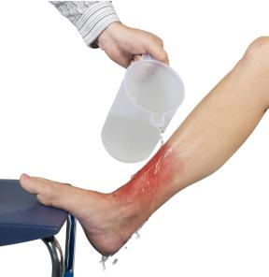
Burns Management
First Aid
  Stop the burning process
    Flame burns smother/roll
    Scalds remove clothes and jewellery
  Cool the burn surface
    Cool with room temp running water for 20 min (minimise zone of stasis)
    Should be done within 3 hours from time of injury
    Watch for hypothermia
  Dress the wound
    Chlorhex, saline or soap and water
    Wrap in cling-wrap

Slide 15
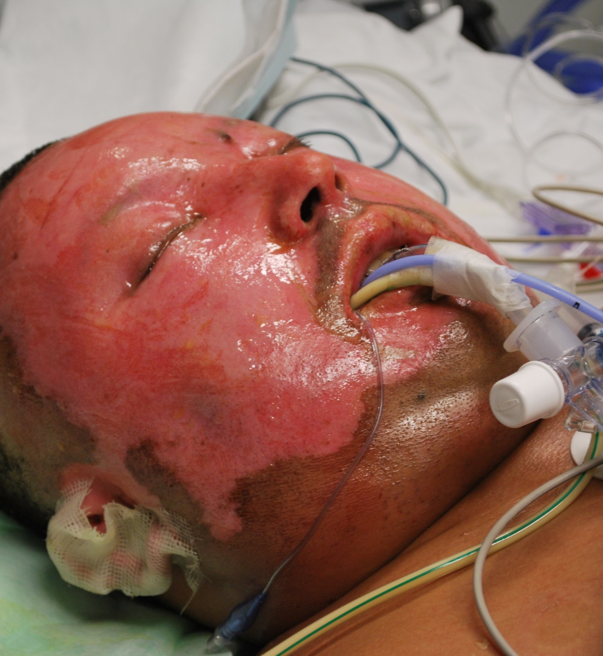
Burns Management
Initial resuscitation
  Depends on extent and depth of burn, causative agent and any associated injury (multitrauma)
ABCDE, secondary survey
Airway
  Inhalation injury
    Burns to face
    Hx enclosed space
    Singed nasal hairs
    Soot mouth/pharynx
    Hoarse voice
    Carbonaceous sputum
    SOB/stridor
    Hypoxia

Slide 16
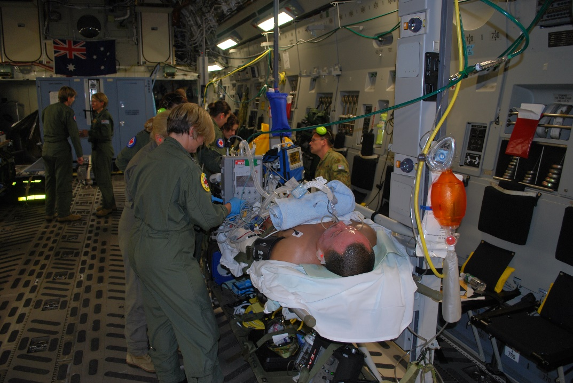
Burns Management
ABCDE
  Airway
    Consider early intubation if any of the above
  Breathing
    Tachypnoea
    Hypoxia
    Acidosis
    Carboxyhaemaglobin

Slide 17
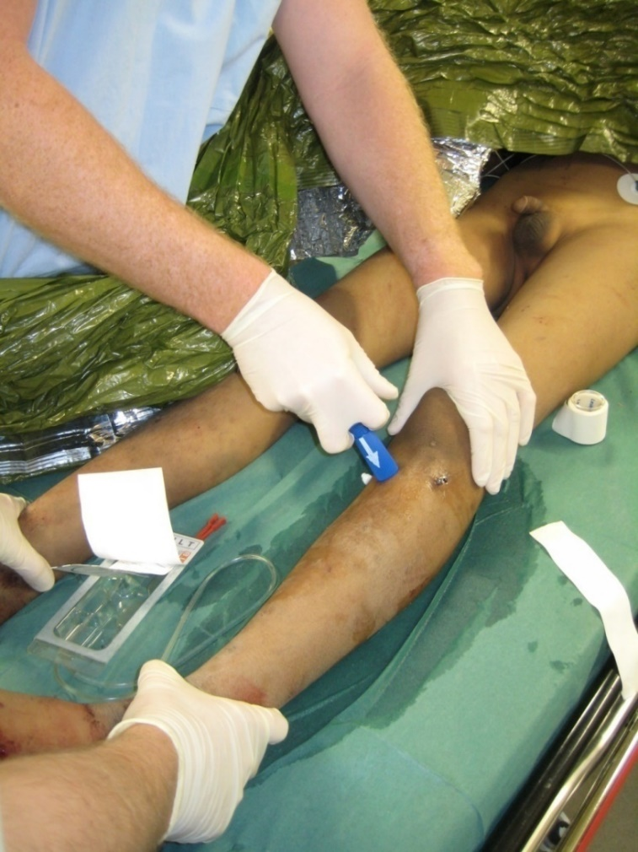
Burns Management
ABCDE
  Circulation
  2 large bore IVC
  Aggressive fluid resuscitation
    Tachycardia
    Hypotension
    IDC for burns >15-20%

Slide 18
Burns Management
Fluid Resuscitation
  Parkland Formula
    Guide only
    4ml/kg/%TBSA
    Volume to be given in the first 24 hrs from time of injury (not time of arrival in ED)
    Give half vol in first 8 hrs then rest over remaining 16 hrs
    Titrate to HR, UO, blood pH, CVP pressures

Slide 19
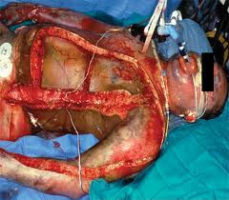
Burns Management
ABCDE
  Disability and Exposure
    Keep pt warm
    Adequate analgesia
    Dress wounds early
      Very effective pain relief
      Silverzine cream/cling wrap
      Burnaid (isolated limbs only)
      Bactrigras/melonin
    Don’t forget tetanus!

Slide 20
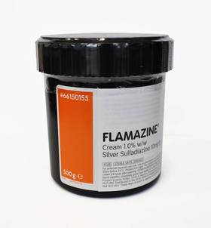
Burns Dressings
Dressings
  Aim for sepsis control
Silverzine Cream
  Cheap, easy to use, slows wound healing
  Changed daily
Acticoat
  Silver impregnated dressing, needs water
  Change every 3-7 days
  Great for skin grafts
Xeroform
  Iodine based dressing, good for post-op grafts
Alginates
  Good for donor sites, no antibacterial properties

Slide 21
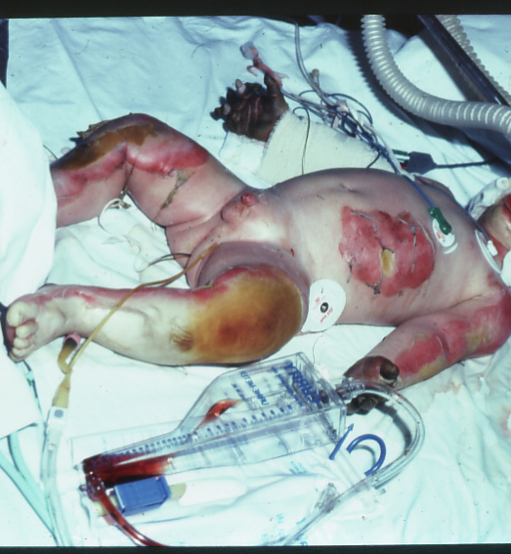
Myoglobinuria
Esp following muscle trauma, electrical injury or ischemia (escharotomy)
Cause ARF
Push UO 1-2ml/kg/hr
Alkalise urine (Na Bicarb 25meq/L)
Mannitol 12.5gm/l resuscitation fluid

Slide 22
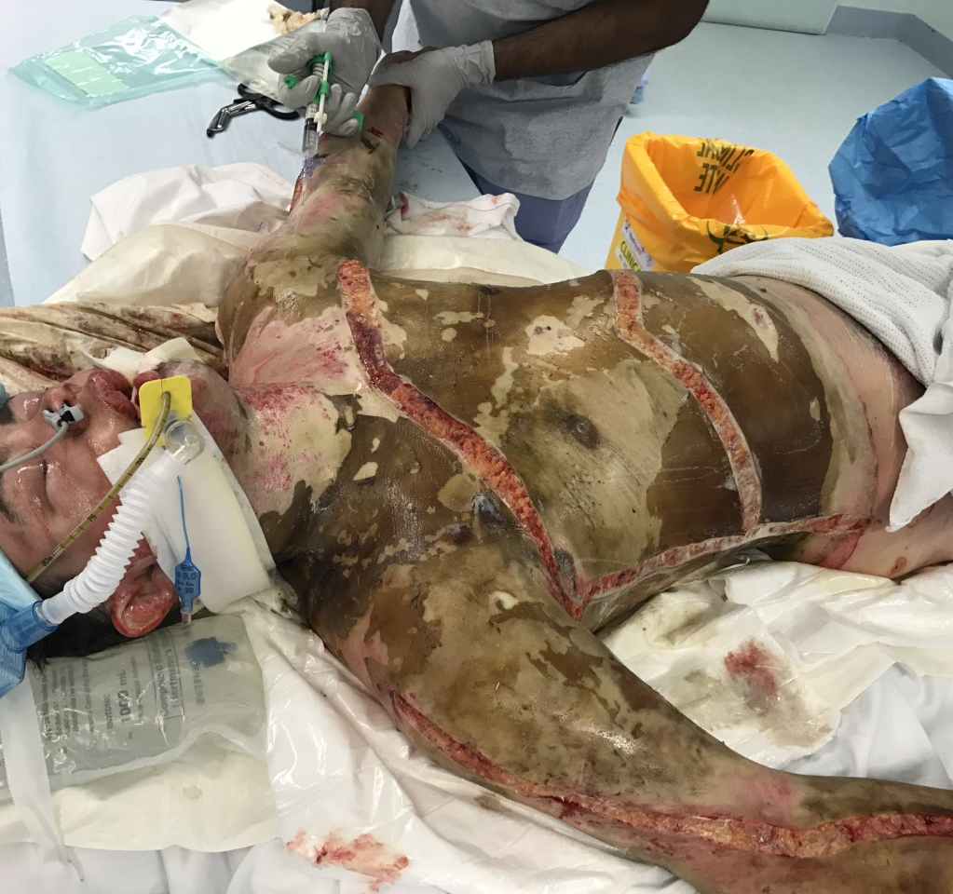
Escharotomy
Escharotomy
  Circumferential burn involving dermis
  Rising tissue pressures within in-elastic skin due to oedema
  Incr pain, loss of distal sensation, worsening acidosis, distal pallor, loss of pulses
  Watch for re-perfusion syndrome (ARF, hyperkalaemia, tachyarrhythmia's, cardiac arrest)
  Must begin and end beyond area of burn
  Can be done with a little LA in awake pts

Slide 23
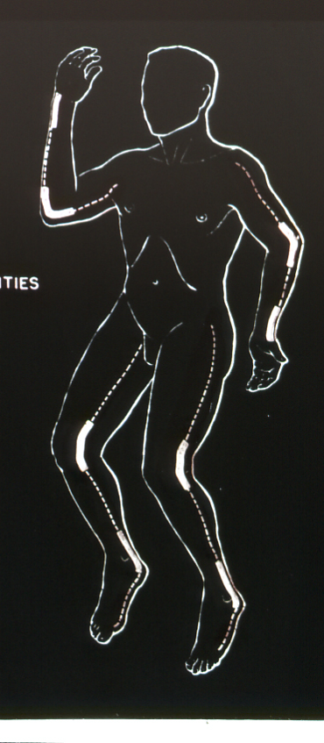
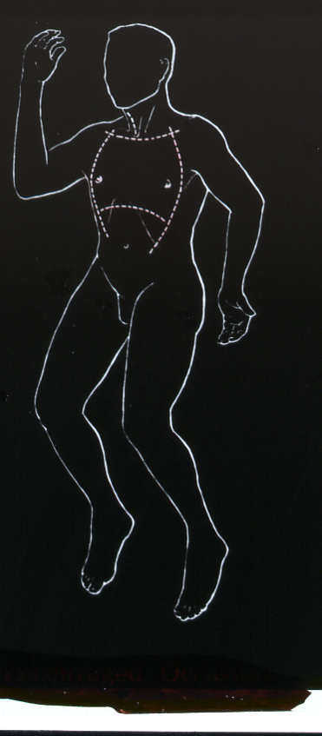
Escharotomy

Slide 24
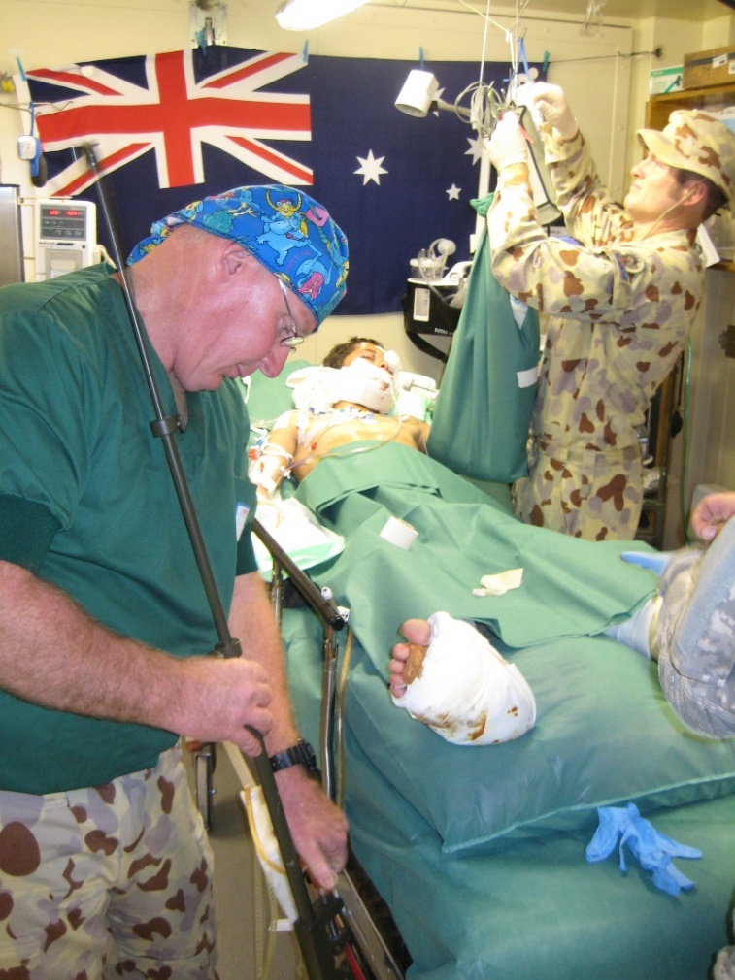
Burns Management
Subsequent management
  Multidisciplinary team
    Surgeons
    ICU
      Severe burns
      Inhalation injury
      Improved survival
    Specialist nursing staff
    Allied Health (OT, physio)
      Limb function, splints, garments, exercises
    Chronic Pain Service
    Psych consult-liaison

Slide 25
Operative Management
Wound Management
  Remove zone of coagulation
  Protect zone of stasis
  Early wound debridement and grafting
    Tangential excision
      Mid/deep/full thickness burns
      Back to healthy tissue

Slide 26
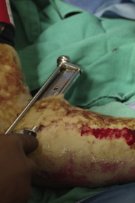
Operative Management
  Early wound debridement and grafting
    Tangential debridement within 24-48hrs of admission but after appropriate resuscitation
      May be staged over several days depending on how sick the pt is.
      Large burns >30% TBSA, we aim to damage control with debridement followed by temporary wound closure
    Splint skin grafting for wound closure
      If pt well, do once debridement is done
      Very large burns, grafting done over several occasions
        Priorities face hands and line sites
        Joints and back
    Meshing aims to incr surface area coverage

Slide 27
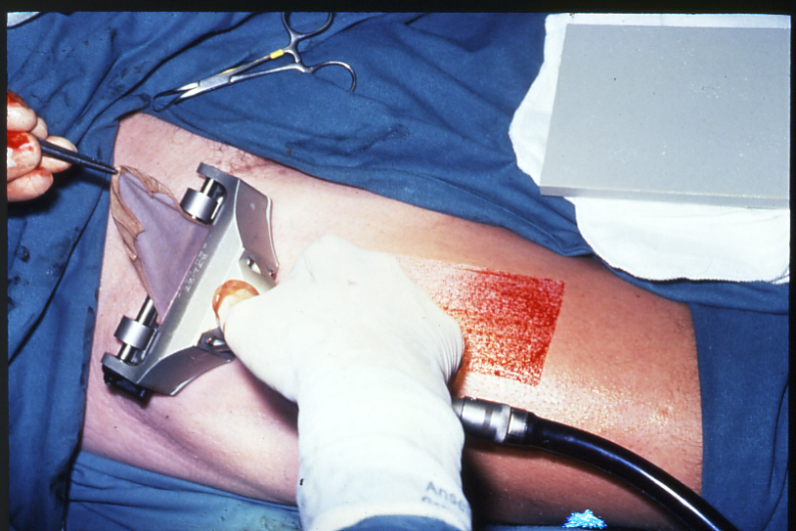
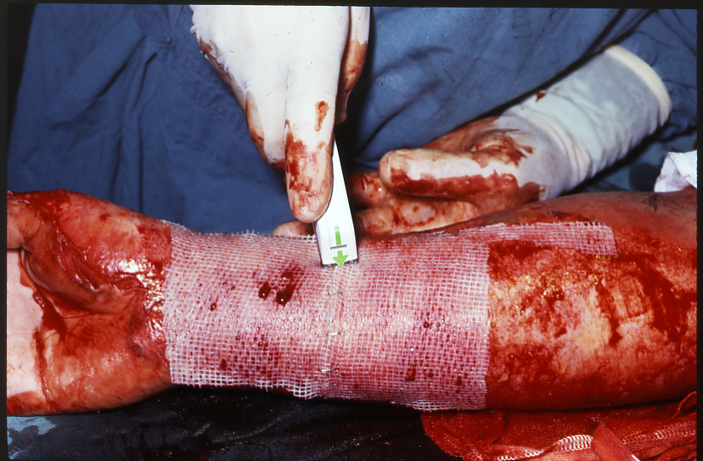
Operative Management
Wound Management

Slide 28
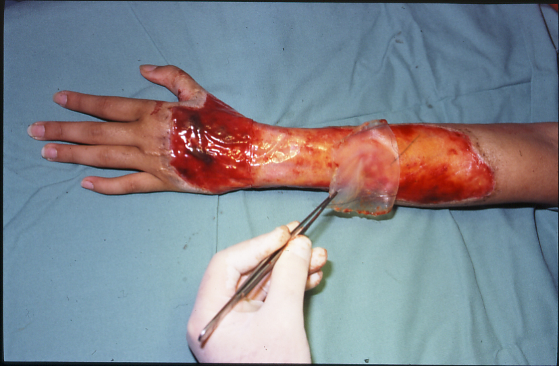
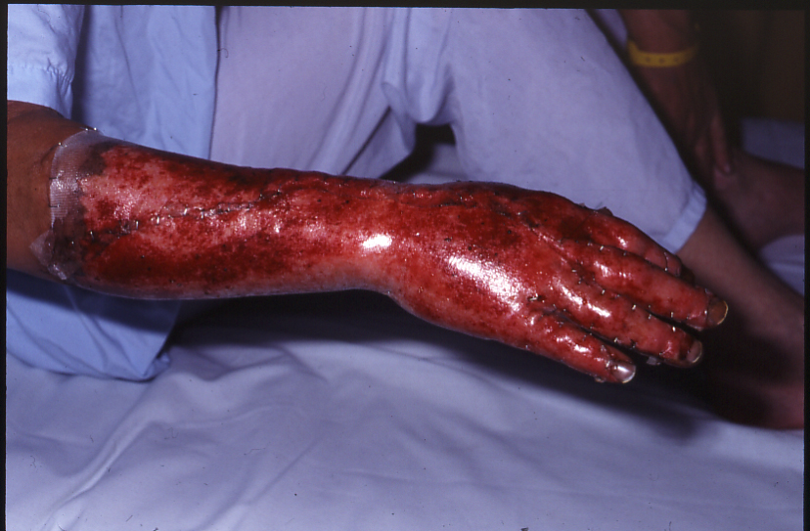
Operative Management
Wound Management:
    Prosthetic materials
      Biobrane – temporary wound closure
      Allograft – temporary wound closure
      Integra – dermal substitute
      BTM – dermal substitute

Slide 29
Burns Post op
  Hyper metabolic syndrome
    BMR >1.5-2x normal
    Loss of muscle
    Vitamin and micronutrient deficiencies
    Hypertrophic ossification
  Early nutritional support
    NG/NJ feeds
    TPN
    B-blockers, bisphosphinates, anabolic steroids

Slide 30
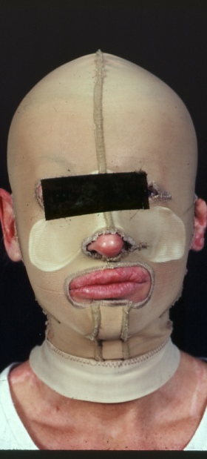
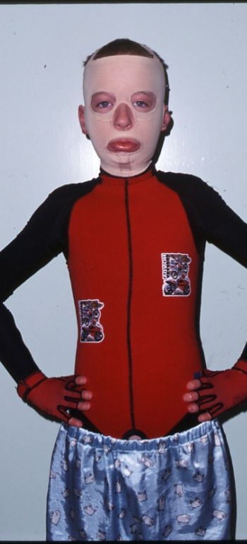
Burns Post Op
Contracture Management
  Early grafting
  Sepsis control
  Early splinting and exercise programs
  Pressure garments

Slide 31
Burns Referral
When to refer to a dedicated burns unit
  TBSA > 10%
  Special areas (hands, feet, face genitalia, perineum, major joints)
  Chemical or electrical burns
  Inhalation injury
  Circumferential burns of limbs or chest
  Burns at extremes of age (children, elderly)
  Multitrauma
  Extensive co-morbidities

Slide 32
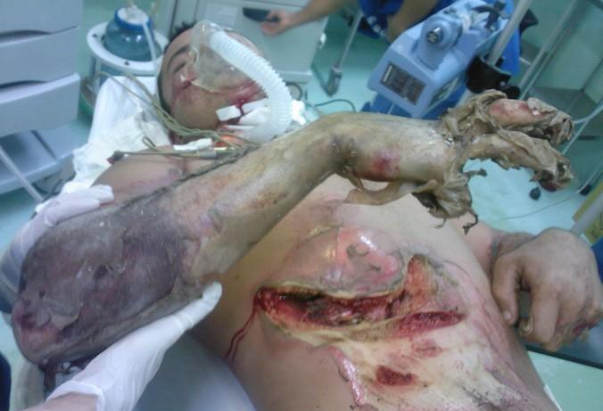
Electrical Burns
Extent of injury depends on voltage, duration of contact, resistance of the tissue and path of current
Avoid injury to those rendering assistance
Treat cardiac or respiratory arrest
Assess and manage any associated trauma
  Consider early referral to a burns unit
  Continuous cardiac monitoring for 24 hrs

Slide 33
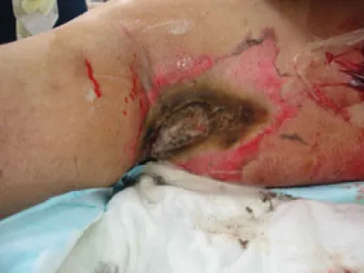
Electrical Burns
Watch for subfascial oedema of limbs (compartment syndrome – consider fasciotomy), especially following high voltage injuries
Haemochromogenuria common in high voltage injuries – keep UO over 75-100ml/hr till clear
Entry/exit wounds often full thickness, may have extensive soft tissue damage underneath

Slide 34
Chemical Burns
Types
  Industry
    Alkalis (Na, K, NH4, Li, Ba, Ca hydroxide)
    Acids (hydrochloric, hydrofluoric, acetic etc)
  Household
    Alkalis (drain cleaner, paint stripper)
    Phenols (deodorants, disinfectants)
    Sodium hypochlorite (bleaches)
    Sulphuric acid (toilet cleaner)
    Phosphorous (fireworks, insect ides, fertilizers)
  Military
    Phosphorous
Extent of damage depends on concentration of agent, quantity, duration of contact and tissue penetration
Injury continues until inactivated by neutralizing agent of dilution with water
Acids produce coagulative necrosis, alkalis liquefactive necrosis
Vesicants cause ischemic or anoxic necrosis
May have systemic toxicity as well (hepatic, renal, haemolysis)

Slide 35
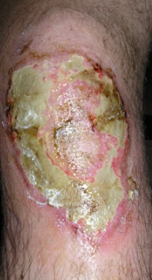
Chemical Burns
Cement Burns
  Caustic agent (pH up to 12.9)
  Pain and burns occur late (several hours)
  Prolonged irrigation
  Often difficult to assess true depth
    More conservative with management

Slide 36
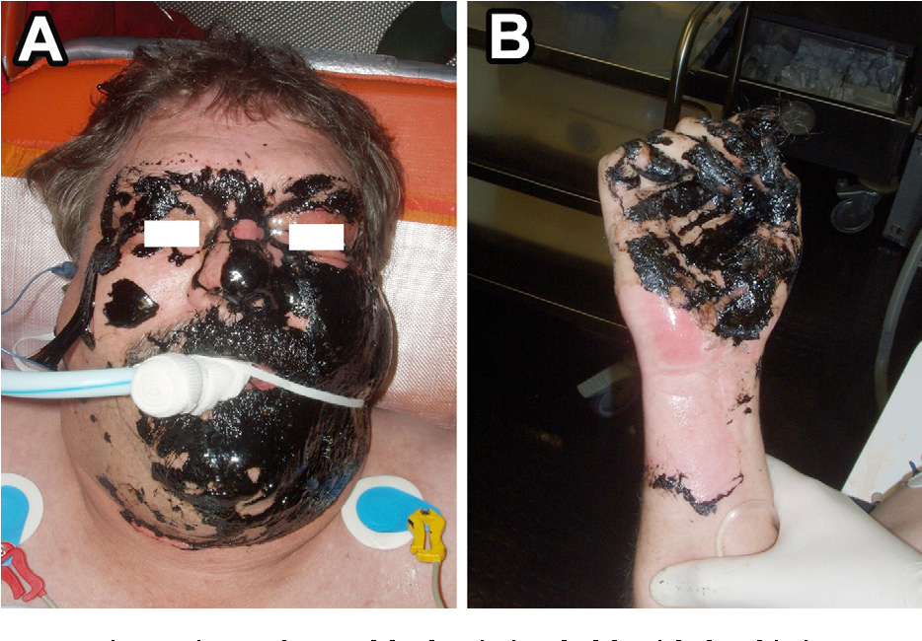
Chemical Burns
Petrol Burns
  Hydrocarbons dissolve lipids and causes increased cellular permeability
  Can cause systemic toxicity with generalised endothelial damage to liver, kidney and lung
Bitumen/Tar
  Thermal and chemical injury
  Need to be removed with other petroleum products (bitumen: kerosene, paraffin; Tar: toluene)

Slide 37
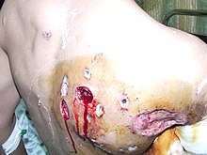
Chemical Burns
Phosphorous Burns
  Military personnel
  Ignites and continues to burn in air
  Embedded particles continue to burn
  Treatment with copious irrigation with water, debridement of particles and application of copper sulphate
Hydrofluoric Acid Burn
  Very corrosive, 2% TBSA can be fatal
  Fluoride ions bind Ca
  Arrhythmias (hypocalcaemia, hypomagnesaemia)
  Treat with water irrigation, topical Ca gluconate gel or inject Ca gluc into wound or systemic infusion

Slide 38
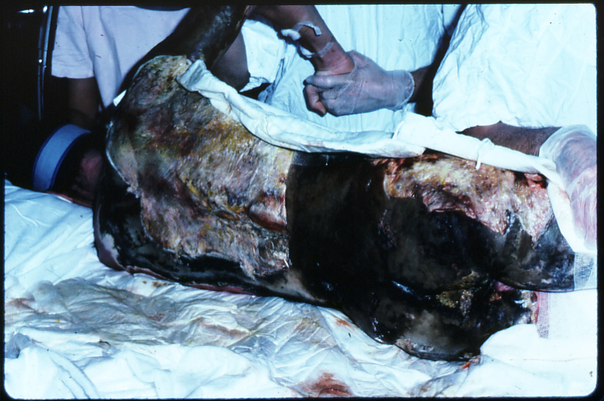
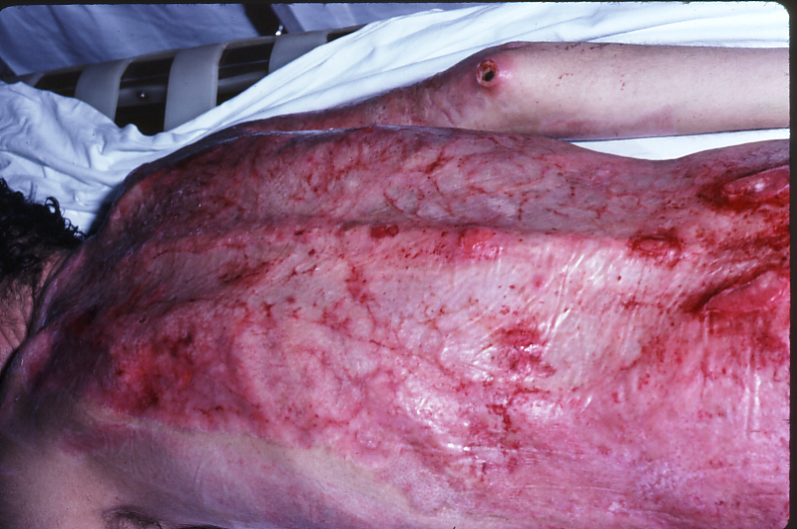
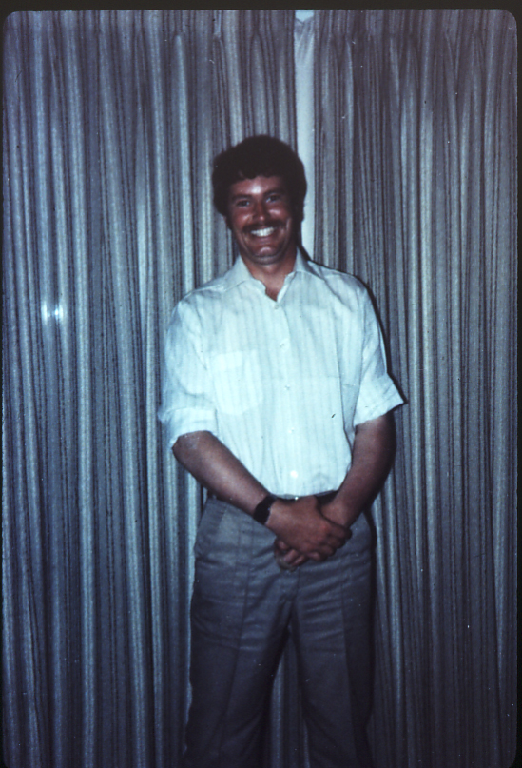
Questions?

