Slide 1
David J Read CSC MBBS MEpid(Dist) FRACS, Director of Trauma General, Trauma & Colorectal Surgeon
Large Bowel Emergencies
Royal Melbourne Hospital
Notes:
How to answer a question on the topic

Slide 2
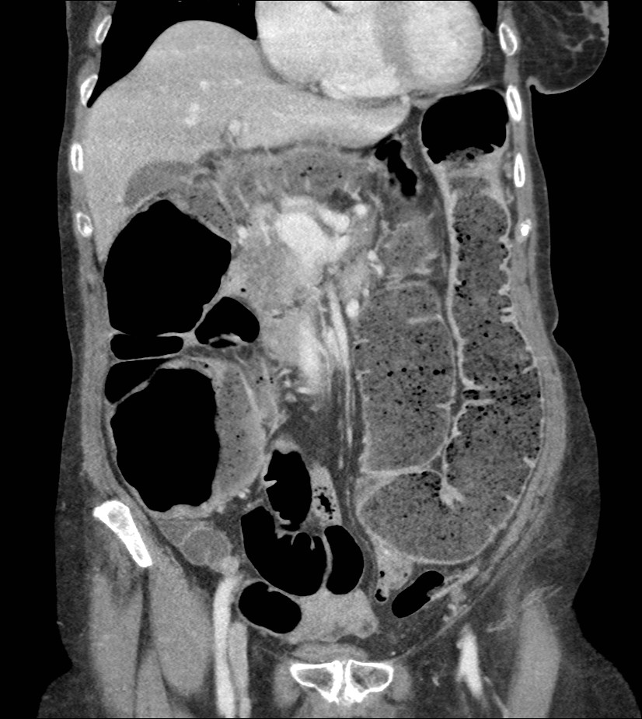
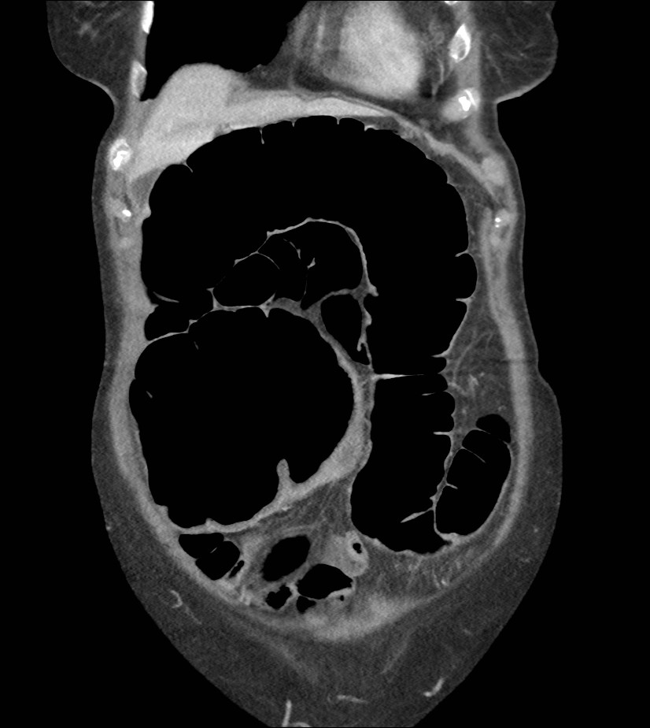
65yoM 2 days abdo pain, distension, BNO, no flatus

Slide 3
Large Bowel Obstruction – Management Options
Surgery Stent
Resection Diversion Bypass

Slide 4
Sigmoid Resection
Hartman’s Primary Anastomosis PA+ Covering
Ileostomy
(end colostomy)

Slide 5
Questions
When would you divert? Ileostomy or colostomy? Sigmoid or RUQ transverse?
What are the potential problems associated with colonic stenting?
Stent as a bridge to surgery?

Slide 6
85 yo from RACF
Abdo pain, distension, no flatus

Slide 7
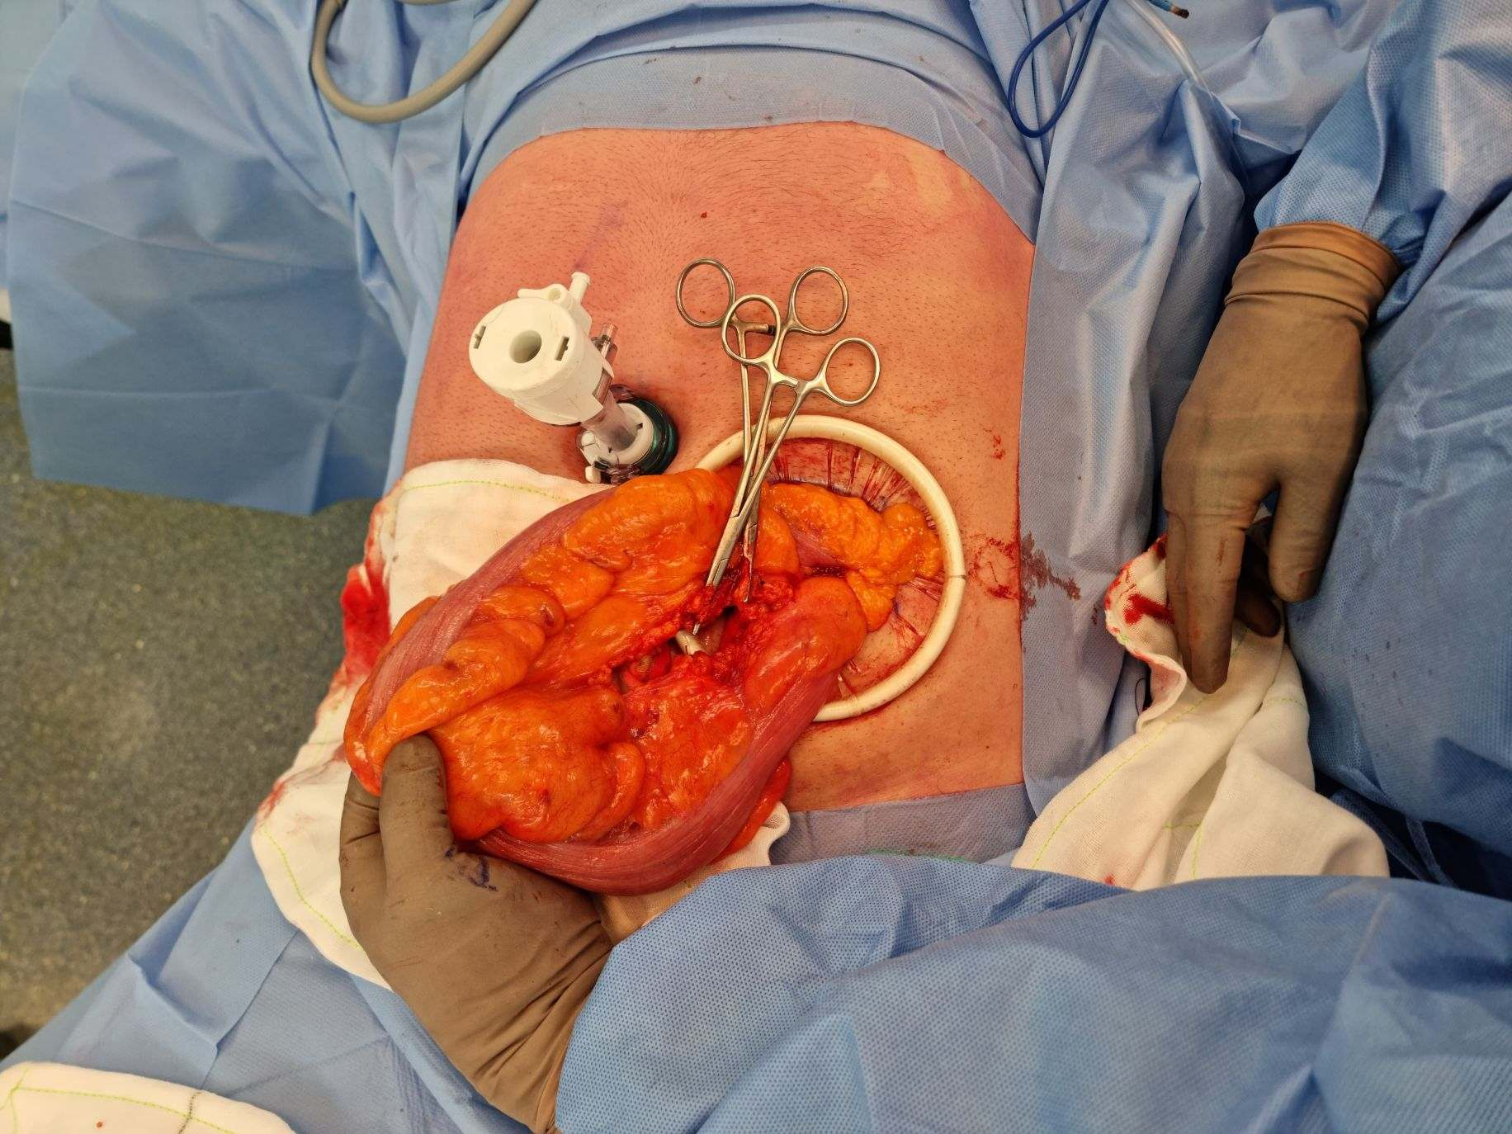
Management options?
Sigmoidoscopic decompression: rigid or flexible?
Operate or not?
Surgery, lap or open?
Recurrence around 50%
Resectional surgery mortality 10%
Anastomotic leak rate 5 -10%

Slide 8
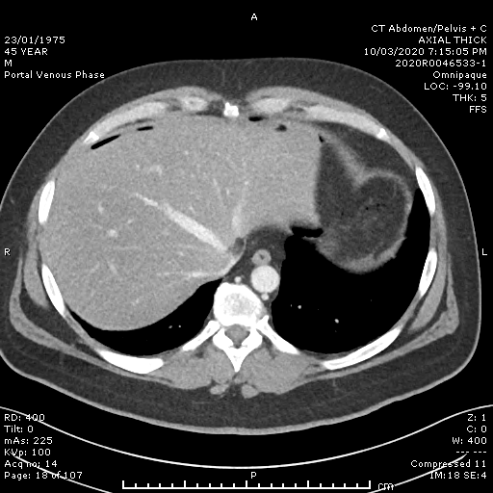
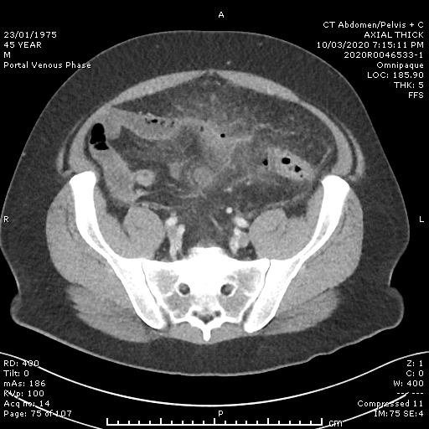

Slide 9

Acute complicated diverticulitis
Hinchey III – Hartmann’s Procedure
Hinchey IV– Hartmann’s Procedure

Slide 10
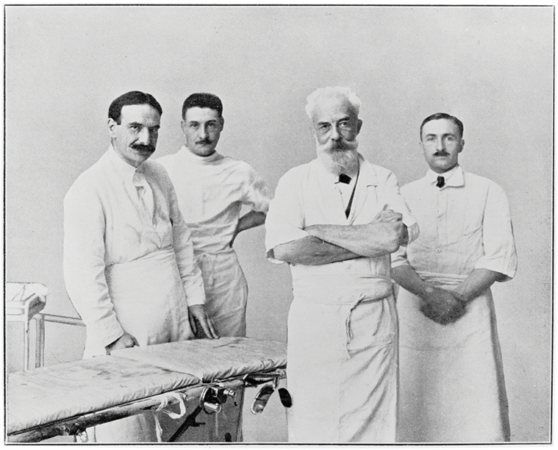
Reversal of Hartmann’s
What’s all the fuss?
‘50% of stomas will not be reversed’
Laparoscopic approach certainly acceptable, usually LOS benefits (retrospective studies)
High conversion rate in some series
Less complications (when pooled)

Slide 11

Question #1: What role for laparoscopy in Hinchey III?
Laparoscopic Lavage (LL) versus Resection (HP)
Trial | pts | inclusion | Outcomes | Interpretation | Criticism
DILALA | 75 | Radiological criteria | No difference morbidity or mortality. Reduced LOS in LL | Inconclusive | ?Selection bias, large no exclusions, Differing perforation rates (50% HP v 5%LL)
SCANDIV 2015 | 162 | Clinically needed surgery | Reoperation LL 30% HP 6% | Unsupportive of LL | 4 cancers missed
LOLA (of the LADIES) | Terminated 90pts | Hinchey III on laparoscopy | Failed to control sepsis in 24% of LL Morb. LL 39% v HP19% | LL is not superior to HP
LAPLAND | Ongoing, target 300 |  |  |  | Since 2010…….

Slide 12
Analysis of RCT’s: LL v HP
 | mortality | Reoperation & reintervetion | Additional | Conclusion
Marshall & Eglington Ann Surg 2017 | No increase in 30d or 90d mortality | RR 3.0 reintervention (LL 28% v HP 9%) |  | LL Higher intervention rate
Angenete Int J CR Dis 2017 | comparable | No diff @ 12mo |  | LL superior as it is cheaper, a valid alternative
Acuna DCR 2018 | similar | Increased risk major complications (C-D>IIIa) | Looked at HP versus Primary resection and anastomosis (PRA) | PRA preferable as higher stoma free rate
Shaikh IJS 2017 | No difference | Higher reintervention LL, but percutaneous |  | LL is safe and quick

Slide 13
Resection and Primary anastomosis (RPA)
Primary Anastomosis and Proximal Diversion (PAPD)
 |  | Mortality | Stoma free | Morbidity | Comments
DIVERTI | Prospective multicentre RCT, 102pts Hinchey III&IV | No diff PAPD 4% HP 7.7%. | 96% PAPD 65%HP @18mo | No difference | Washout, drains, stoma (2/3) left to surgeon
Oberkofler | RCT 62pts Hinchey III & IV | No diff | 90% PAPD 75% HP | No diff | Reversal DLI v HP, less OT time, less LOS, Less compilations
LADIES (DIVA) 2019 | Multicentre RCT, 133pts Hinchey III&IV | No diff PAPD 39% HP 44% | PAPD 95% HP 71% @12mo | No diff HP 3% PAPD 6% | PAPD preferable if <85yo, immunocompetent and HD stable

Slide 14
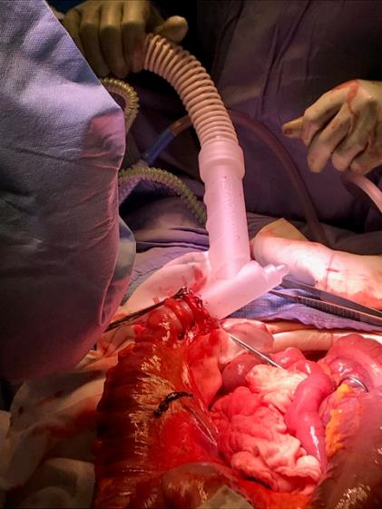
Primary Anastomosis and Proximal Diversion (PAPD) Meta analyses and Retrospective reviews
Reviews of RCTs and observational studies support PAPD superior but both acceptable
A large US based admin data study (10K pts) showed mortality 2x when ‘non CR surgeons’ performed PAPD v HP
Question: How would you perform an on table washout?

Slide 15
Thank you

