Slide 1
Local anaesthetics for general surgeons
Dr Aimee Parker
Anaesthetist
BSc, MBChB, FANZCA

Slide 2
General Surgical Curriculum
Classification of local anaesthetics
Mechanism of action
Side effects and management
Local anaesthetics as intravenous infusions for perioperative pain management
Local anaesthetics in laparoscopic surgery and laparotomy

Slide 3
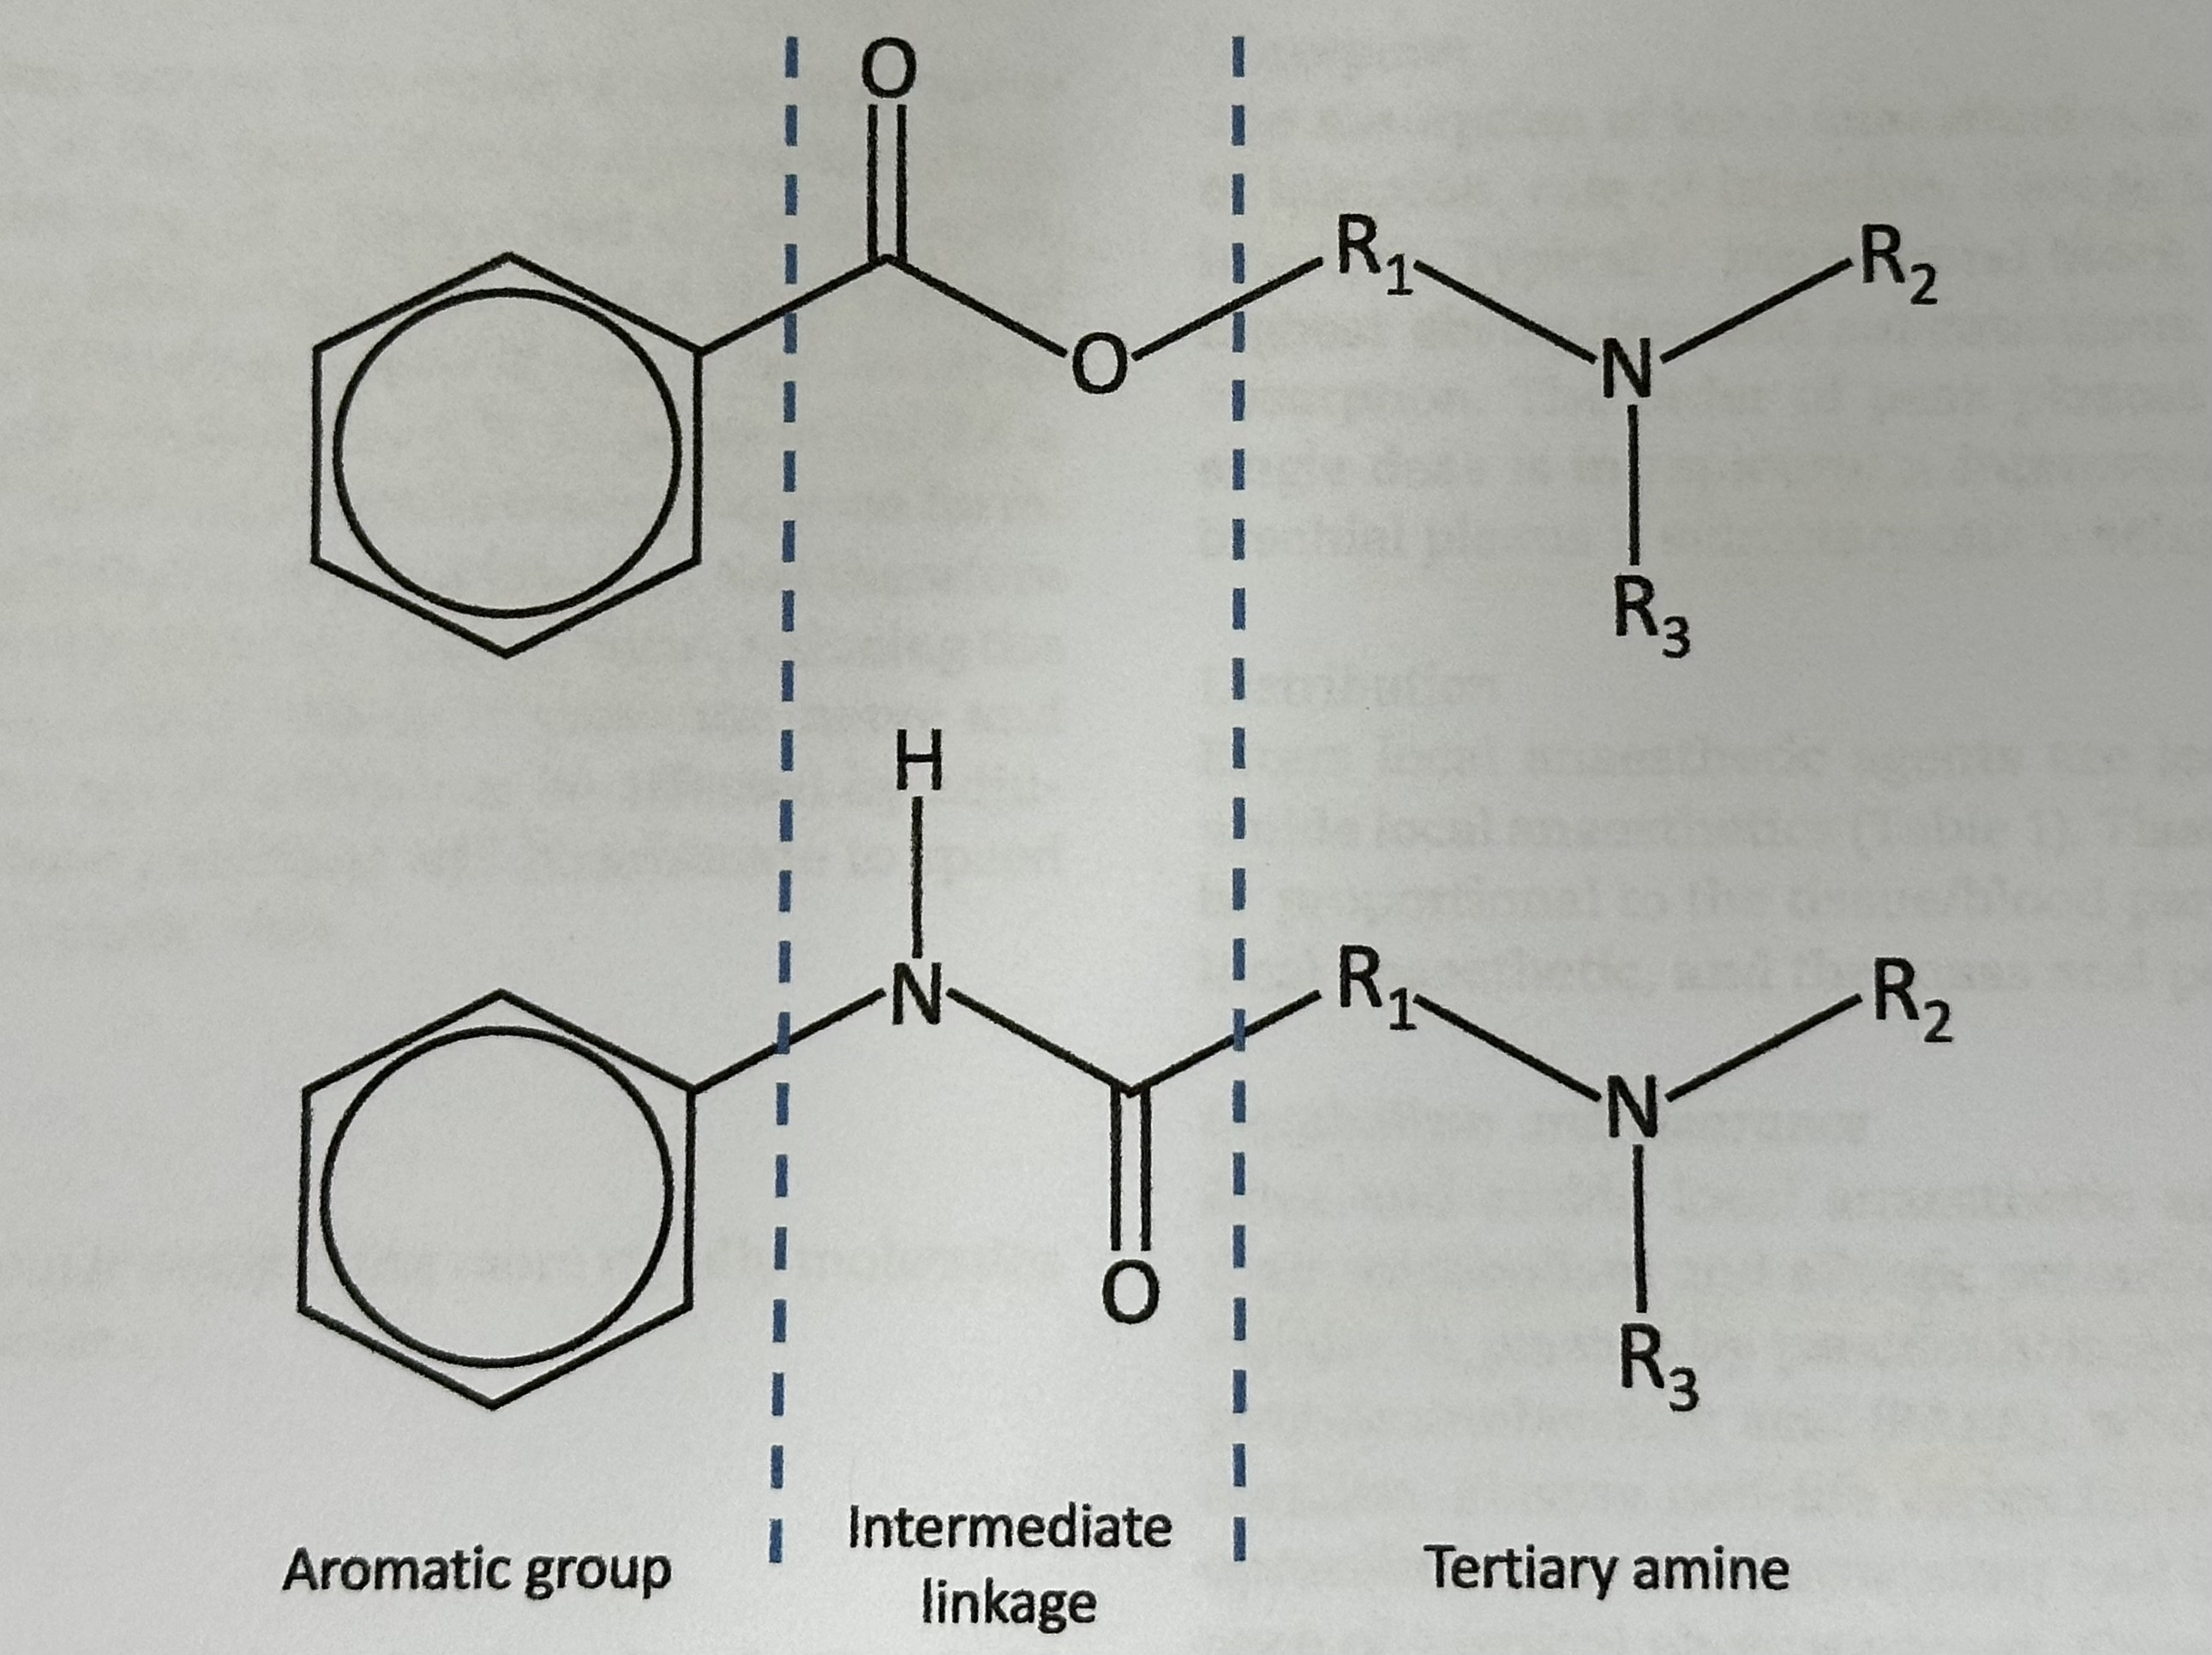
Structure activity relationships
Same basic structure
Lipophilic end
Hydrophilic end
Intermediate chain
Classified as ester or amide depending on linkage between aromatic group and intermediate chain
R groups determine the pharmacokinetic and pharmacodynamic properties of each individual LA
Isomerism important for toxicity

Slide 4
Local anaesthetic Solutions
All are weak bases existing in ionized and unionized forms
Both forms required for activity
At pH7.4:
[LA+] > [LA]
The pKA of each drug determines the relative proportions of each form
Prepared in slightly acidic solution to favour water soluable ionized form
pH = pKa + log[LA⁺]/[LA]

Slide 5
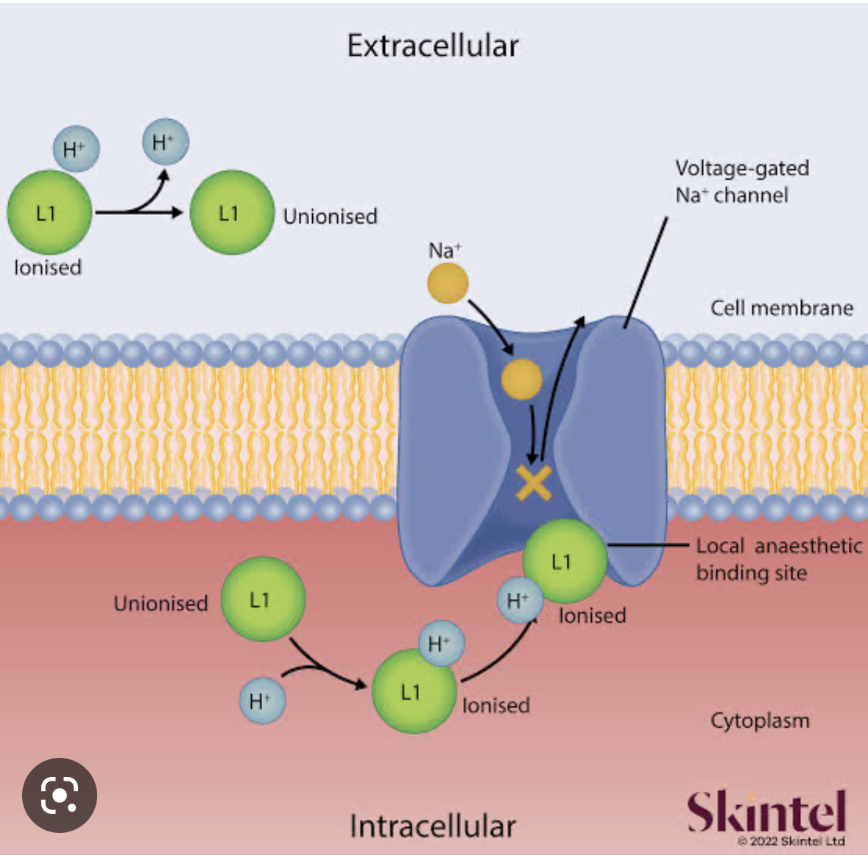
Mechanism of action
LA injected
pKa determines proportion present as unionized molecules at pH 7.4
Unionised molecules diffuse through axonal membrane
Acidic intracellular environment favours ionization of molecules
Ionised molecules binds to inside of the voltage gated sodium channel when open
Channel stabilized in ”inactive” state

Slide 6
Comparison of commonly used local anaesthetics
Classification | Potency | Onset | Duration (min) | pKa | % unionized at pH7.4 | Lipid solubility | Protein binding %
Amides
Lignocaine | 1 | rapid | 60-120 | 7.9 | 25 | mod | 70
Bupivacaine | 4 | slow | 240-480 | 8.1 | 17 | High* | 95
Ropivacaine | 4 | slow | 240-480 | 8.1 | 17 | mod | 94
Esters
Procaine | 1 | slow | 45-60 | 8.9 | 3 | low | 6
Tetracaine | 16 | slow | 60-180 | 8.5 | 7 | high | 76

Slide 7
Additives
Adrenaline
Promotes local vasoconstriction which delays systemic absorption and prolongs the duration of lignocaine
Has no effect on the duration of action of bupivacaine but improves safety
Bicarbonate
Increases pH resulting in increased proportion of unionized drug molecules and faster onset of action

Slide 8
Pharmacoeconomics
Bupivacaine 0.25%
Approx $3
Bupivacaine 0.25% + 1:200,000 adrenaline
Approx $83
Ropivacaine 0.2%
Approx $2
Lignocaine 1%
Approx $1

Slide 9
Calculation of maximal dose (70kg patient)
Bupivacaine 0.25%
2.5mg/ml
Max dose 2mg/kg = 140mg = 56ml
Same dose regardless of adrenaline
Ropivacaine 0.2%
2mg/ml
Max dose 3mg/kg = 210mg = 105ml
No adrenaline added
Lignocaine 1%
10mg/ml
Max dose 4mg/kg = 280mg = 28ml
Lignocaine 1% + 1:200,000 adrenaline*
10mg/ml
Max dose 7mg/kg = 490mg = 49ml
* 1:200,000 adrenaline = 5mcg/ml (add 100mcg of adrenaline per 20ml local anaesthetic if making fresh)

Slide 10
Adverse effects of Local anaesthetics
Systemic
Related to peak plasma concentration
Hypersensitivity
Para-aminobenzoic acid (metabolite of ester LAs)
Methyl paraben
Direct neurotoxicity
Intraneural injection
Pressure effects with subsequent ischaemia
Drug specific effects
Incorrect preparation

Slide 11
“I’m allergic to local anaesthetics”
True allergy to local anaesthetics is rare
More common with esters
History is important
What were the symptoms?
Rapid onset of tachycardia/palpitations/anxiety/vasovagal without other signs of immediate allergic reaction – unlikely to be allergic reaction so continue as normal
Rapid onset of itch/urticuria/angioedema/bronchospasm/hypotension/tissues not contiguous with site of injection – possibly IgE mediated; defer if non urgent
Delayed onset (3-72hr) dermatitis/swelling/mucosal inflammation – possible cell mediated – defer if non urgent
Refer to allergy specialist if non urgent surgery
If urgent, chose an LA from a different class or avoid completely

Slide 12
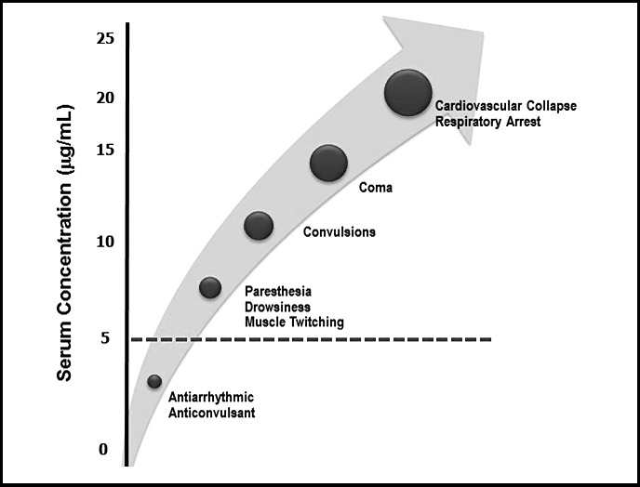
Local anaesthetic Toxicity
Relates to peak plasma concentration
Central nervous system signs before cardiac (usually)
Bupivacaine is the most toxic
High affinity for cardiac receptors
Patient factors contribute
Extremes of age, pregnancy
Comorbidites
Administration factors
More likely to have elevated peak plasma levels when injected into more vascular areas

Slide 13
Emergency Management of LAST
Use a cognitive aid to prevent task overload
Stop injection
Call for help
Arrange for cardiac bypass
Manage airway with 100% oxygen
Suppress seizures with midazolam
Manage arrhythmias and provide cardiovascular suppot
Administer lipid rescue

Slide 14
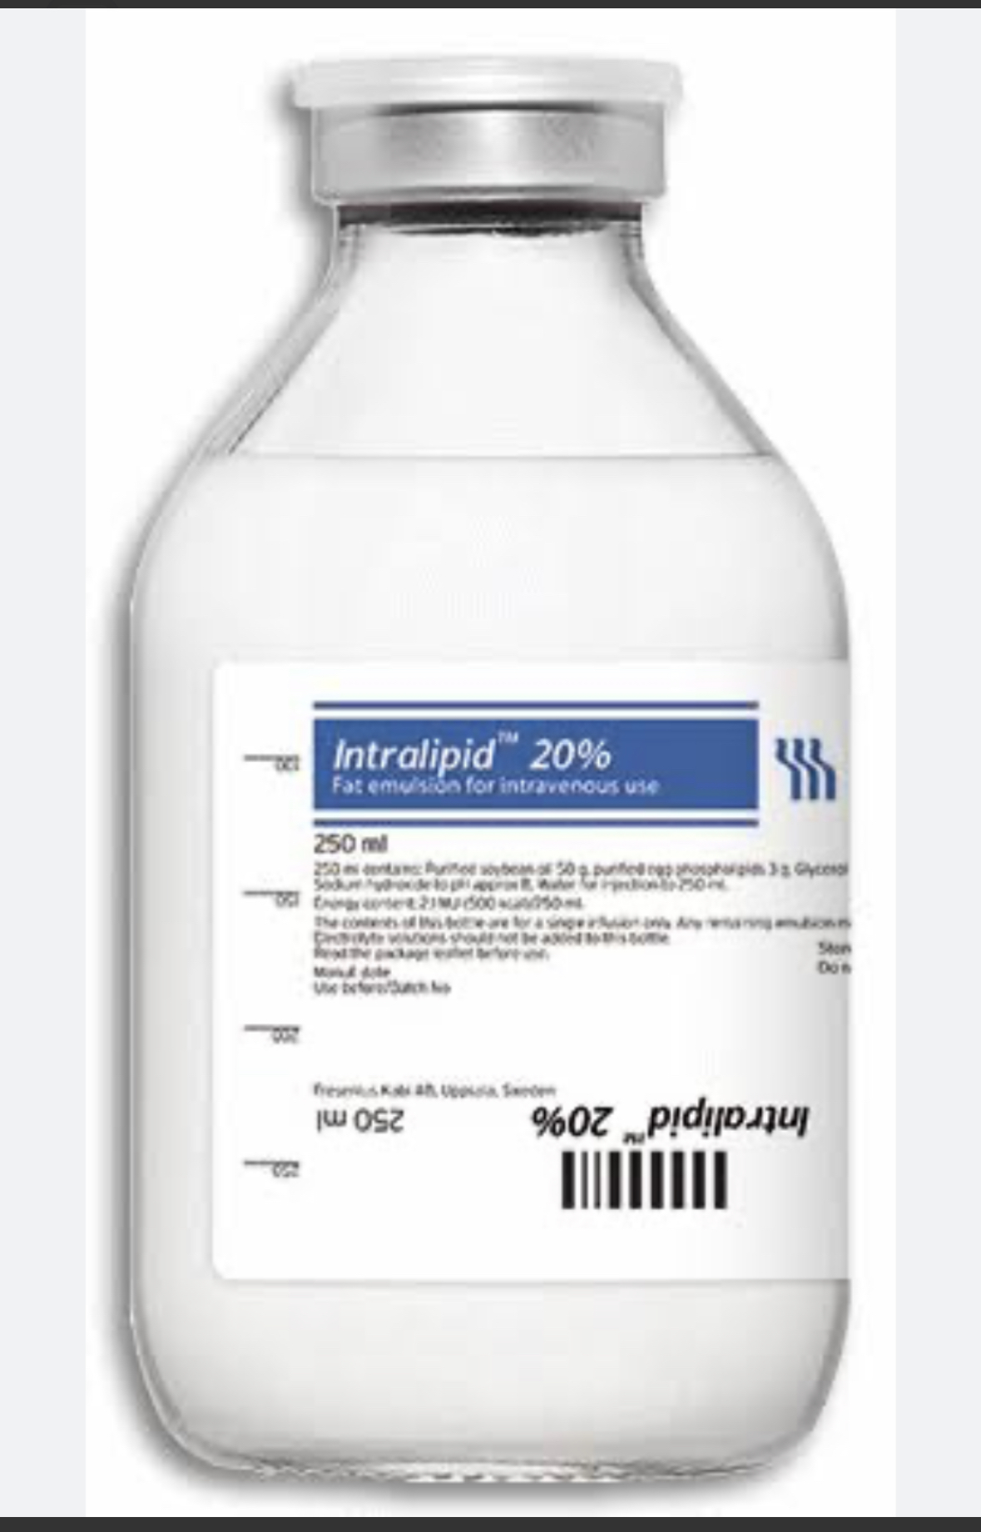
Intralipid 20%
20% lipid emulsion
Bolus and subsequent infusion
Bolus may be repeated
“lipid sink” hypothesis
Watch for pancreatitis later
Never use propofol as a substitute!!!!

Slide 15

Evidence-based local anaesthesia
Collaboration between ANZCA + FPM
Endorsed by RACS
Most recent version published in 2020
Review of available literature 2014 - 2019
Assesses quality of evidence for a variety of analgesic modalities and determine whether previous recommendations remain accurate
LAs an integral part of multimodal analgesic regimens
Good evidence for efficacy
More than 1300 pages!

Slide 16
Perioperative IV Lignocaine infusions
1.5mg/kg on induction of anaesthesia
1mg/kg/hr thereafter
Potential to continue postoperatively
Reported efficacy for:
Breast surgery – reduced chronic post surgical pain
General reduced pain and opioid requirement
Preventative analgesia
Chronic neuropathic pain
Paediatric surgery
Considered controversial amongst anaesthetists
Dispute re: mechanism – does not appear to be mediated by sodium channels
Concern re: LAST
Evidence lacking for universal adoption
No protocol in this hospital
An area of ongoing research….

Slide 17
Local Anaesthesia in Laparoscopic surgery
Ambulatory and short-stay surgery
Wound infiltration and intraperitoneal instillation for lap cholecystectomy has good analgesic efficacy, especially when combined and prior to trocar insertion and commencement of pneumoperitoneum (level 1 S)
Same true for lap gastric surgery (level 1 N)

Slide 18
Local Anaesthesia in Laparotomy
Much of the literature focuses on the debate between RSC vs epidurals
Case by case approach is best
Evidence is clear that either can be beneficial as part of a multimodal analgesic strategy

Slide 19
Other types of surgery
Mastectomy
Paravertebral block (level 1S) and local infiltration (level 1N) reduce the progression of acute to chronic pain

Slide 20

The Future….

