Slide 1

7 Myths about the Part 2
Adrian Secker
Nelson

Slide 2
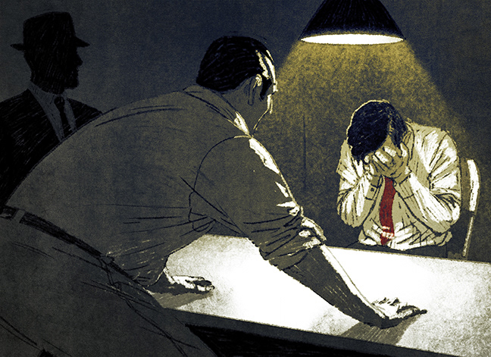
Myth 1: If I get that bastard Secker (or insert other name here), he’ll fail me for sure

Slide 3
Myth 1: If I get that bastard Secker, he’ll fail me for sure
Exam has 7 components
2 papers and 5 vivas
Each component has two examiners
Thus each candidate is considered by 14 examiners

Slide 4

Myth 2: Always give the ‘Exam Answer’

Slide 5
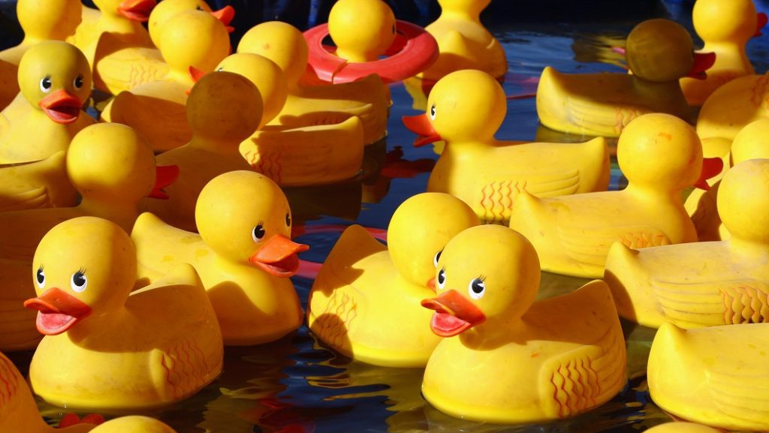
Most surgical problems have a range of potential solutions
Examiners are looking for reasoned discussion of the options
Higher order thinking beats rote learning/lists

Slide 6

Myth 3: I heard that (X) failed on a silly technicality

Slide 7
Myth 3: I heard that (X) failed on a silly technicality
Candidates failing a single component will usually pass
A failing candidate has usually failed at least two components
One bad viva does NOT mean it’s all over
It probably went better than you thought
Keep going!!

Slide 8
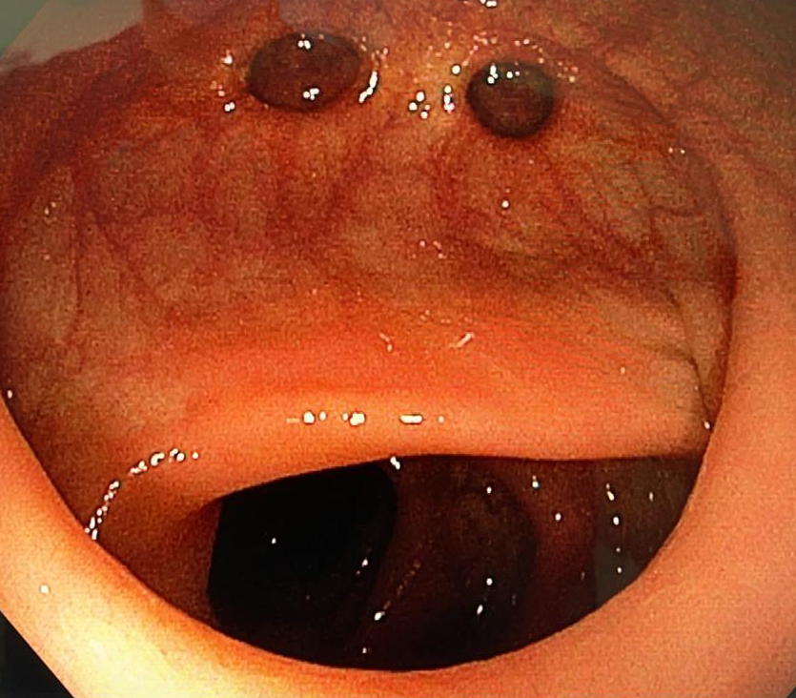
Myth 4: If I just keep talking, I’ll be fine

Slide 9
Myth 4: If I just keep talking, I’ll be fine
Quality of words beats quantity of words
Platitude: “a statement… that has been used too often to be interesting or thoughtful”
Operative vivas are usually about surgical technique, not pre-op preparation

Slide 10
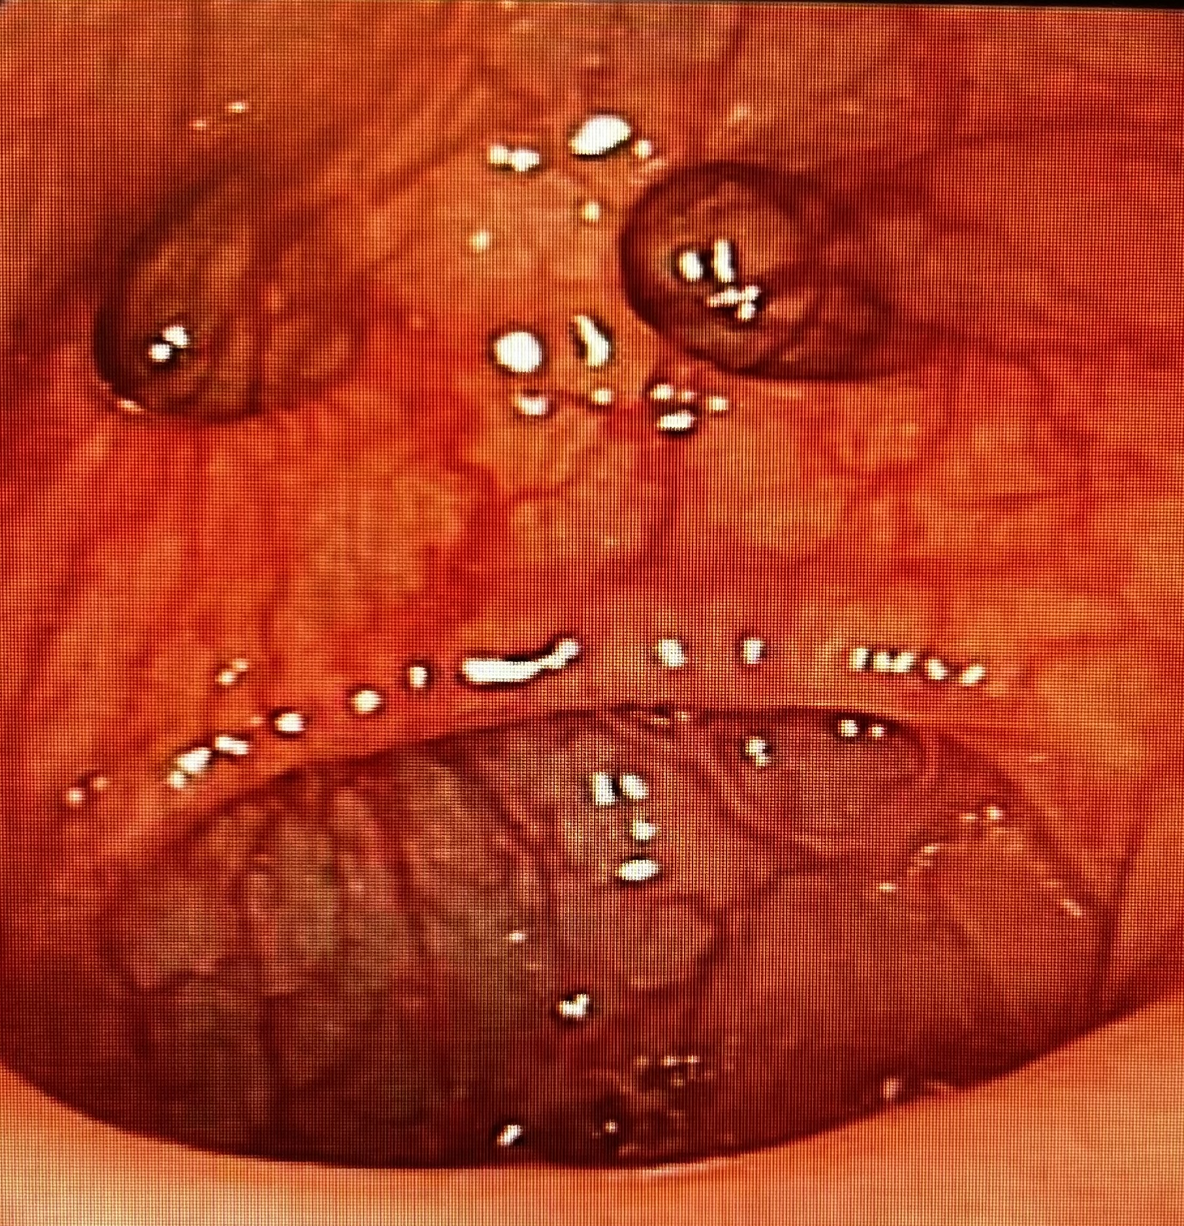
Myth 5: Oh crap! Embryology!! I’m screwed!!!

Slide 11
Myth 5: Oh crap! Embryology!! I’m screwed!!!
If embryology is relevant to surgical pathology, it’s worth knowing
If it’s not, then it will not be the basis of a failing viva
and shouldn’t be in the exam anyway

Slide 12
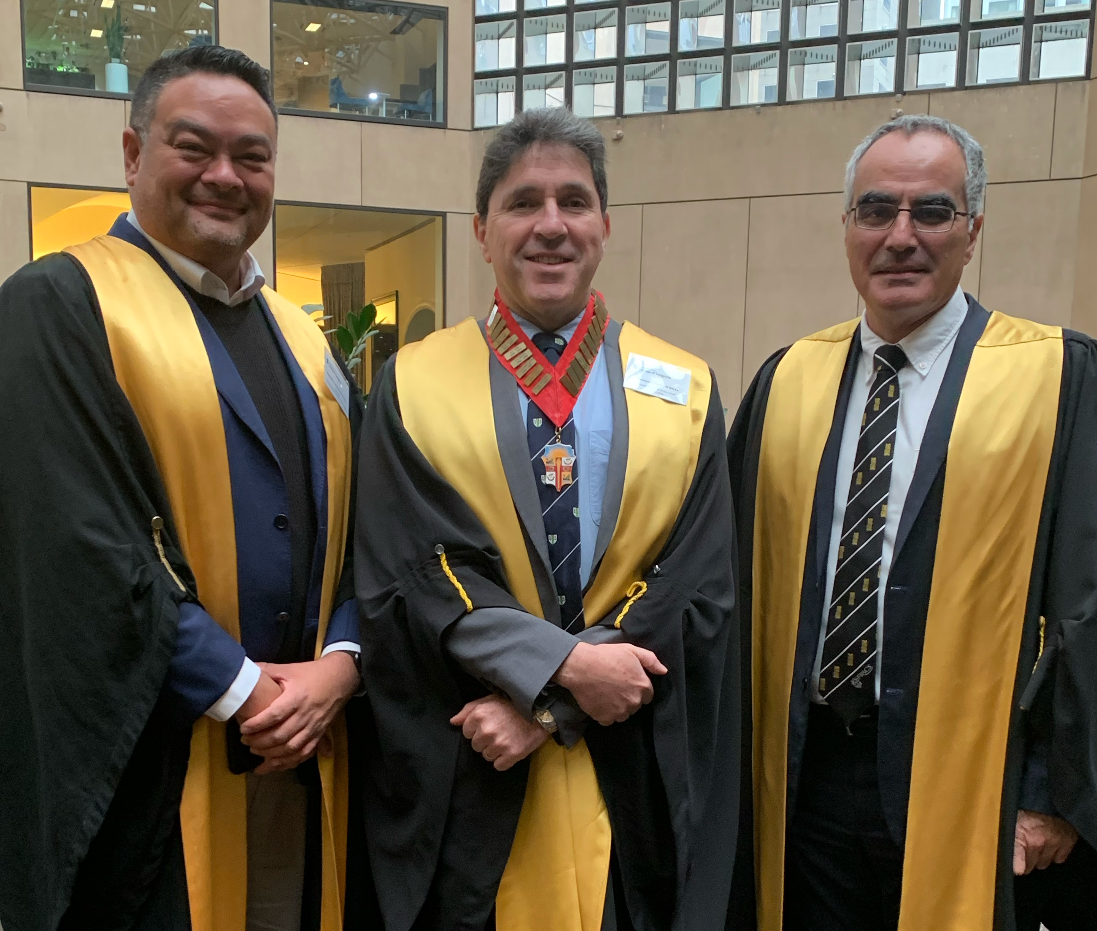
Myth 6: If I don’t pass the Part 2 on my first try, I’ll always be a second-rate surgeon

Slide 13
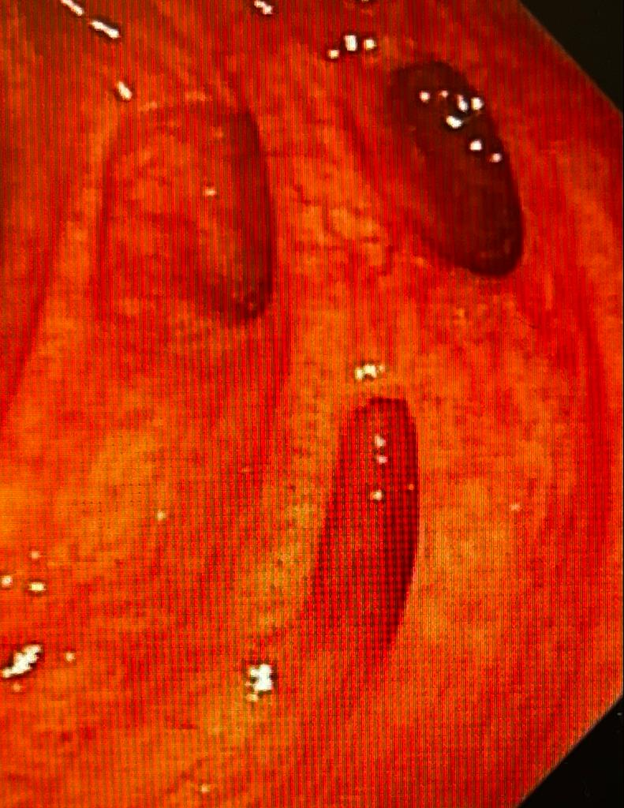
Myth 7: Imagine your examiners in their underpants

Slide 14
Myth 6: Imagine your examiners in their underpants
See your examiners as your colleagues
Think of your vivas as a collegial discussion
Try to feel and sound confident

Slide 15
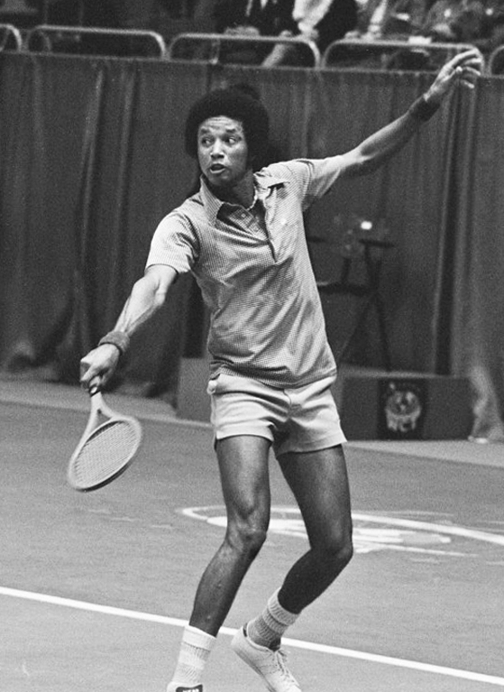
Arthur Ashe on confidence:
"One important key to success is self-confidence. An important key to self-confidence is preparation."

Slide 16
Other points:
The Exam continues to evolve
Please turn up for presentation of successful candidates!
The future of the Court of Examiners is in this room

Slide 17
AMA

