Slide 1

Parotid tumour diagnosis and management
Nicola hill
Otolaryngology surgeon

Slide 2
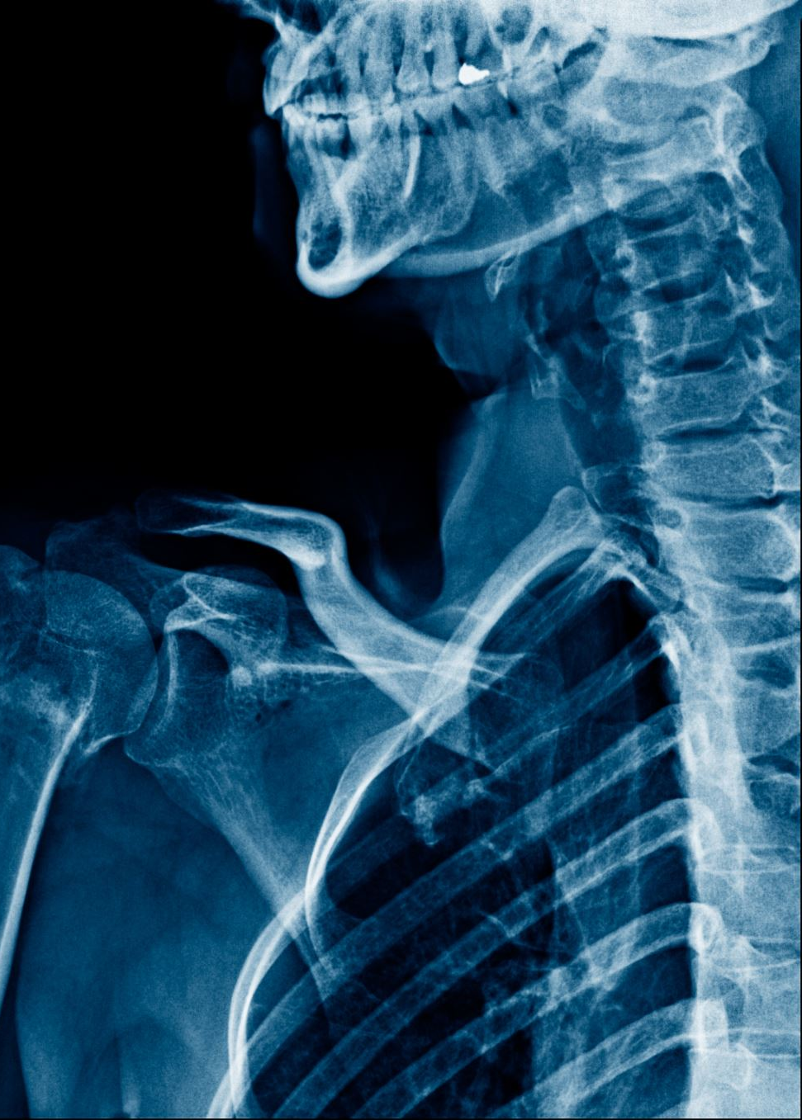
Points to cover
Anatomy
Presentation
Differential
Management
Potential questions

Slide 3
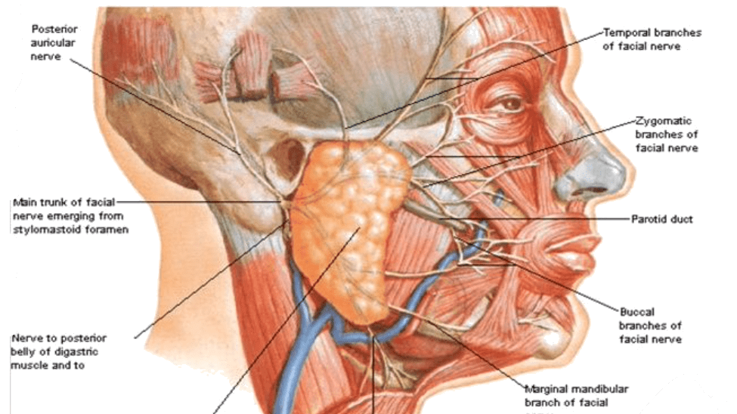

Slide 4
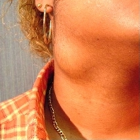
‘Thank you for seeing this patient with a neck lump…’

Slide 5
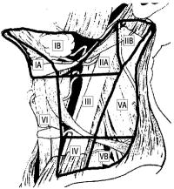
Approach?
History
general – age, sex, general medical conditions, medications
Smoking?
Skin cancer
Examination
Neck exam
Scars from skin excisions
Full oral exam etc
Neck levels
Facial nerve

Slide 6
What’s the differential diagnosis?
Neoplasm
Benign (pleomorphic adenoma, Warthin’s tumour)
Malignant (primary salivary gland, metastatic SCC, lymphoma, metastatic melanoma, other metastases)
Use a surgical sieve (COTDIM)
Congenital
Branchial cleft abnormality
Lymphatic malformation
Inflammatory/immune/idiopathic
Abscess
Sjogren’s
Drug-related
Lymphoepithelial lesions with HIV
Metabolic
TB/sarcoid!

Slide 7
Management
Full history and examination
Fine needle aspiration
?clinic/USS-guided
About 95% sensitive/specific
Core biopsy controversial
CT scan

Slide 8
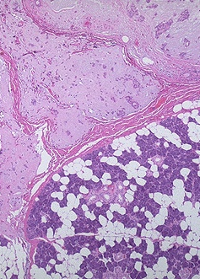
Benign neoplasms
The most likely diagnosis
Rule of thumb - Parotid 70% benign, submandibular 50%, minor salivary 30%)
Pleomorphic adenoma = 80%
Women, 40s, Caucasian
1-5% recurrence rate
Warthin’s tumour = 5%
Men, 50-60s
10% multicentric, bilateral
Cysts – can get inflamed or bleed
Adenoma, oncocytoma, monomorphic tumour

Slide 9
Malignancy
Glandular secretory tissue + supporting connective tissue + blood vessels + lymph nodes
VII paralysis, pain, trismus
Mucoepidermoid carcinoma 30%
High vs low grade distinction; spreads to regional nodes 1st
Adenoid cystic carcinoma
Propensity for perineural spread, skip lesions, distant metastases
Malignant mixed, acinic cell carcinoma, adenocarcinoma
Squamous cell carcinoma

Slide 10
Next steps depend on diagnosis
Benign
Excision vs observation
Factors that might influence
Age, medical condition, patient preference
Rule of thumb - Carcinoma ex pleomorphic adenoma 1% per year
Malignant
Multidisciplinary meeting
Surgery/surgery and post-operative radiation/(chemo)radiation/palliative care
Rule of thumb – VII sacrificed only if visibly involved

Slide 11
Malignancy
Management depends on features of tumour
Positive features
Low grade
Less than 4 cm in greatest diameter
No local invasion
No lymphatic/neural/vascular
No evidence of regional node involvement
Primary (not recurrent tumour)
Staging

Slide 12
Operations
Partial parotidectomy (but not enucleation)
Superficial parotidectomy
Total parotidectomy
+/- neck dissection

Slide 13
Superficial parotidectomy
‘Appropriately worked up and consented patient under general anaesthesia’
Preparation – head ring and shoulder bolster, marking, facial nerve monitor, local, paint and drapes
Skin incision

Slide 14
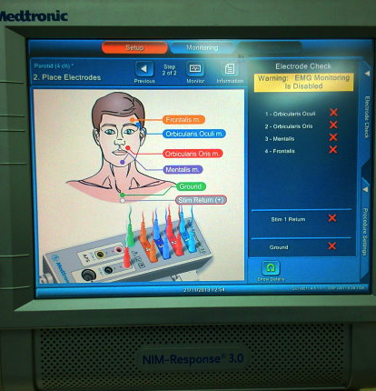
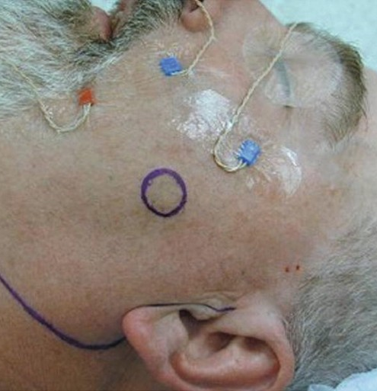

Slide 15
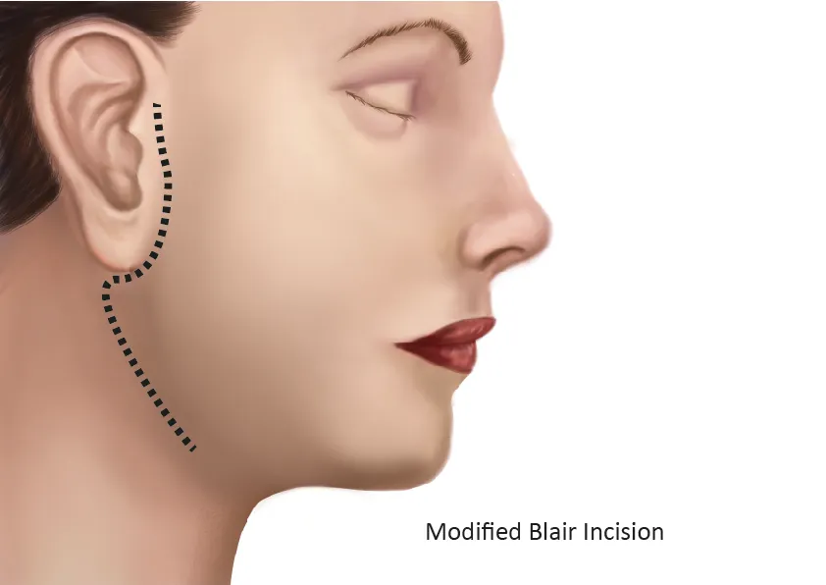
‘Modified Blair’
Preauricular, around the lobule of the ear towards the mastoid tip, extending into a neck crease
Some surgeons do modified facelift incision

Slide 16
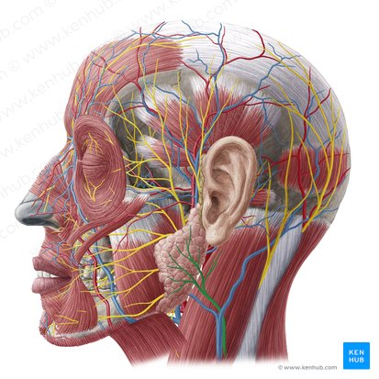
Subplatysmal flap
Identify structures – parotid, sternomastoid, great auricular nerve
Vessels
superficial temporal and occipital arteries (ECA)
superficial temporal and maxillary veins > RMV > anterior (+facial = common facial) + posterior (+ posterior auricular = EJV) divisions
Identify VII

Slide 17
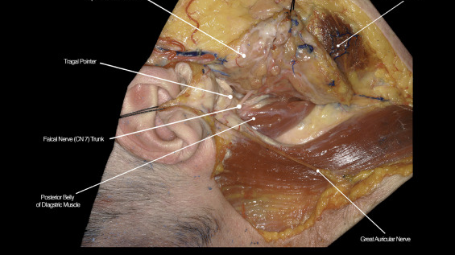
Finding VII
1. Tragal pointer
2. Tympanomastoid suture
3. Posterior belly of digastric
Working on a broad front, using all 3, haemostasis, VII monitor
4. Retrograde dissection
5. Via mastoidectomy

Slide 18
Postoperative care
Overnight stay, E+D
Thromboprophylaxis
Drain – out when <20-30mL/day
Analgesia
ROS 1/52
No antibiotic

Slide 19
Complications
General – GA, DVT, bleeding, infection, scar
Specific
Nerve-related
VII
Great auricular = numb earlobe
Gustatory sweating (Frey’s syndrome) Rule of thumb 90% on test, 50% if ask, 10% complain
Seroma
Salivary fistula

Slide 20
Potential exam questions
Short case and differential
Superficial parotidectomy – steps, complications + management
How to identify the facial nerve, what if you can’t
Cut the nerve?

